Slide 1


Slide 3
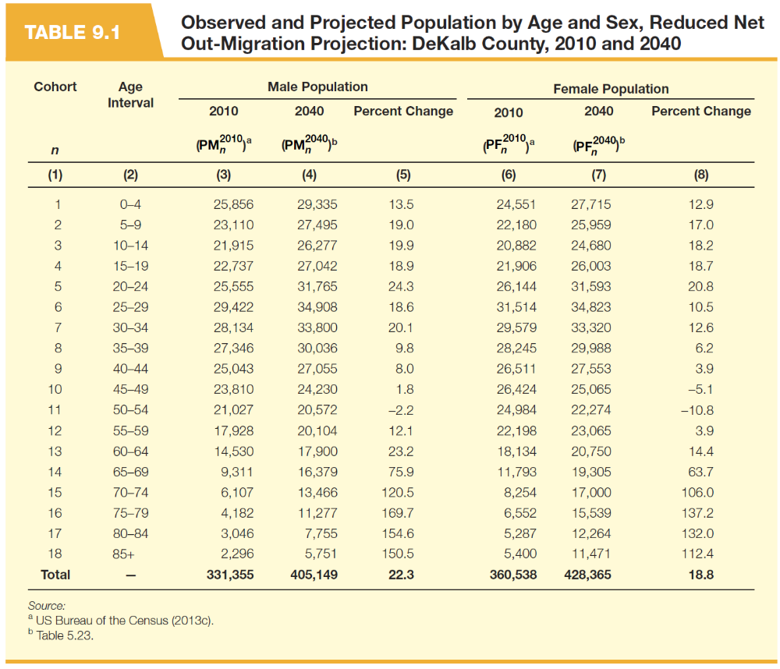

Slide 4
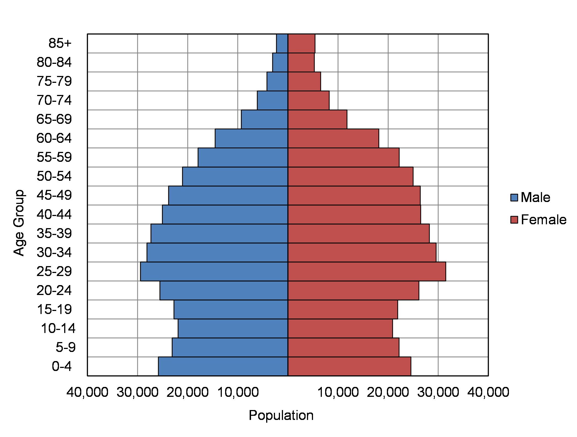
(a) 2010 Population
Figure 9.1 Observed and Projected Population by Age and Sex, Reduced Net Out Migration Projection: DeKalb County, 2010 and 2040

Slide 5
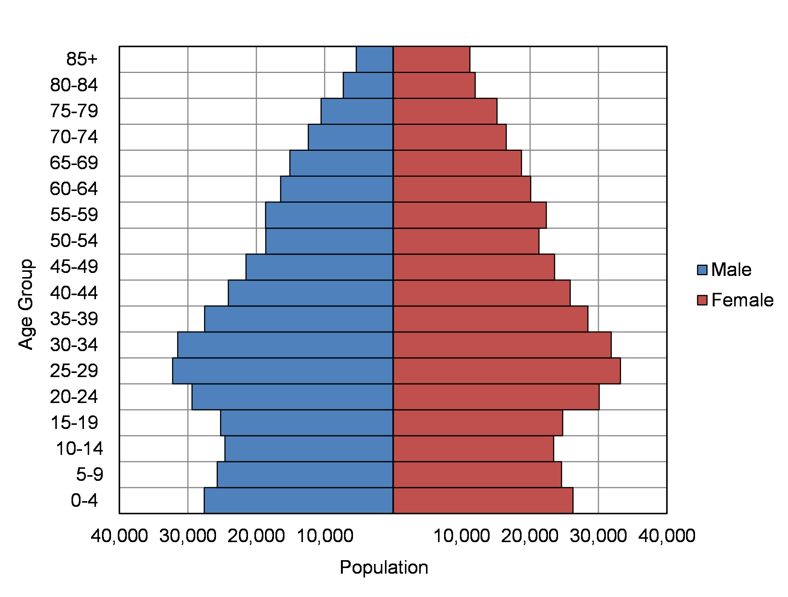
(b) 2040 Population
Figure 9.1 Observed and Projected Population by Age and Sex, Reduced Net Out Migration Projection: DeKalb County, 2010 and 2040

Slide 7


Slide 8
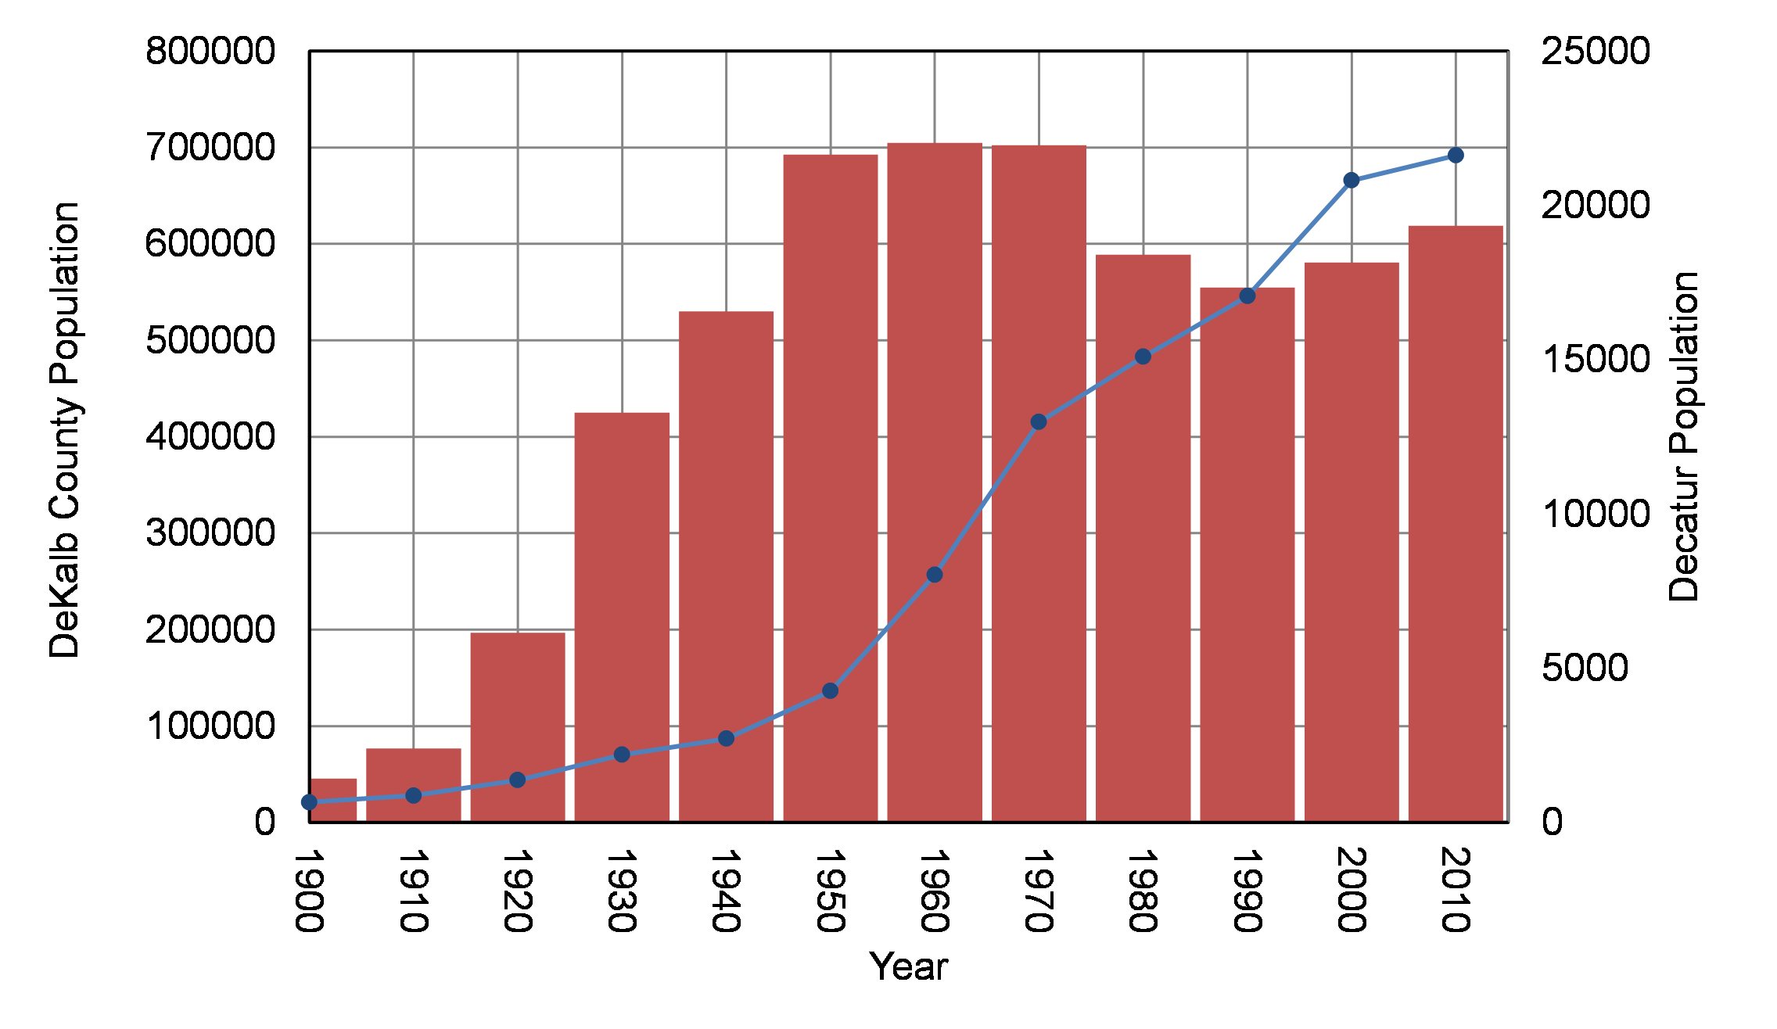
Figure 9.2 Decatur and DeKalb County Population, 1900 to 2010

Slide 9
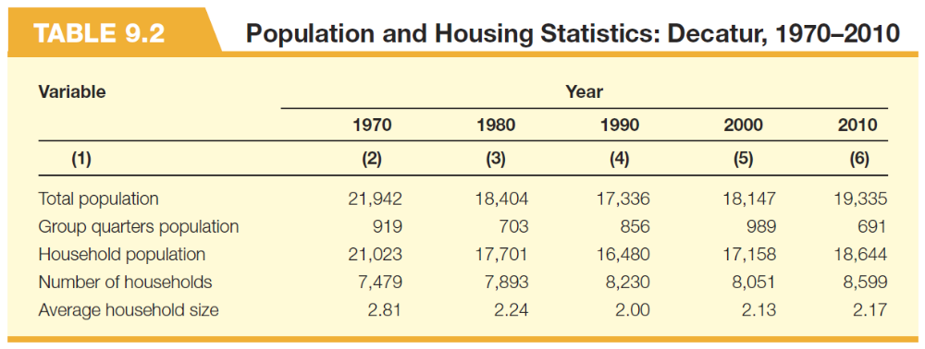

Slide 10
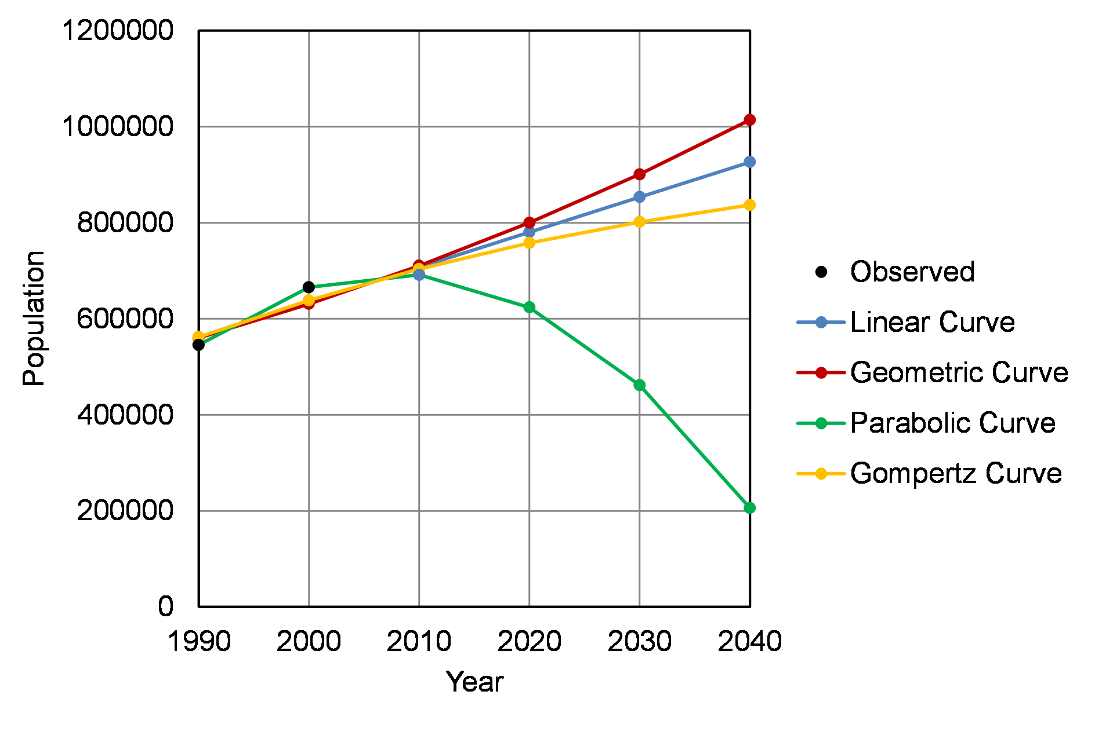
Figure 9.3 Observed and Projected Population: DeKalb County 1990 to 2040

Slide 11
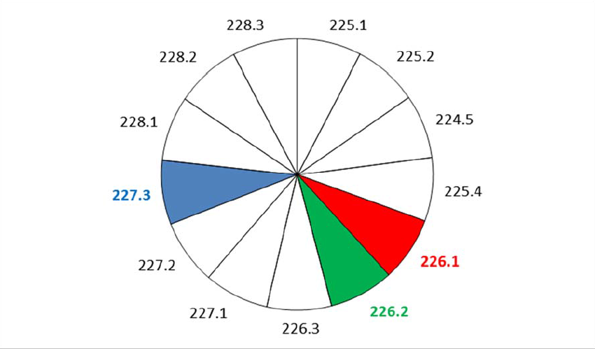
(a) 2010 Population
Figure 9.4 Observed and Adjusted Share-of-Change Population Projections: Decatur Block Groups. 2010 and 2040

Slide 12
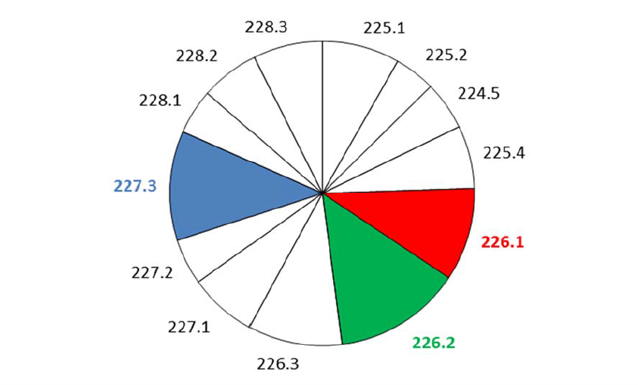
(b) 2040 Population
Figure 9.4 Observed and Adjusted Share-of-Change Population Projections: Decatur Block Groups. 2010 and 2040

Slide 13
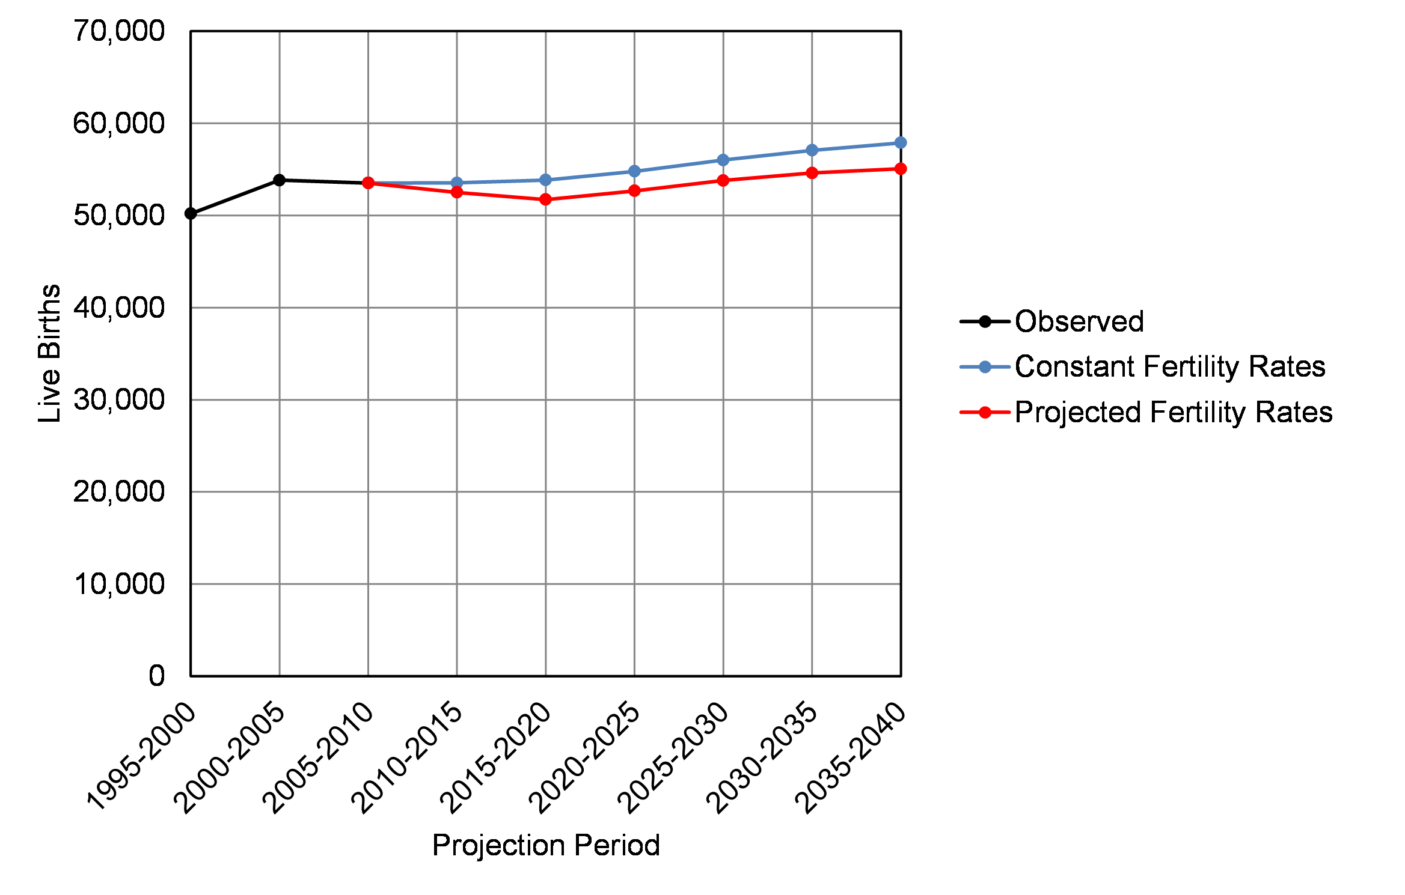
Figure 9.5 Projected Live Births: DeKalb County, 2005 to 2040

Slide 15
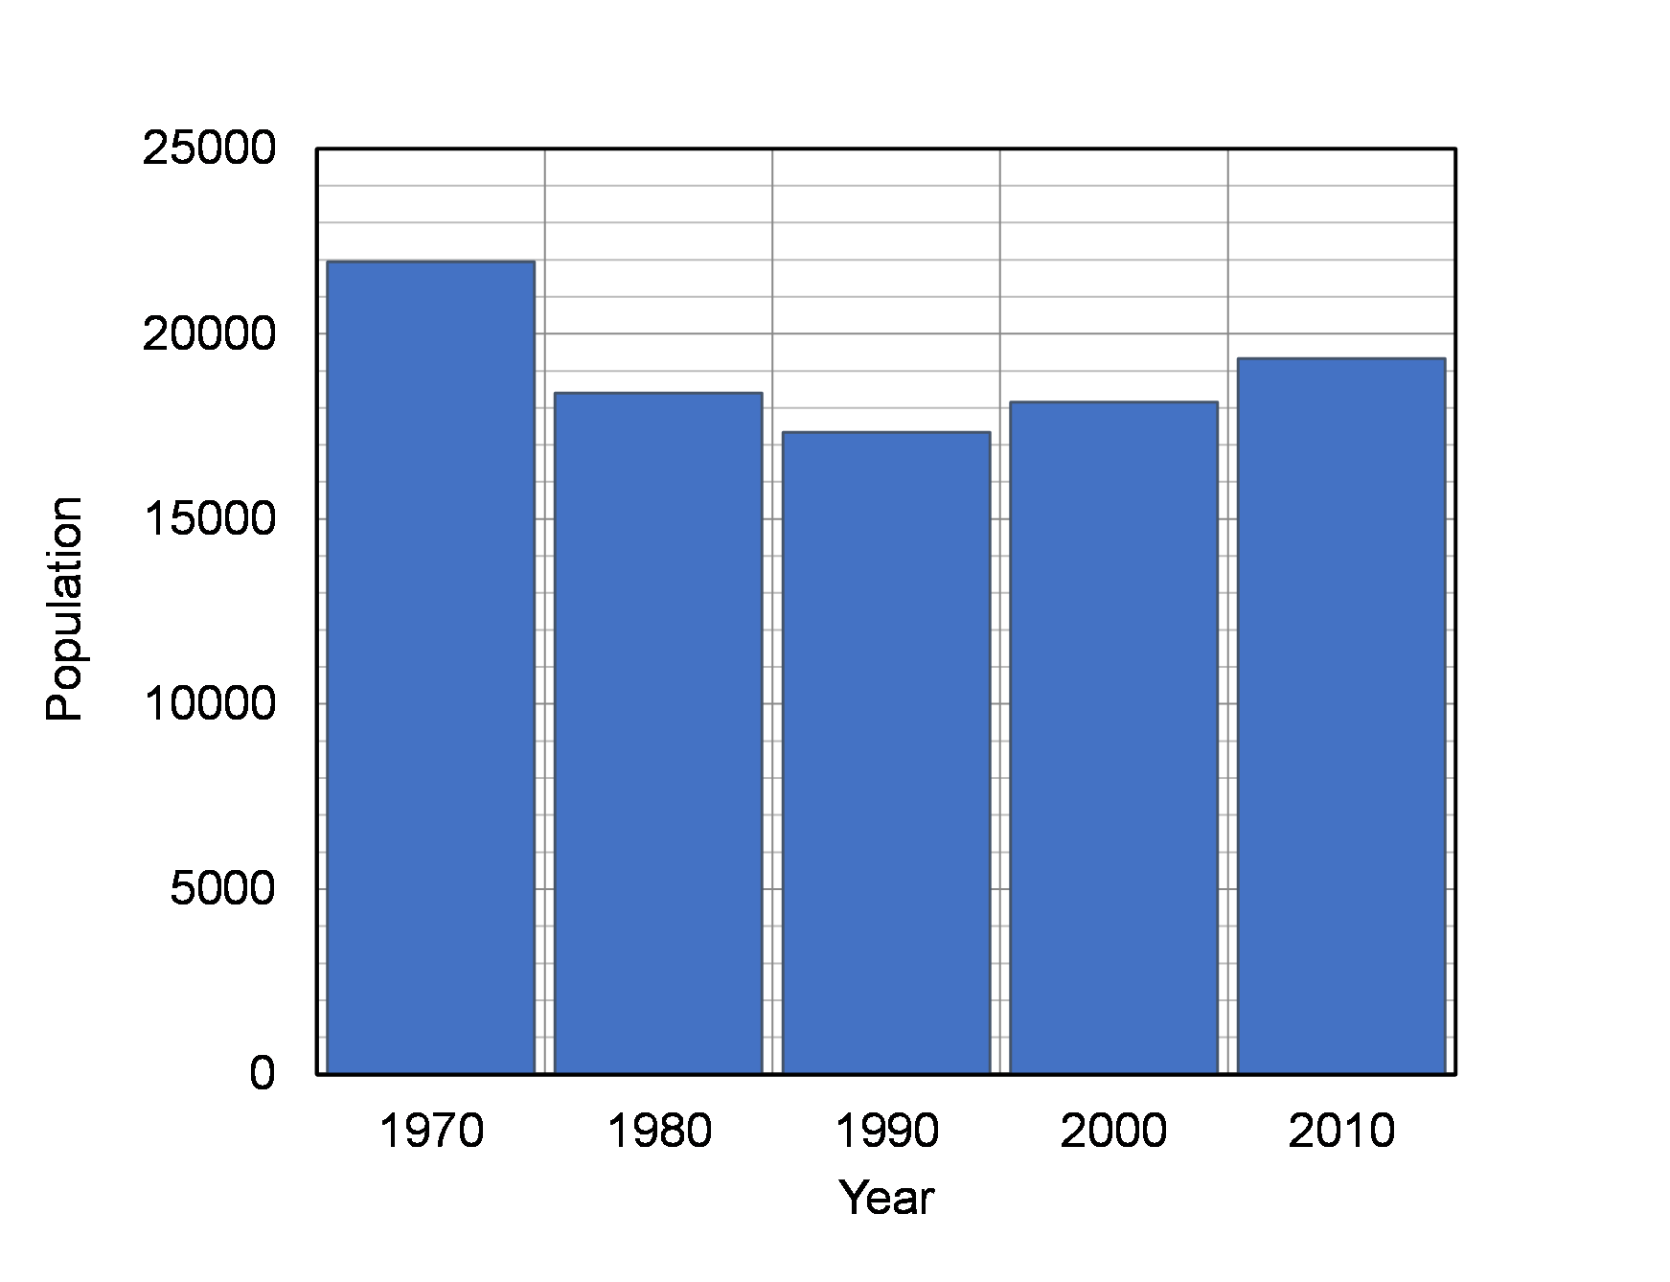
(a) Bar Graph
Figure 9.6 Bar and 3-D Cylinder Graphs: Decatur Population, 1980 to 2010

Slide 16
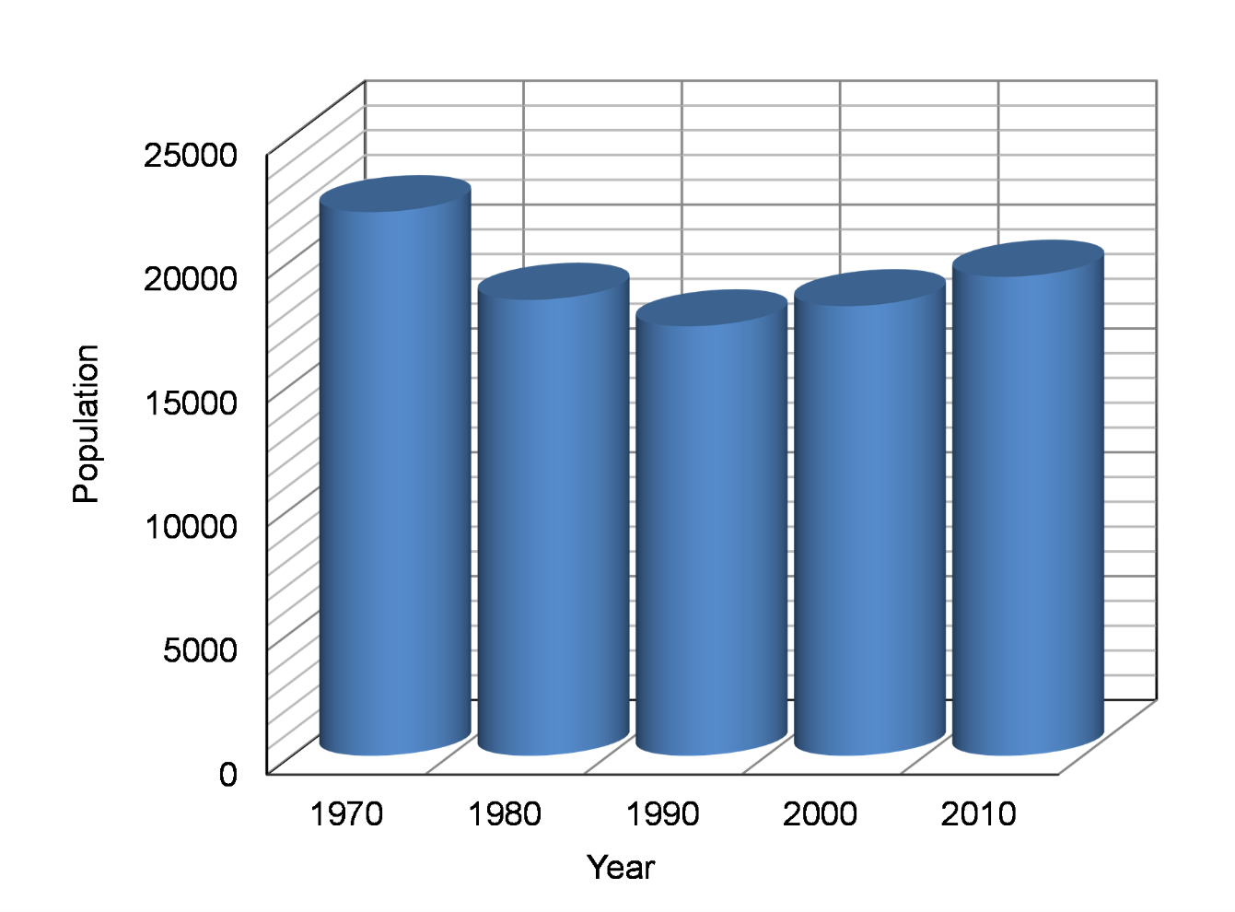
(b) 3-D Cylinder Graph
Figure 9.6 Bar and 3-D Cylinder Graphs: Decatur Population, 1980 to 2010

Slide 17
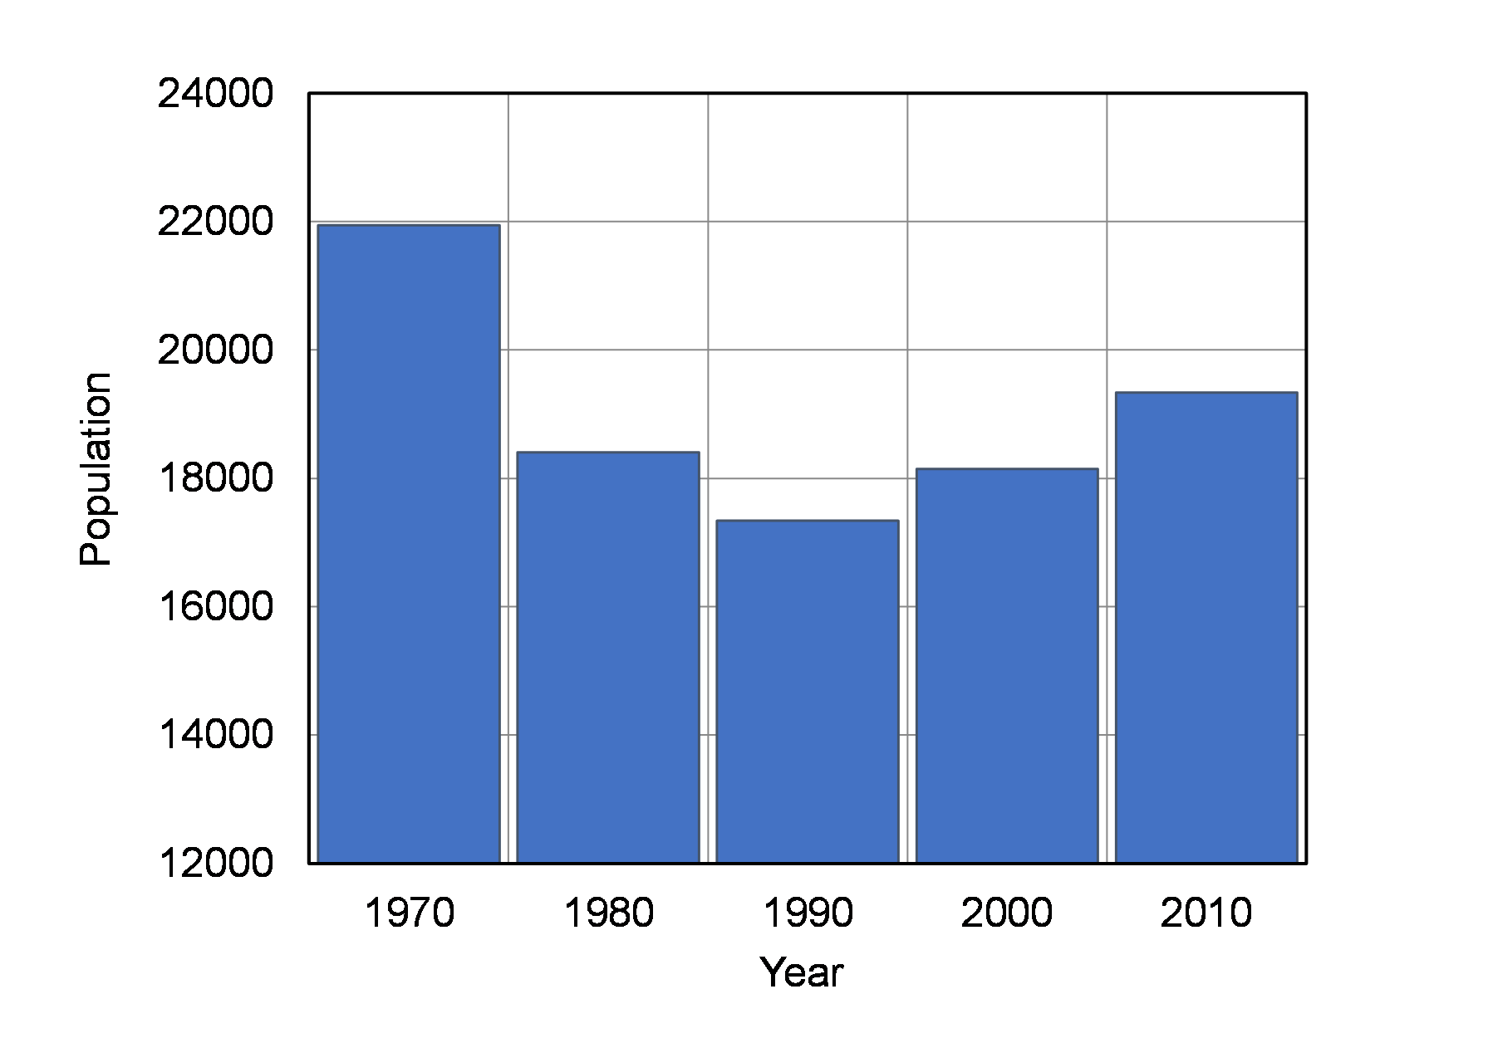
Figure 9.7 Truncated Bar Graph: Decatur Population, 1970 to 2010

Slide 18


Slide 19


Slide 20
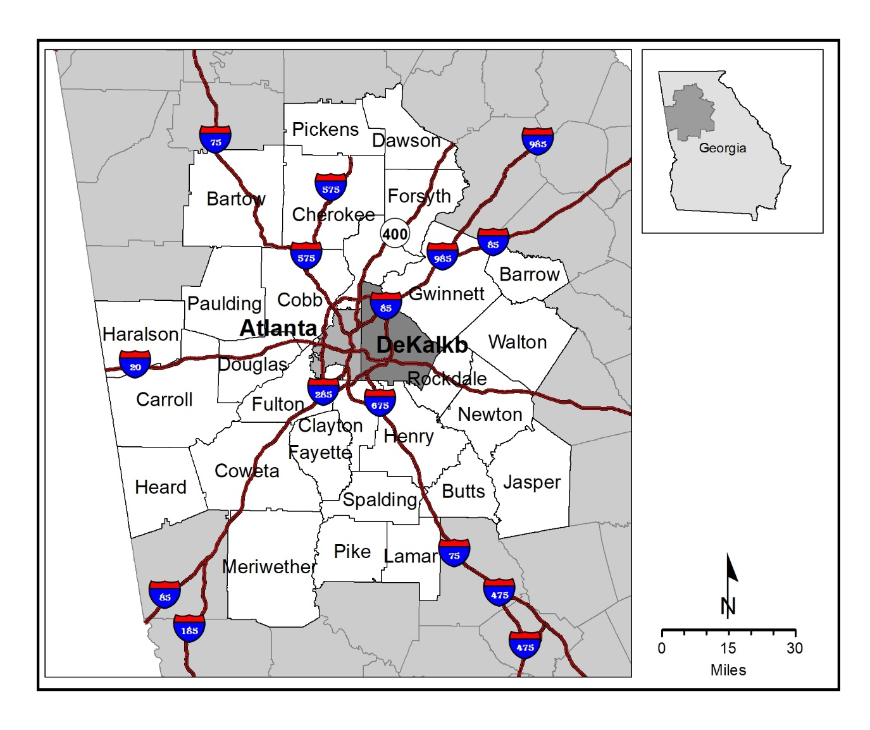
Map 9.1 DeKalb County and the Atlanta Region

Slide 22
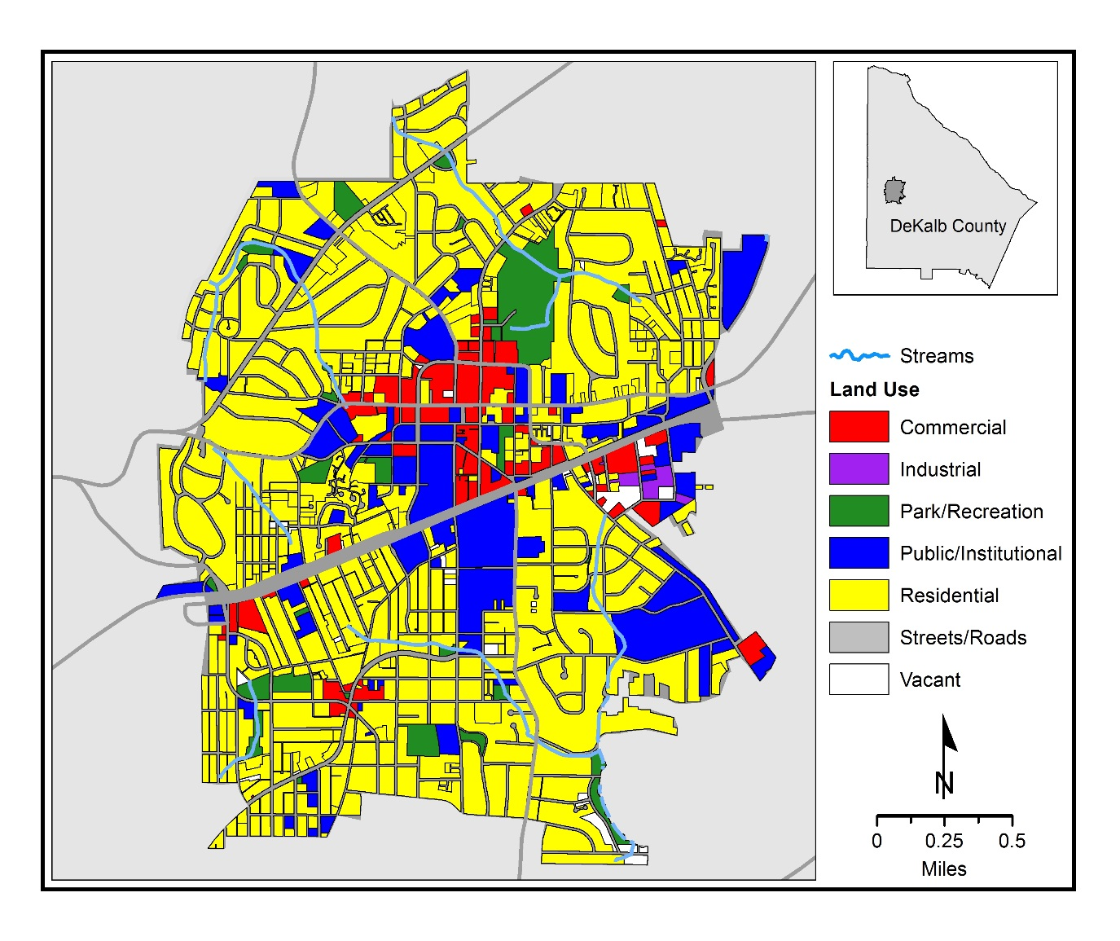
Map 9.2 Decatur Streams and Land Uses

Slide 23
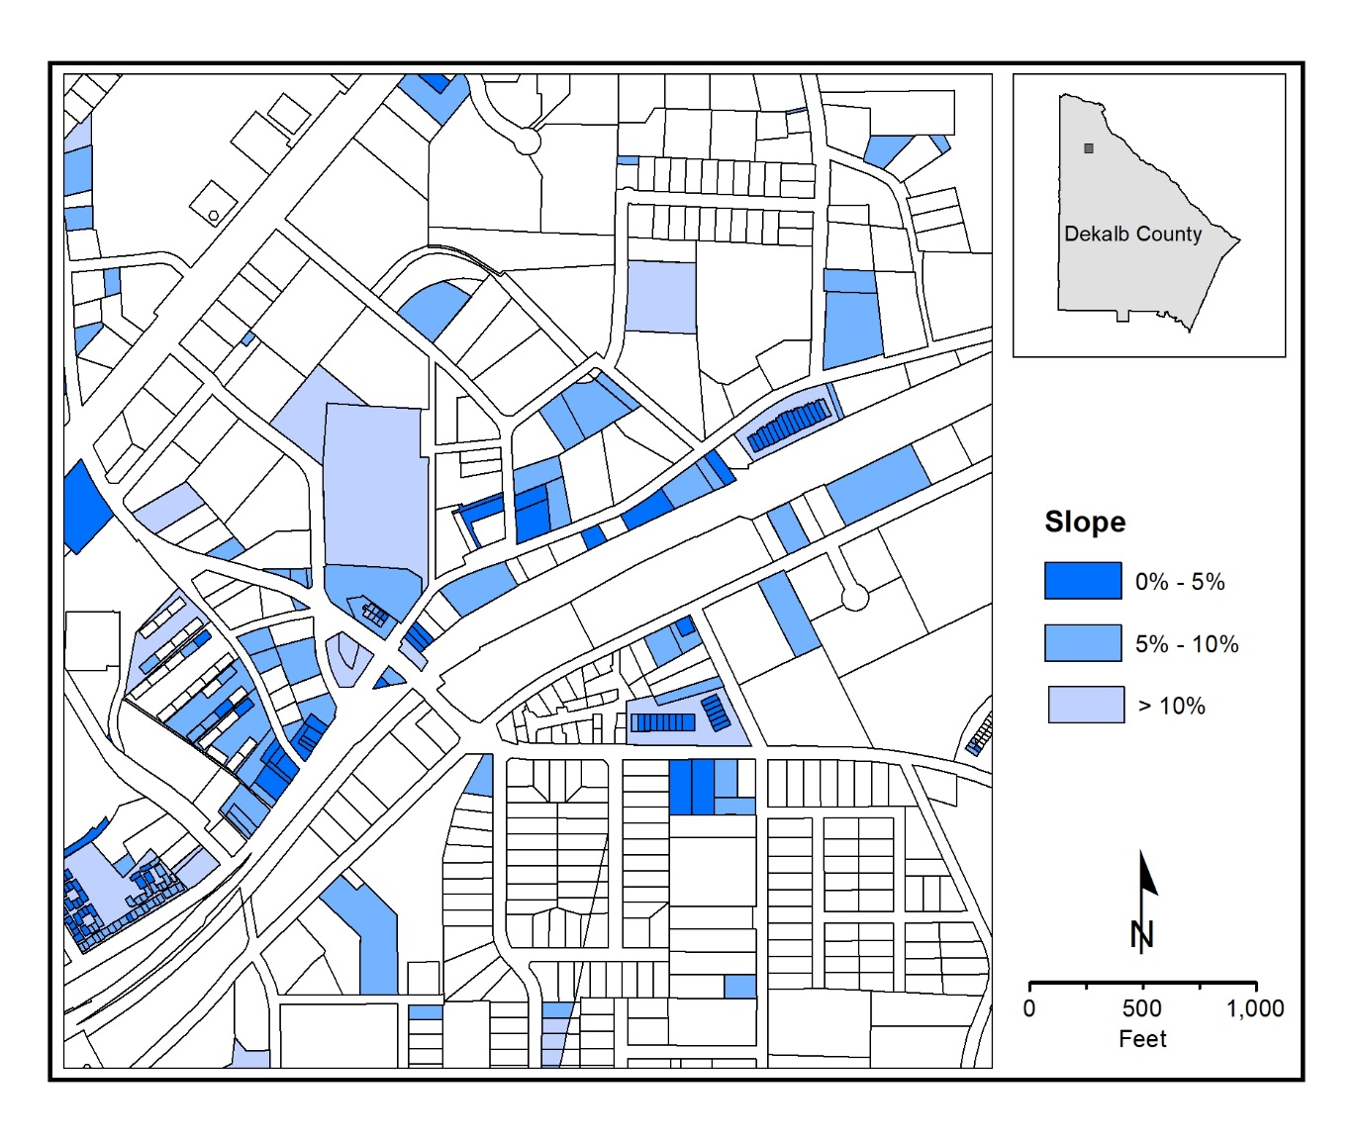
(a) Parcel Slope and Slope Layer
Map 9.3 DeKalb County Suitability Factors
(b) Parcel Distance to Water Feature and Distance to

Slide 24
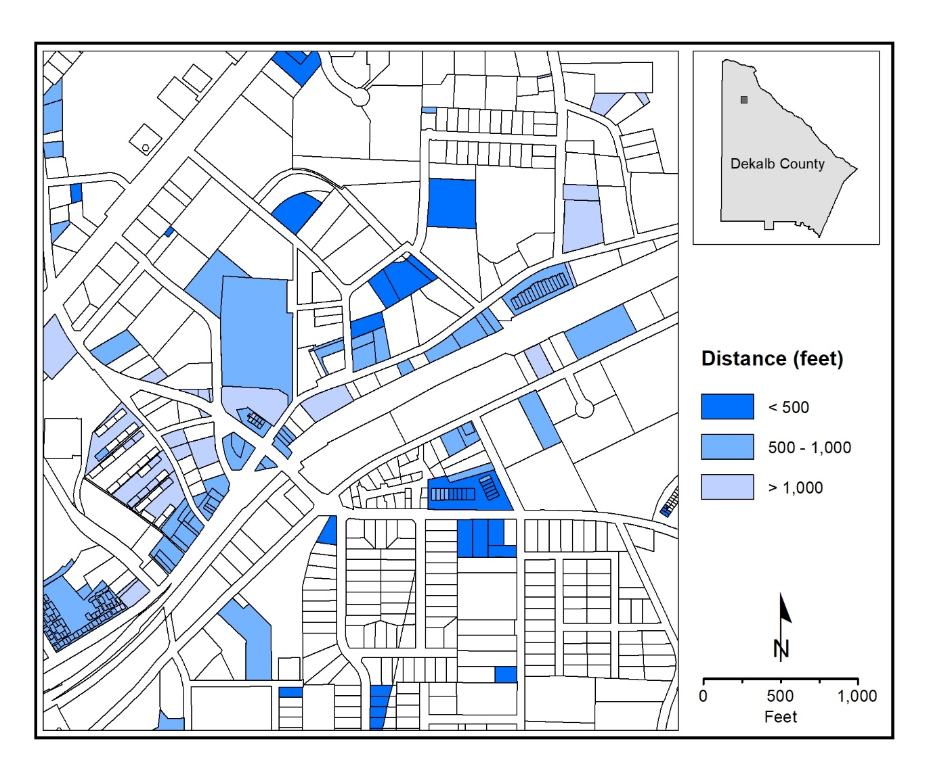
(b) Parcel Distance to Water Feature and Distance to
Map 9.3 DeKalb County Suitability Factors

Slide 26
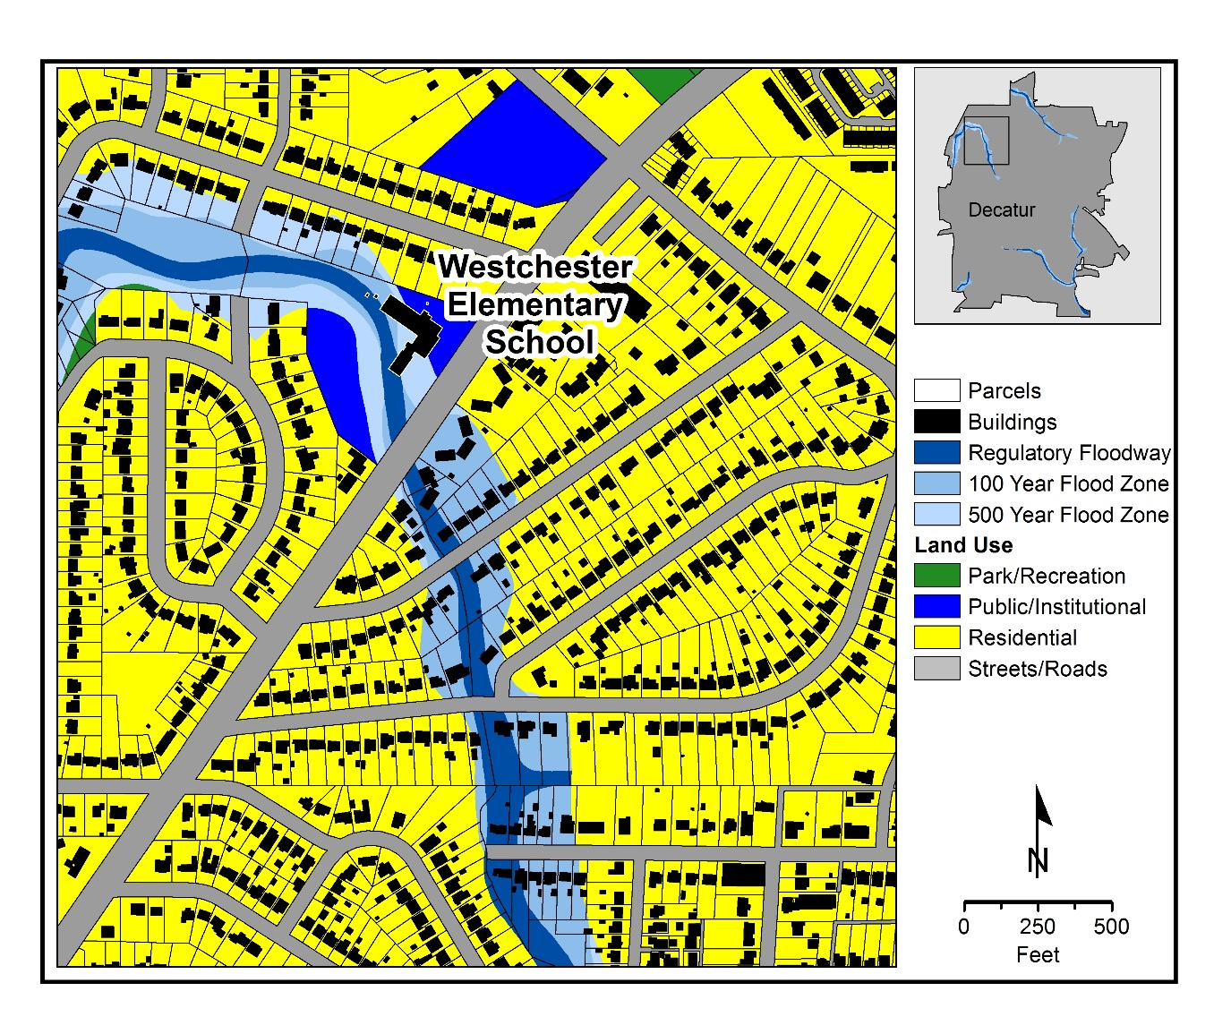
Map 9.4 Figure Decatur Flood Zones

Slide 27
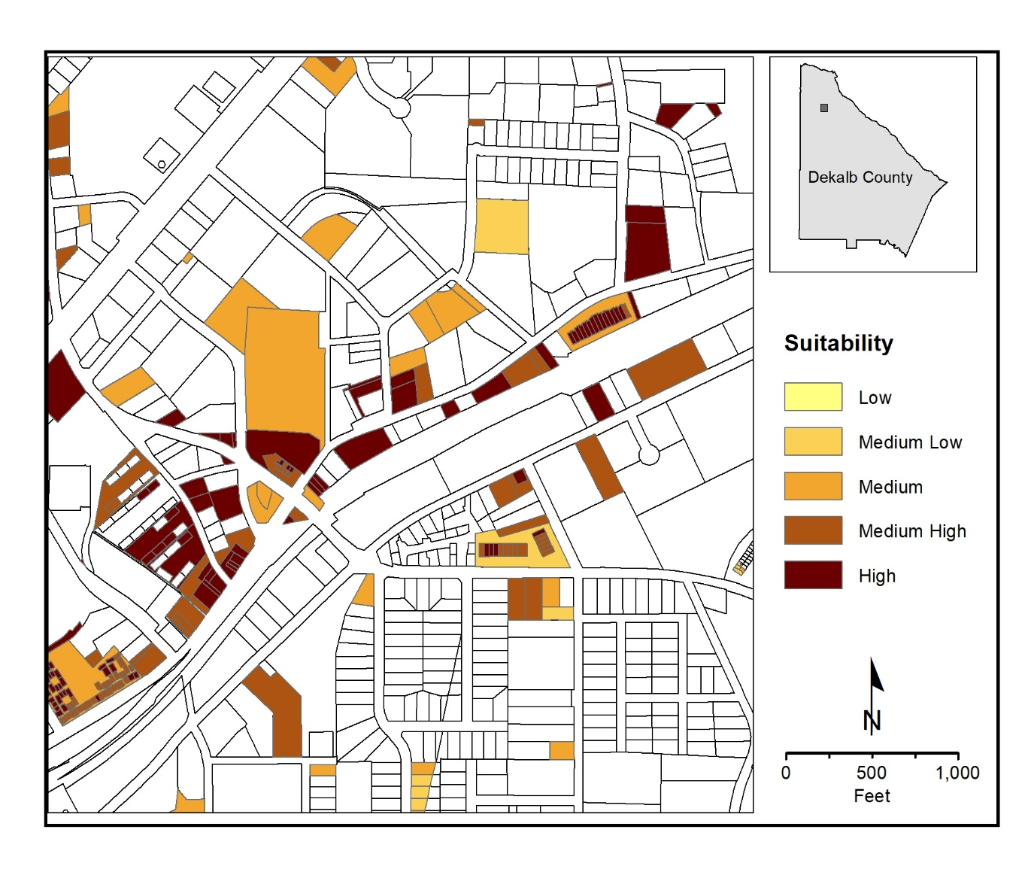
(a) Commercial Suitability
Map 9.5 DeKalb County Ordinal Combination Commercial and Residential Suitability

Slide 28
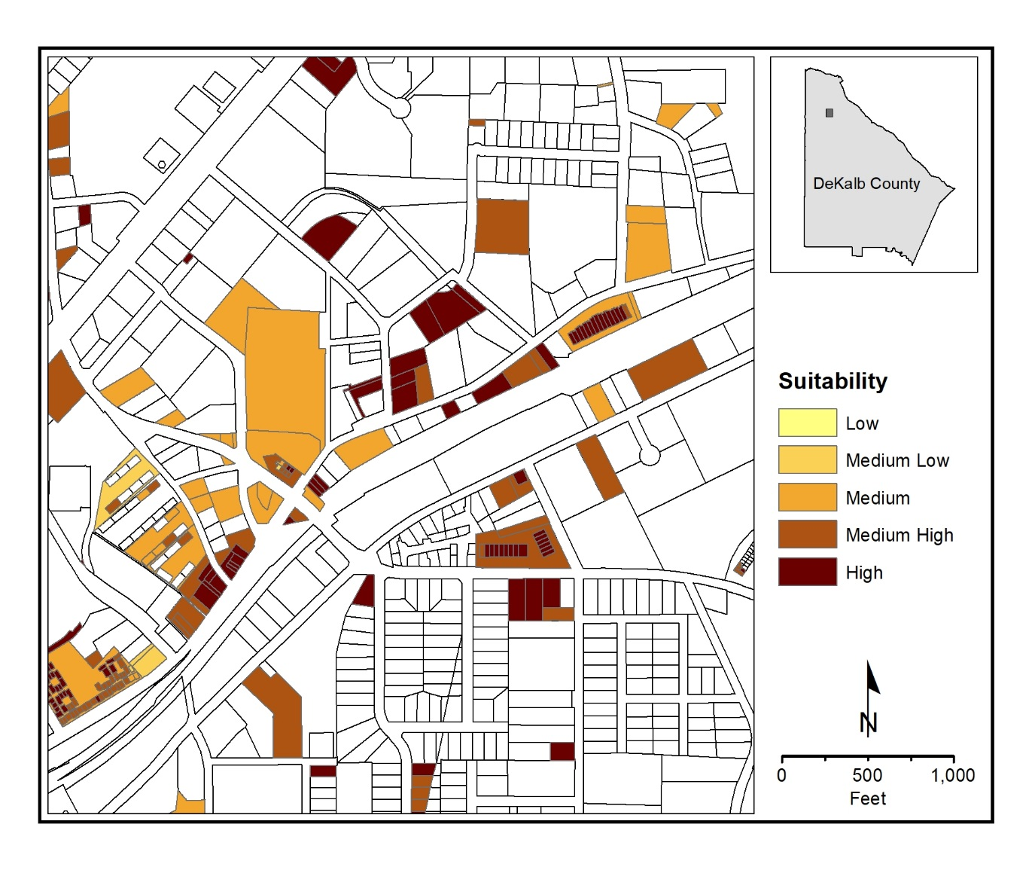
(b) Residential Suitability
Map 9.5 DeKalb County Ordinal Combination Commercial and Residential Suitability

Slide 29
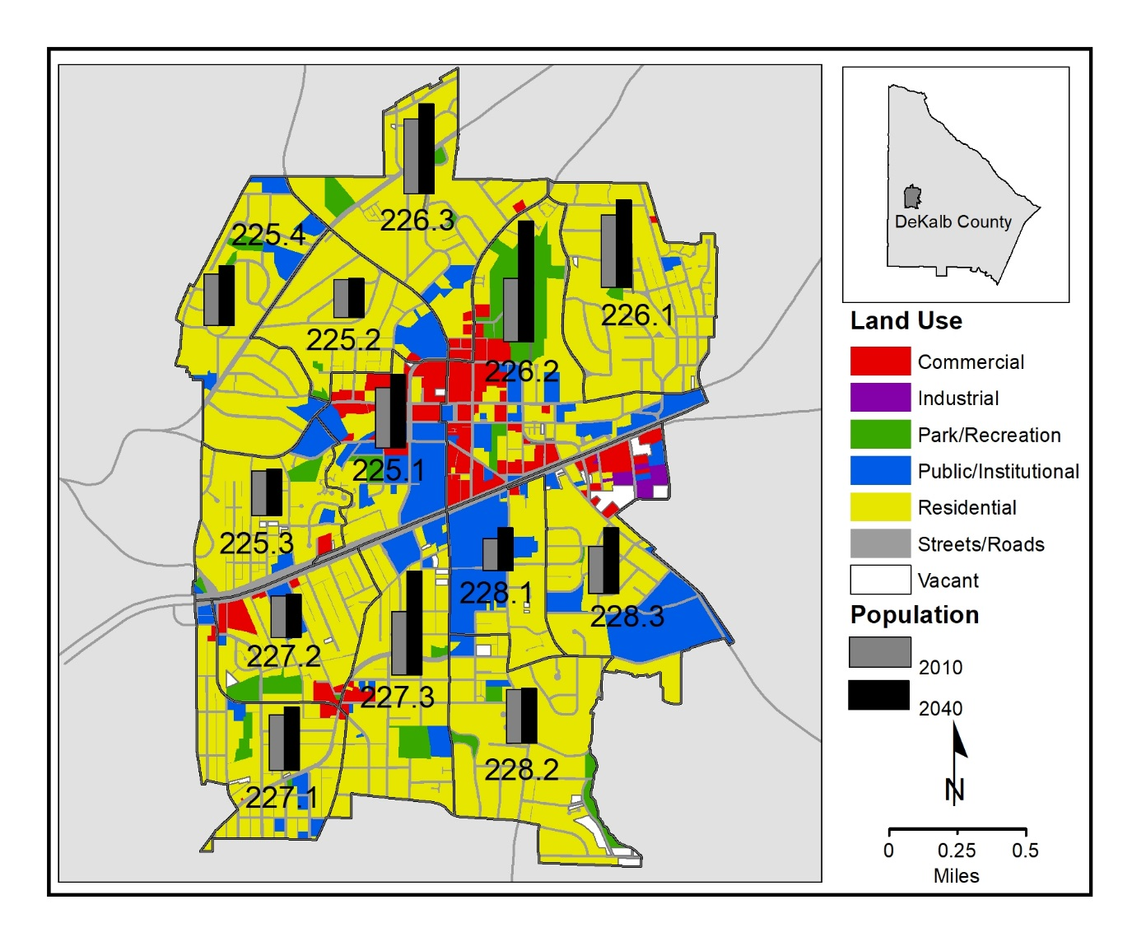
Map 9.6 Adjusted Share-of-Change Population Projections and Land Uses: Decatur Block Groups, 2040

Slide 31


Slide 33
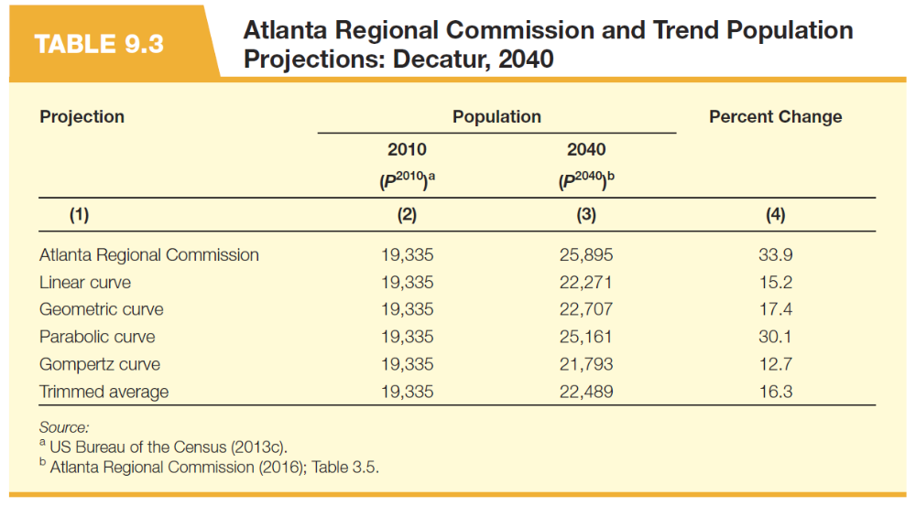

Slide 34
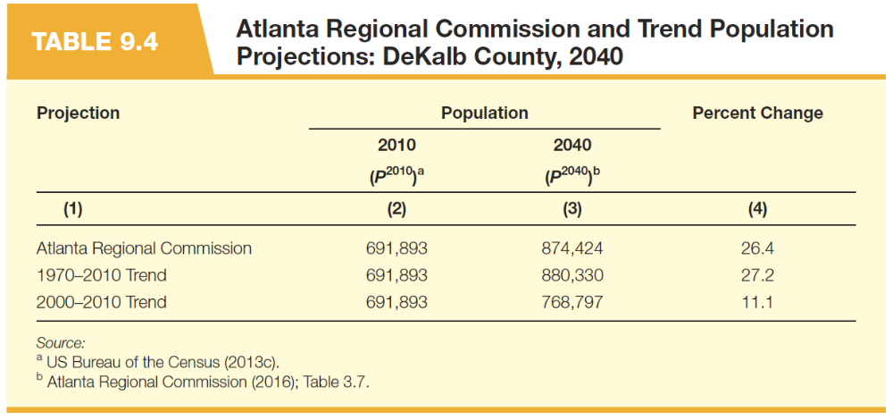

Slide 36


Slide 40
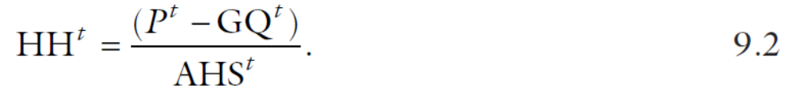

Slide 41
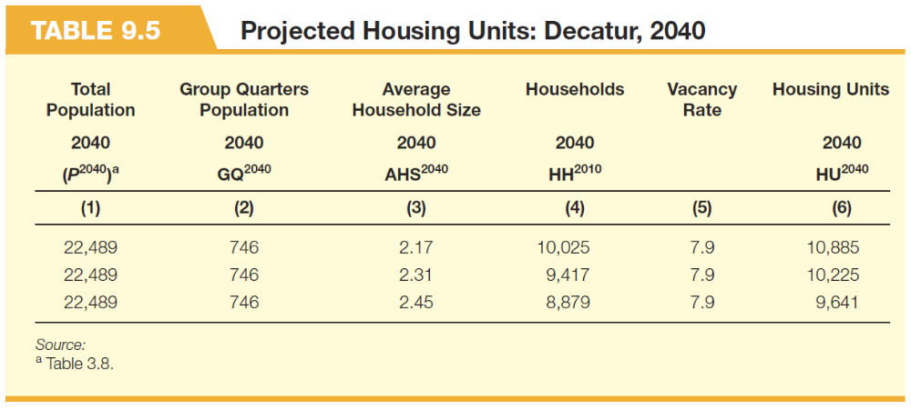

Slide 42
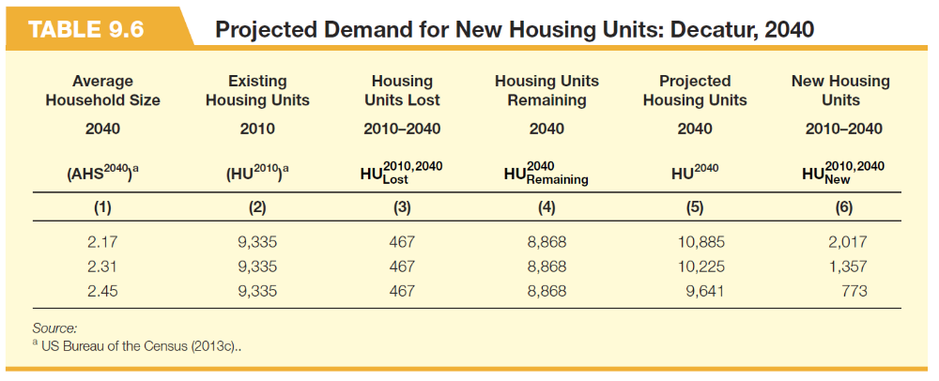

Slide 44
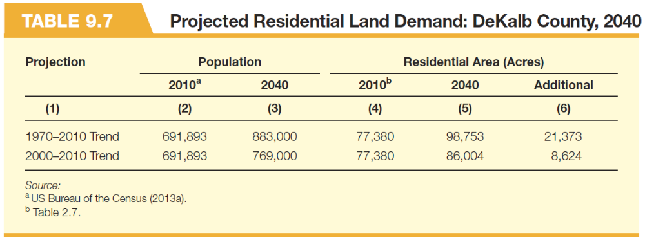

Slide 45
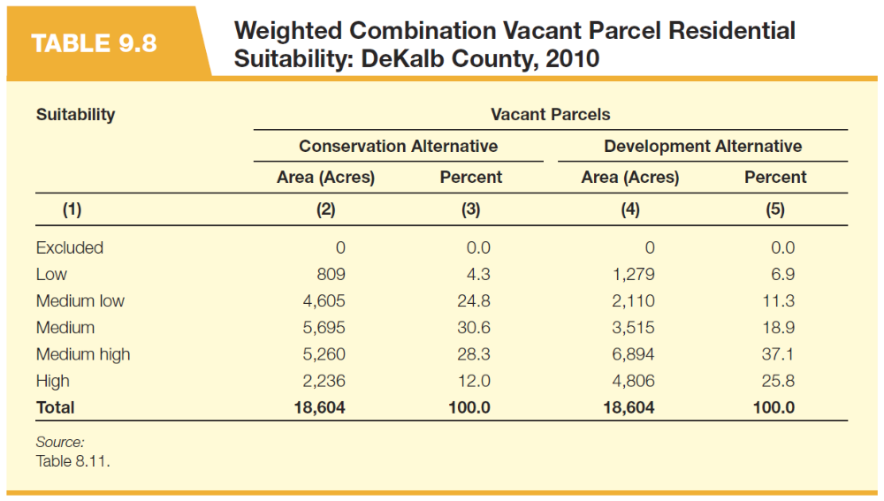

Slide 46
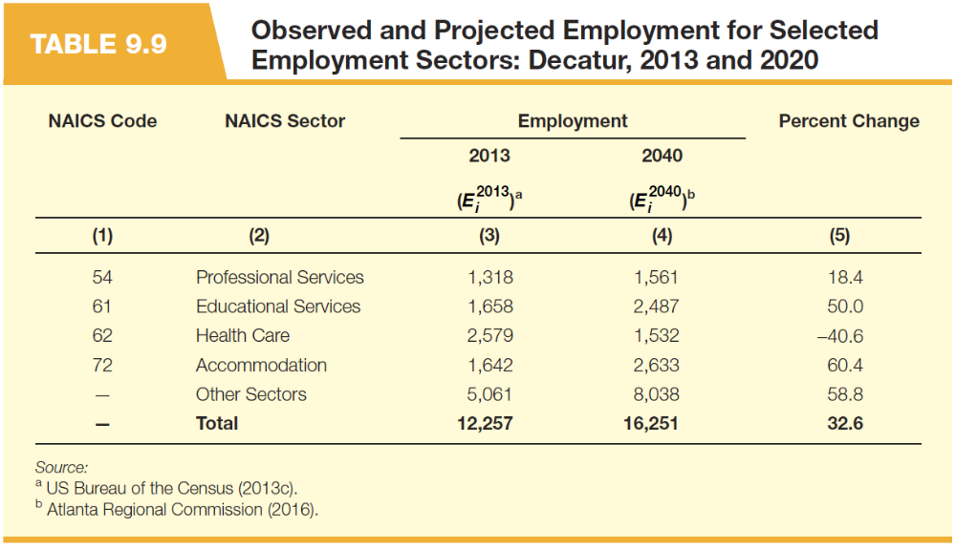

Slide 48


Slide 50


