Slide 1


Slide 2


Slide 3
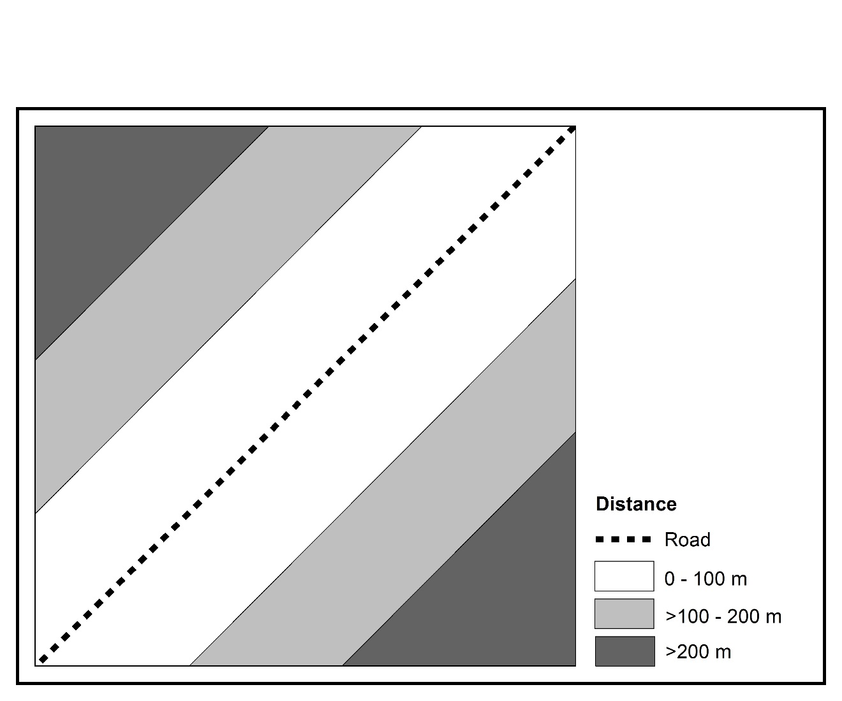
(a) Distance to Road
Figure 8.1 Residential Suitability Analysis: Map Overlay Method

Slide 4
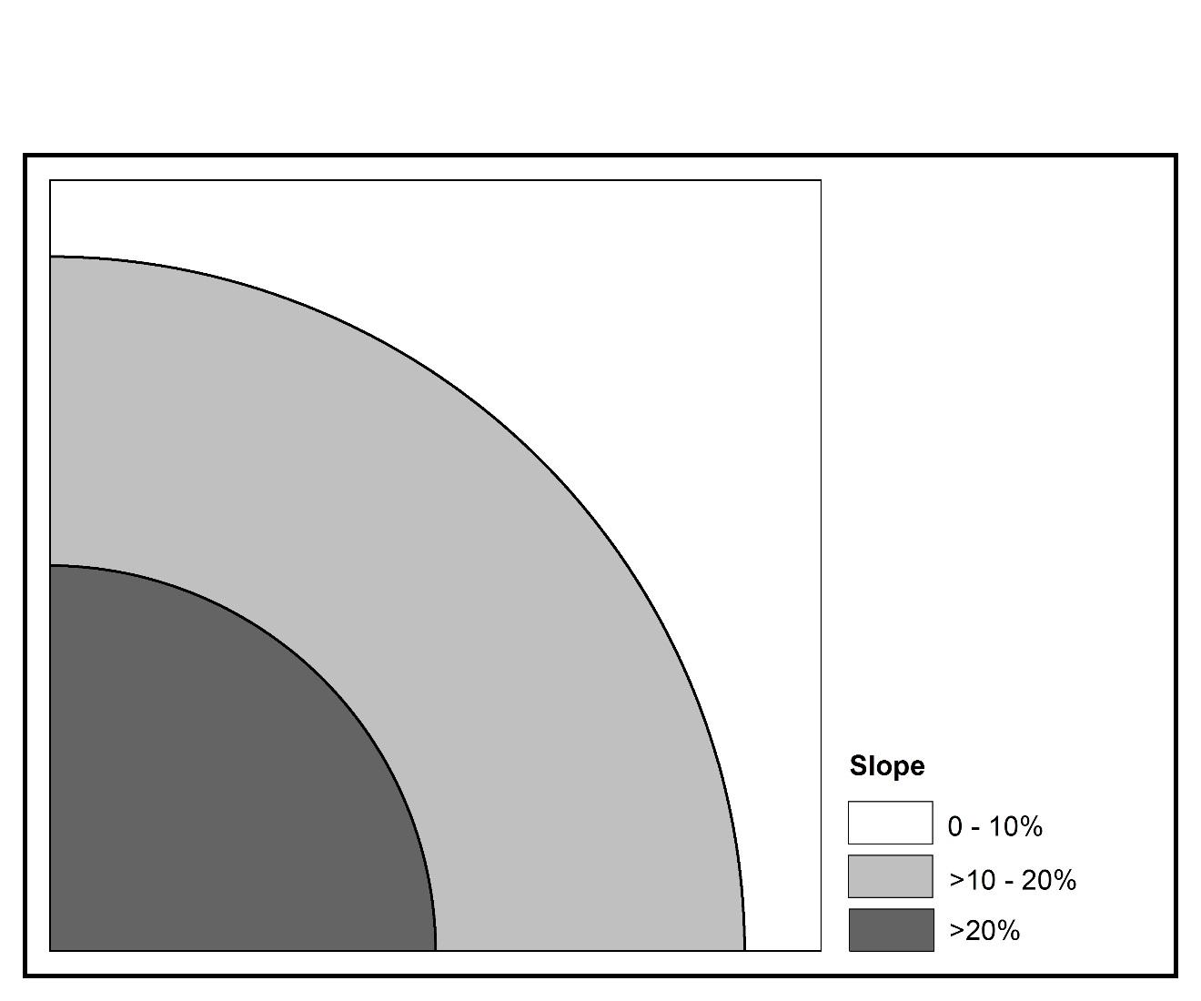
(b) Slope
Figure 8.1 Residential Suitability Analysis: Map Overlay Method

Slide 5
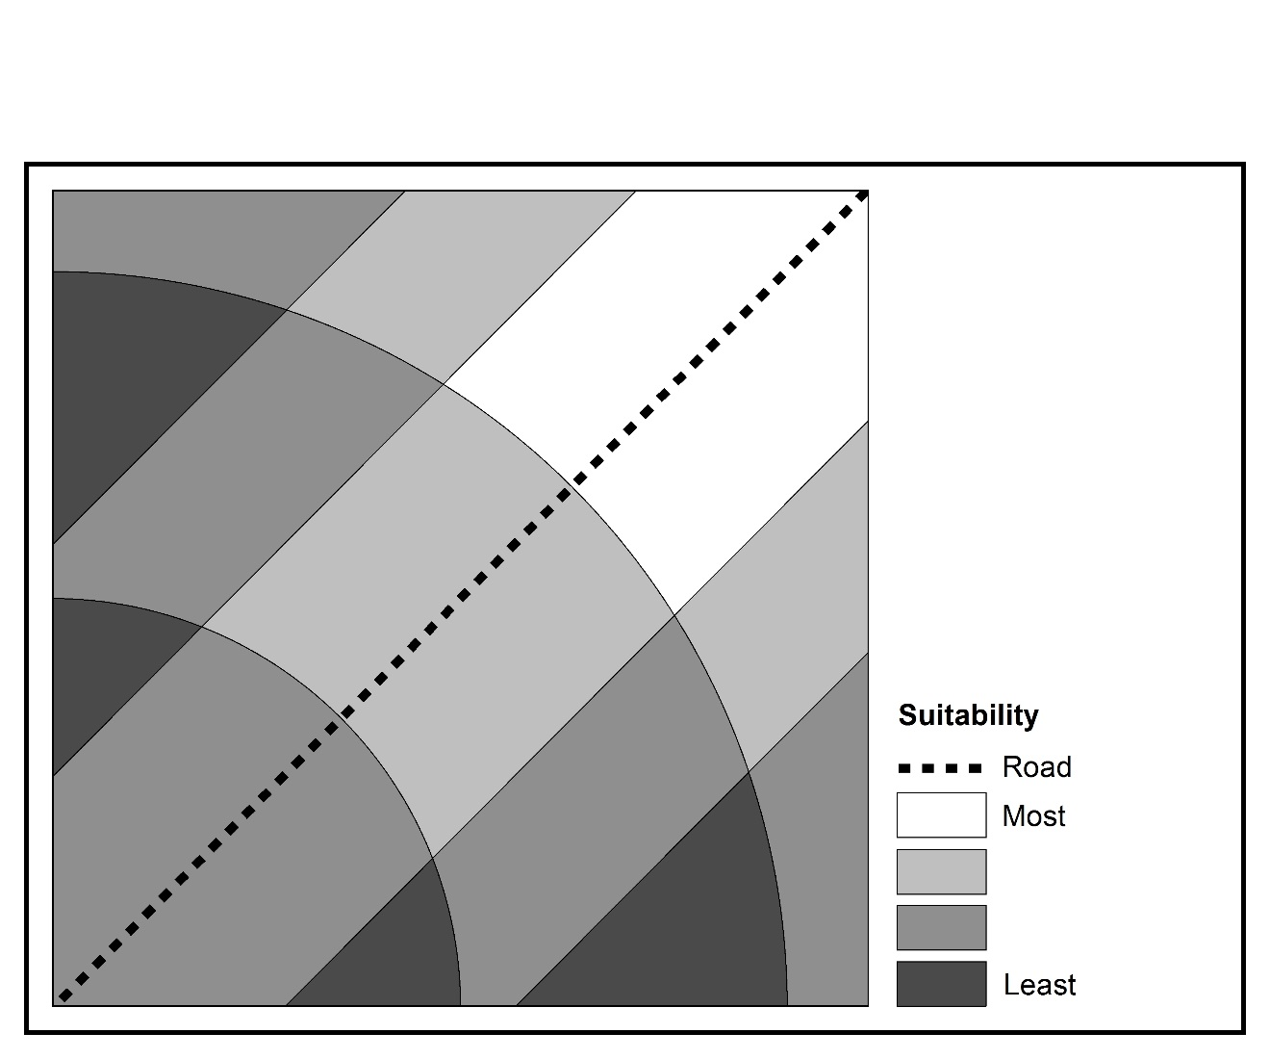
(c) Map Overlay
Figure 8.1 Residential Suitability Analysis: Map Overlay Method

Slide 8
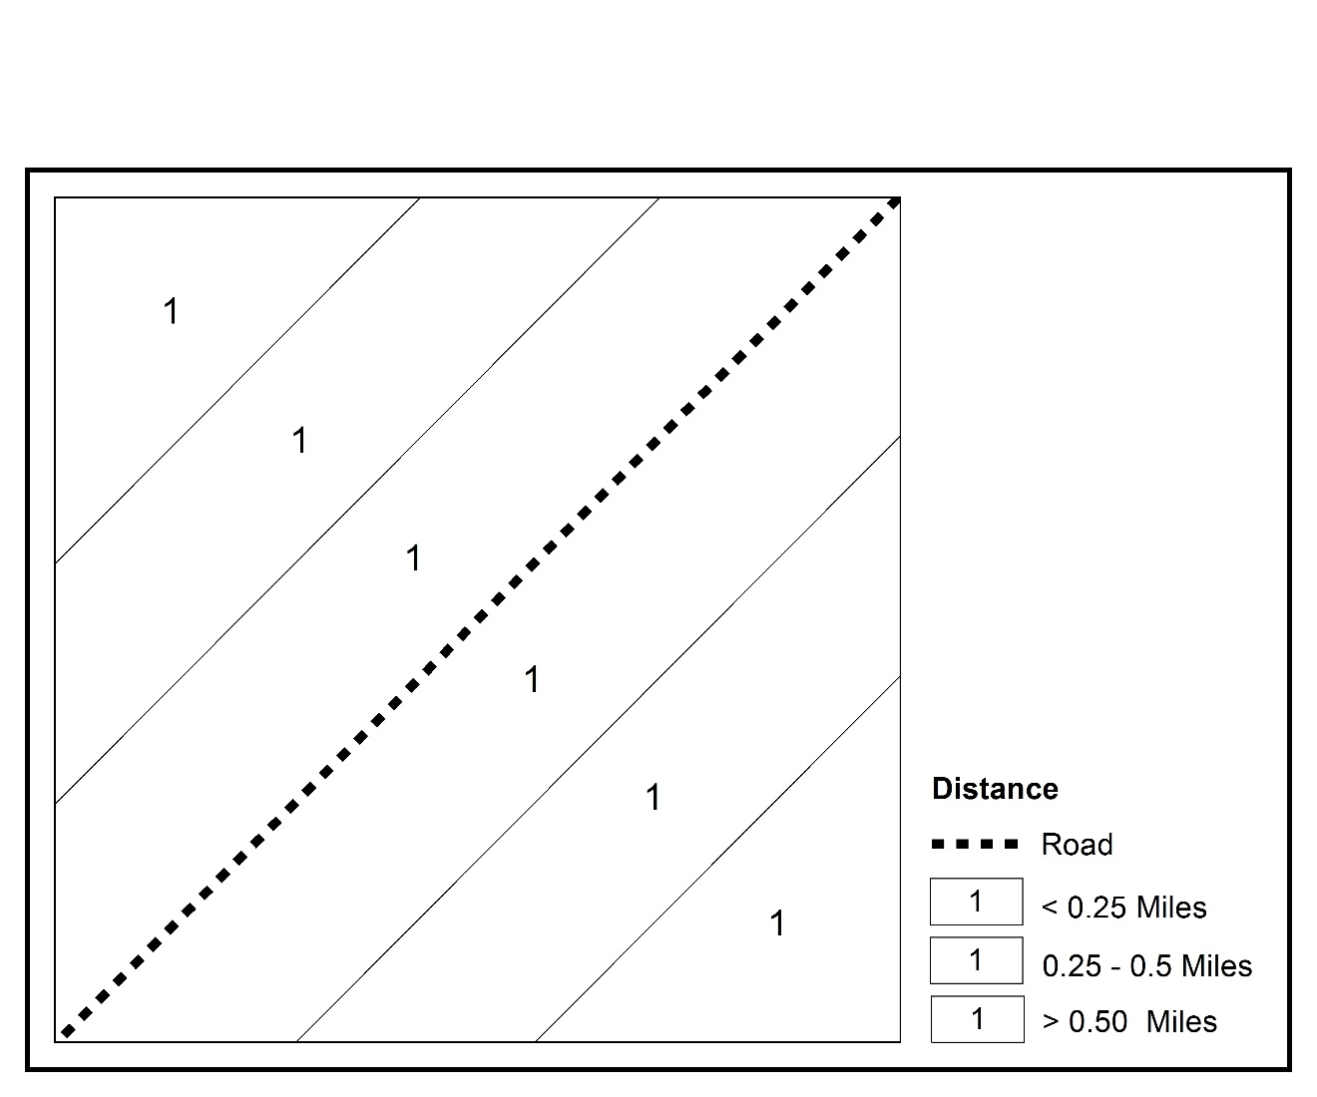
(a) Distance to Road
Figure 8.2 Residential Suitability Analysis: Binary Selection Method

Slide 9
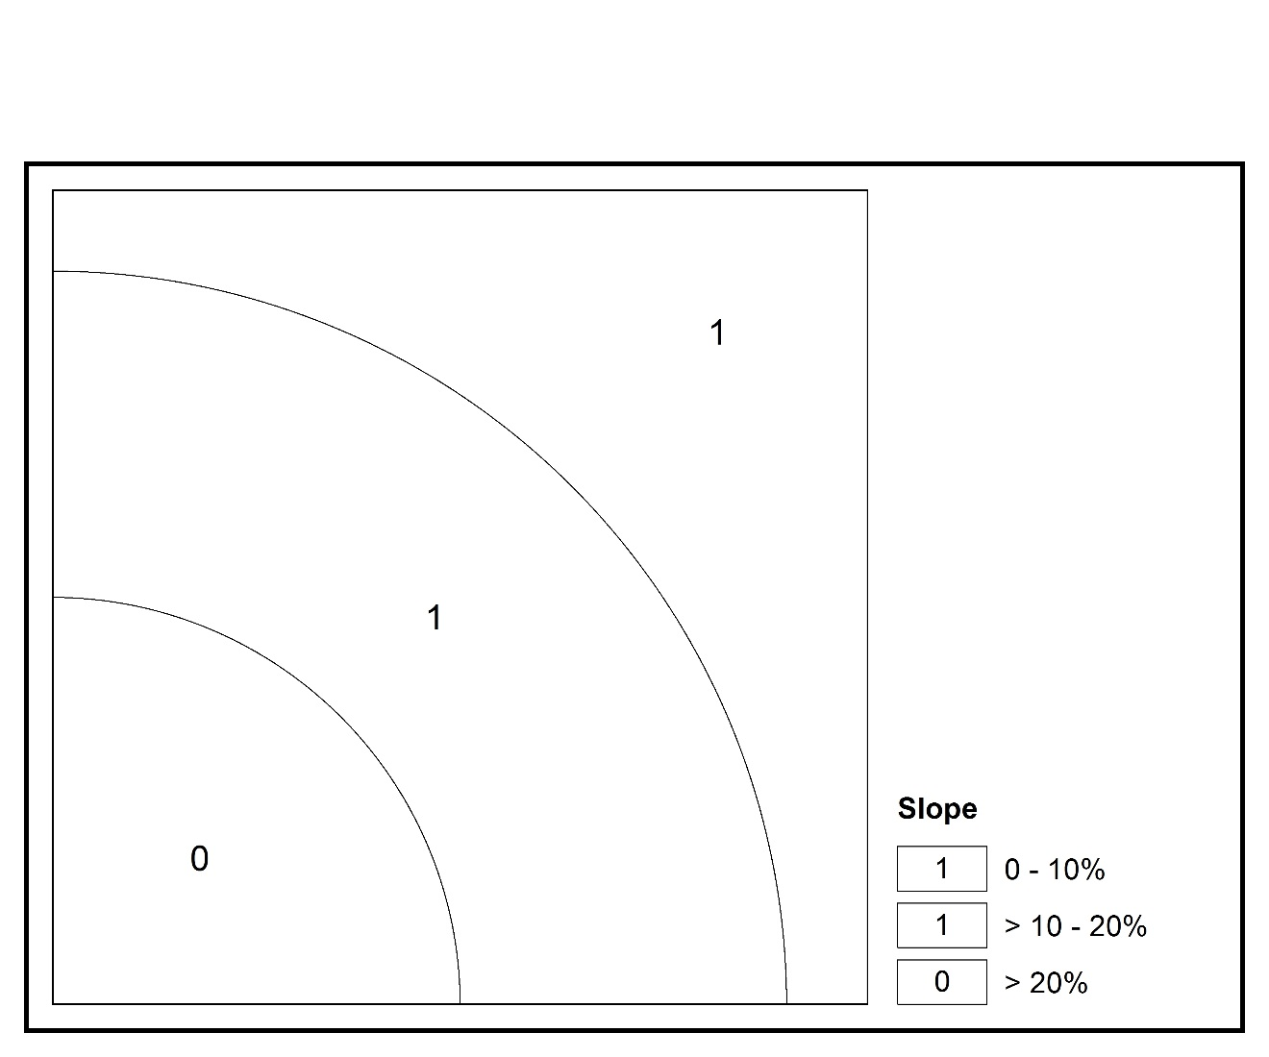
(b) Slope
Figure 8.2 Residential Suitability Analysis: Binary Selection Method

Slide 10
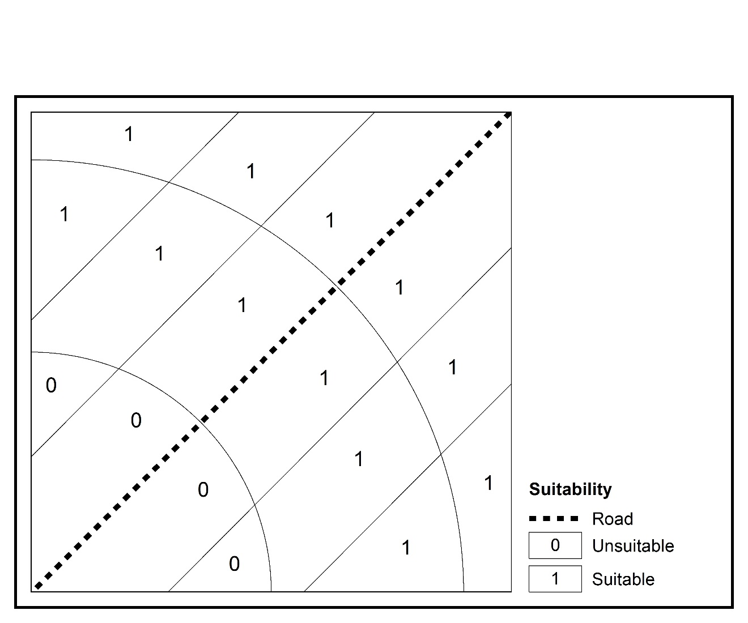
(c) Binary Suitability
Figure 8.2 Residential Suitability Analysis: Binary Selection Method

Slide 11
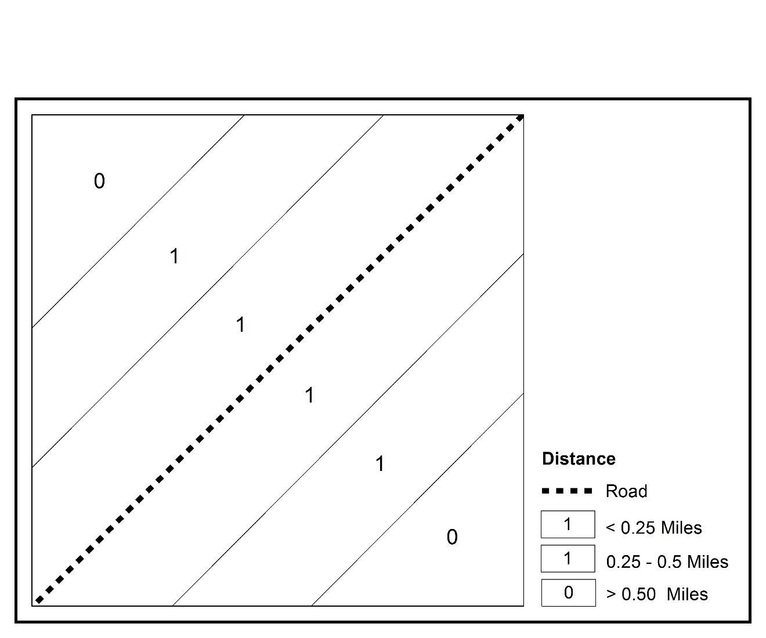
(a) Distance to Road
Figure 8.3 Commercial Suitability Analysis: Binary Selection Method

Slide 12
(b) Slope
Figure 8.3 Commercial Suitability Analysis: Binary Selection Method

Slide 13
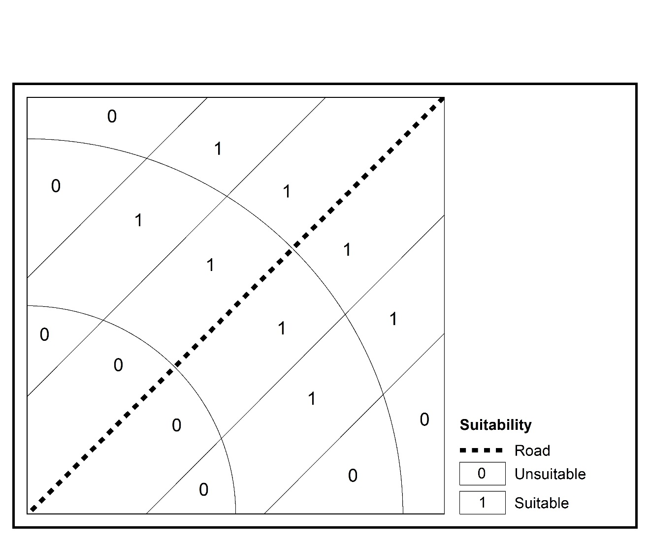
(c) Binary Suitability
Figure 8.3 Commercial Suitability Analysis: Binary Selection Method

Slide 15
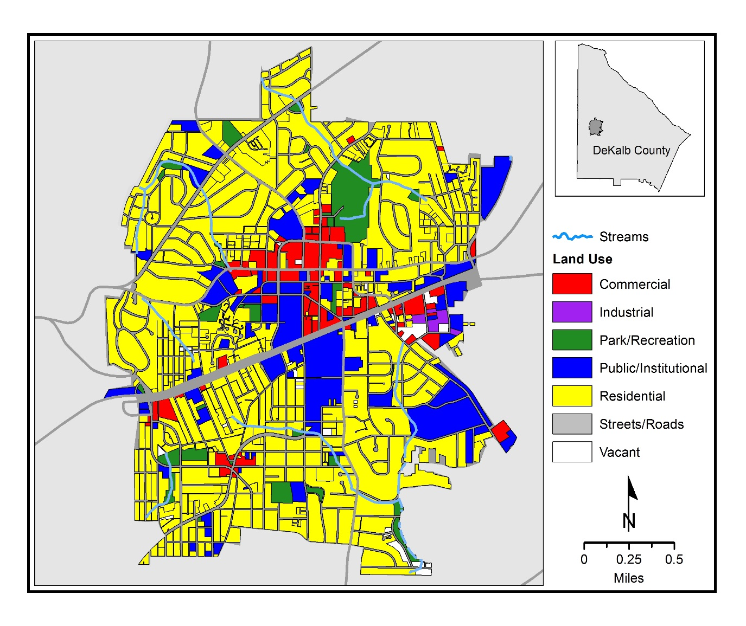
Map 8.1 Decatur Streams and Land Uses, 2014

Slide 16
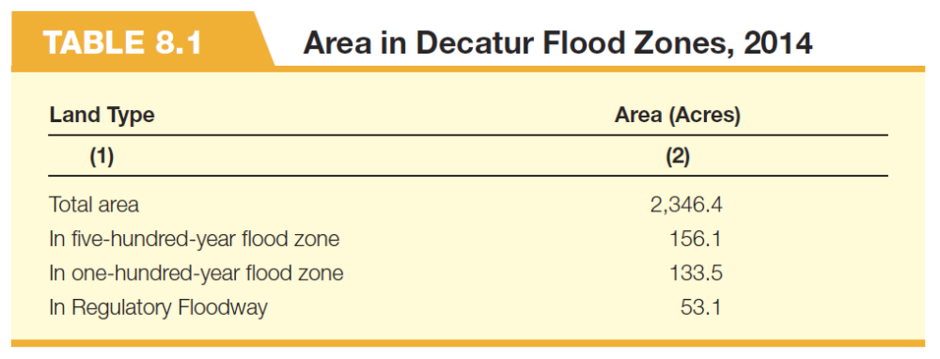

Slide 17
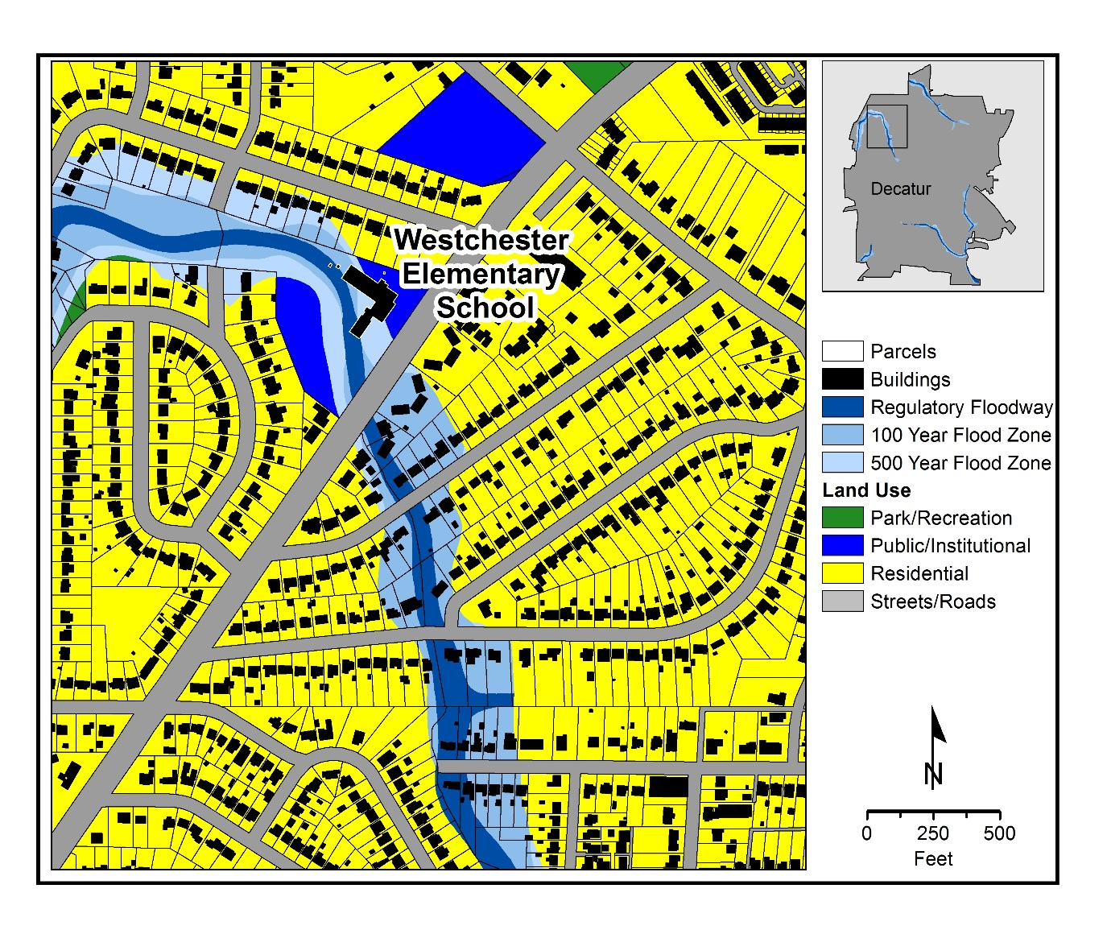
Map 8.2 Decatur Flood Zones , 2014

Slide 18
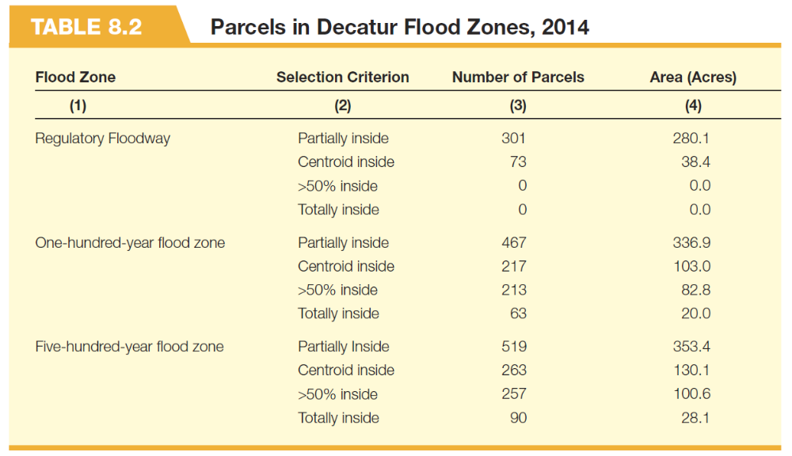

Slide 19
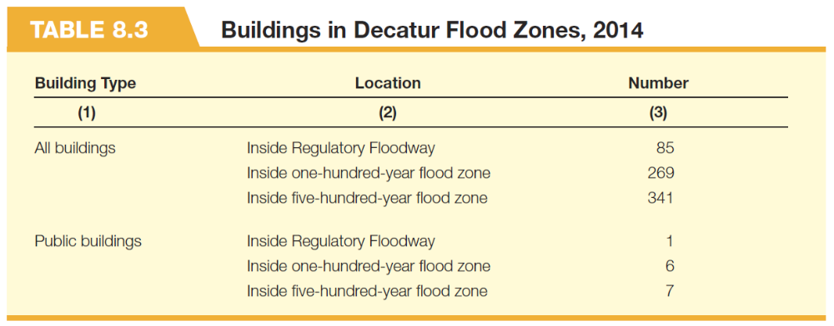

Slide 21
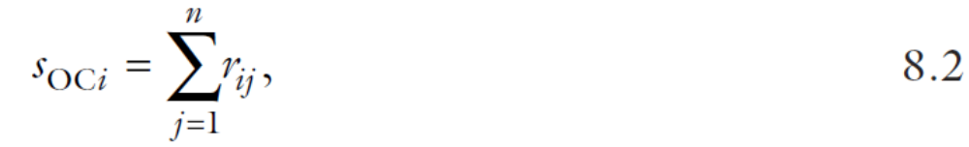

Slide 22
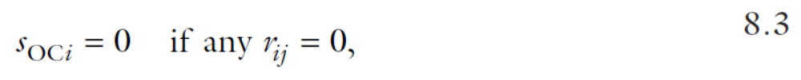

Slide 23
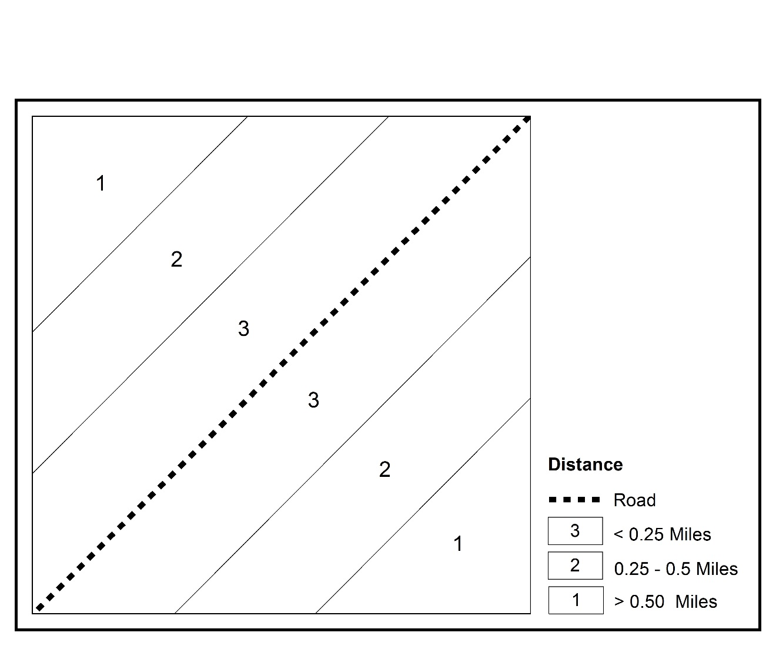
(a) Distance to Road
Figure 8.4 Residential Suitability Analysis: Ordinal Combination Method

Slide 24

(b) Slope
Figure 8.4 Residential Suitability Analysis: Ordinal Combination Method

Slide 25
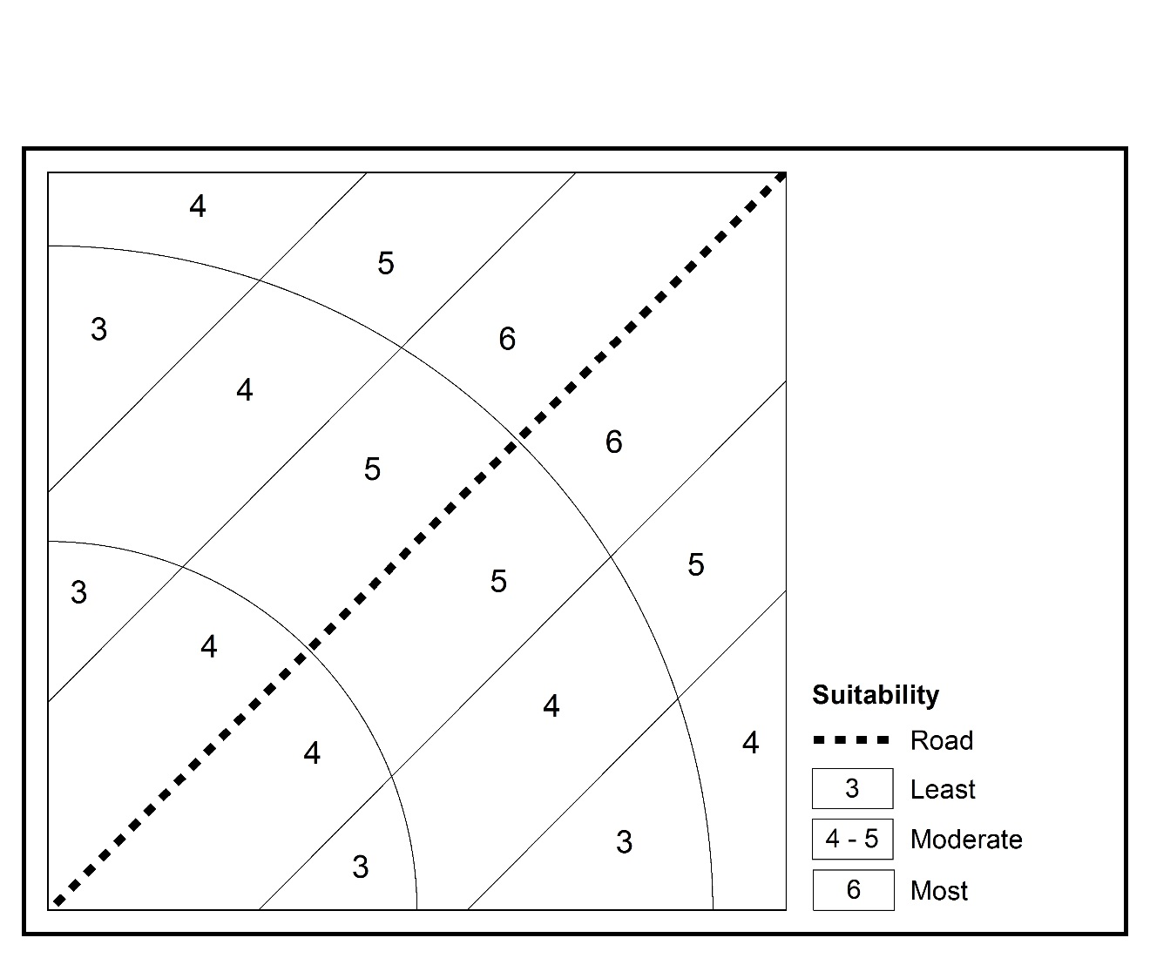
(c) Ordinal Suitability
Figure 8.4 Residential Suitability Analysis: Ordinal Combination Method

Slide 26

(a) Distance to Road
Figure 8.5 Commercial Suitability Analysis: Ordinal Combination Method

Slide 27

(b) Slope
Figure 8.5 Commercial Suitability Analysis: Ordinal Combination Method

Slide 28
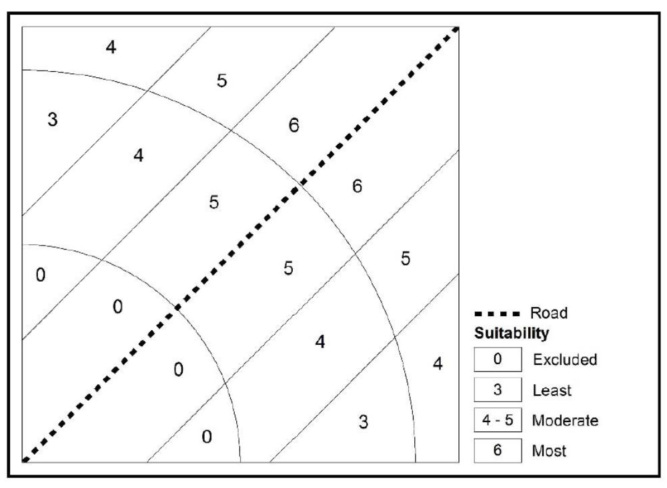
(c) Ordinal Suitability
Figure 8.5 Commercial Suitability Analysis: Ordinal Combination Method

Slide 30
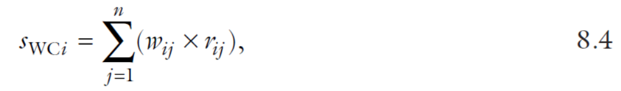

Slide 32

(a) Distance to Road: Weight = 3
Figure 8.6 Residential Suitability Analysis: Access Promotion Alternative

Slide 33

(b) Slope: Weight = 1
Figure 8.6 Residential Suitability Analysis: Access Promotion Alternative

Slide 34
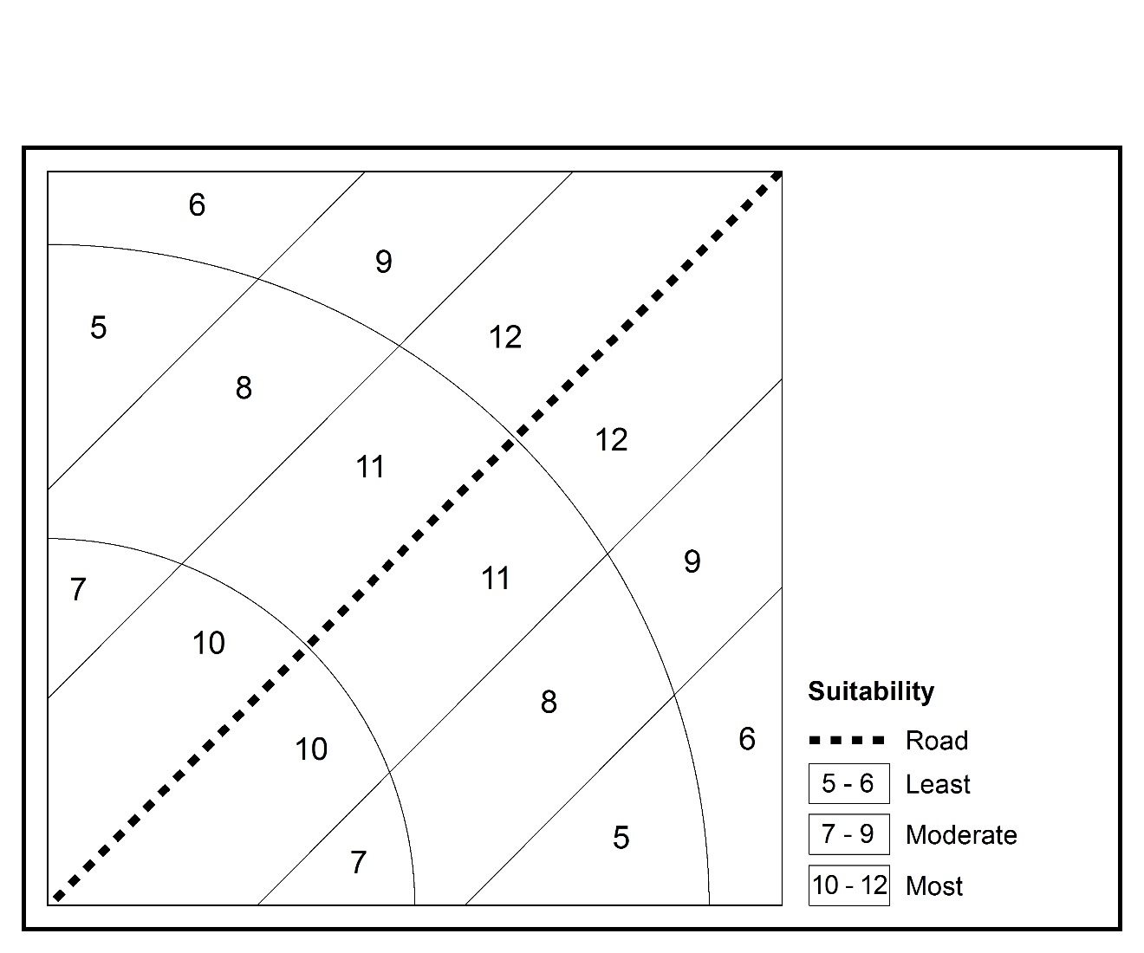
(c) Weighted Suitability
Figure 8.6 Residential Suitability Analysis: Access Promotion Alternative

Slide 35
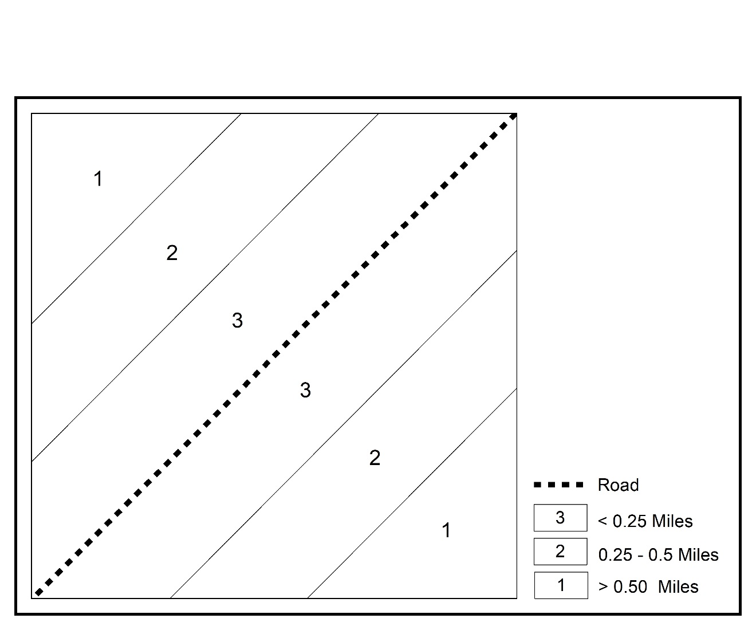
(a) Distance to Road: Weight = 1
Figure 8.7 Residential Suitability Analysis: Cost Reduction Alternative

Slide 36
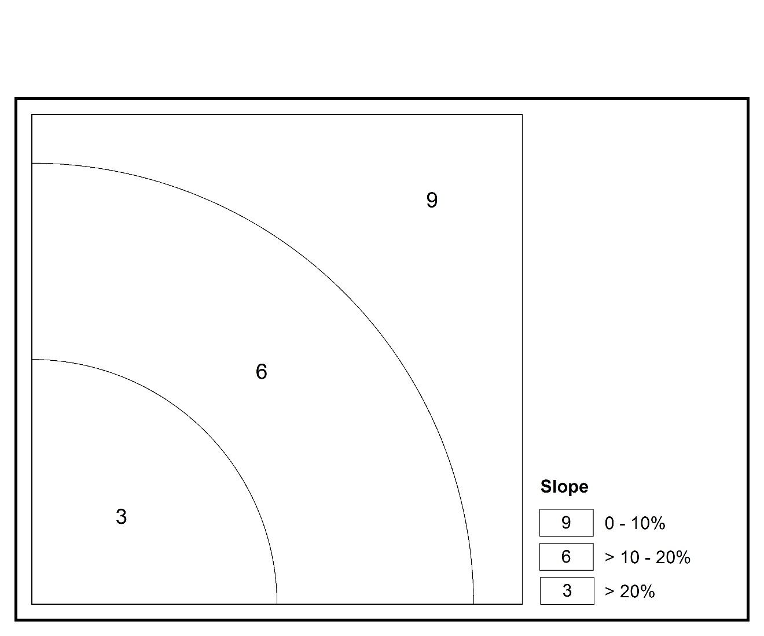
(b) Slope: Weight = 3
Figure 8.7 Residential Suitability Analysis: Cost Reduction Alternative

Slide 37
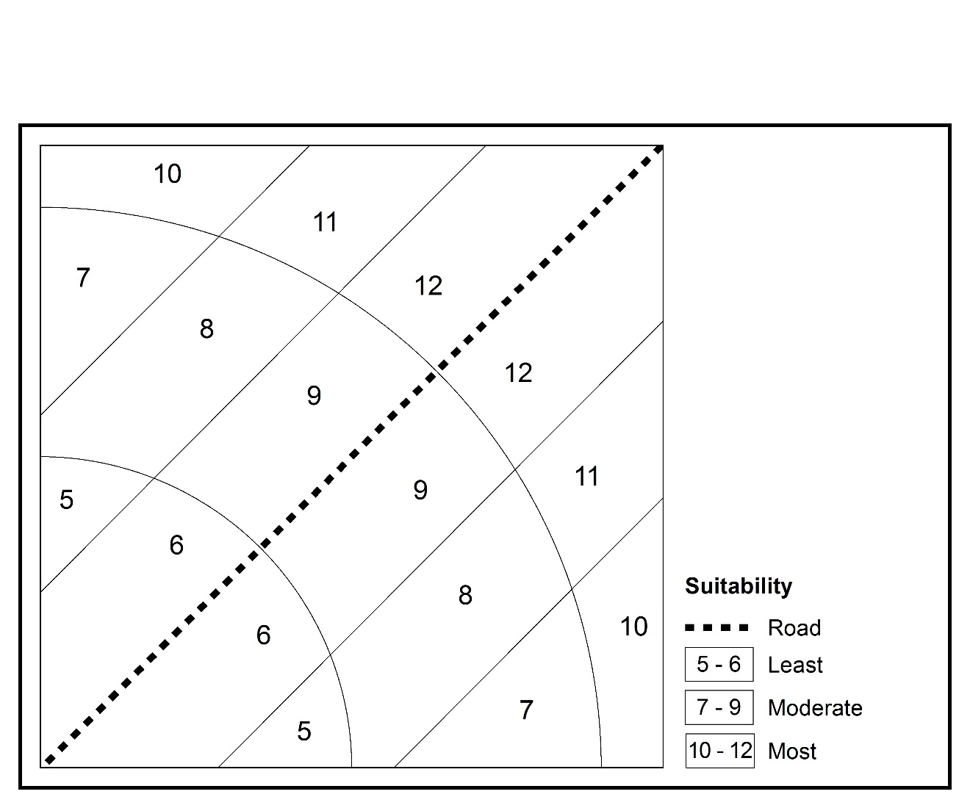
(c) Weighted Suitability
Figure 8.7 Residential Suitability Analysis: Cost Reduction Alternative

Slide 38


Slide 39


Slide 41
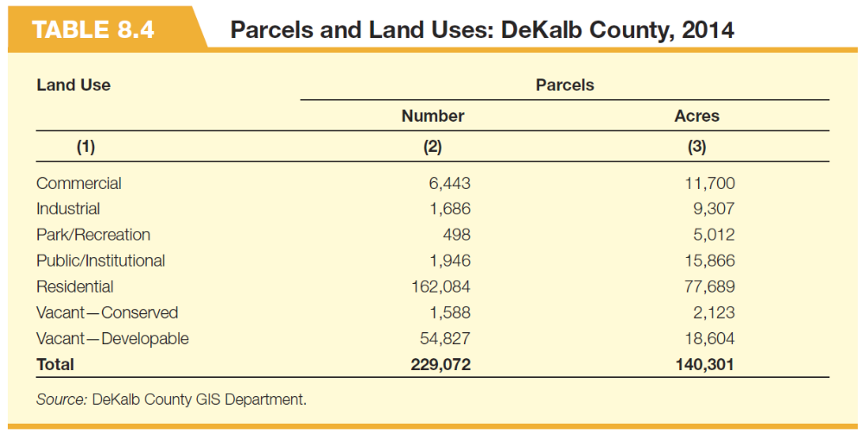

Slide 42


Slide 43
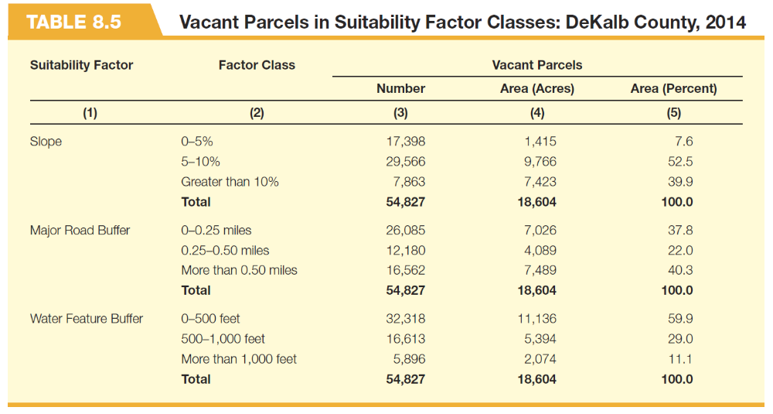

Slide 44
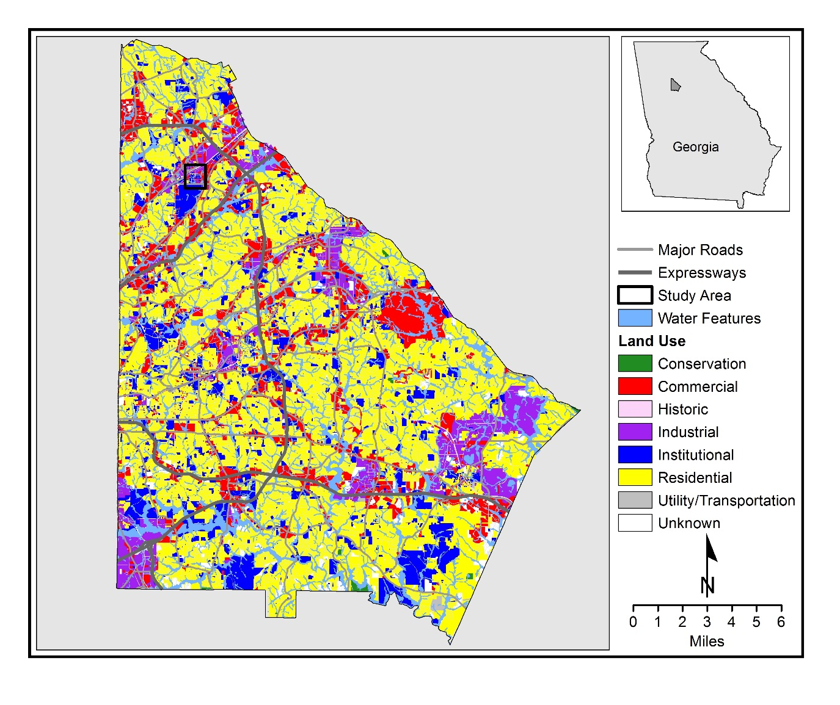
Map 8.3 DeKalb County Water Features, Major Roads and Land Uses

Slide 45
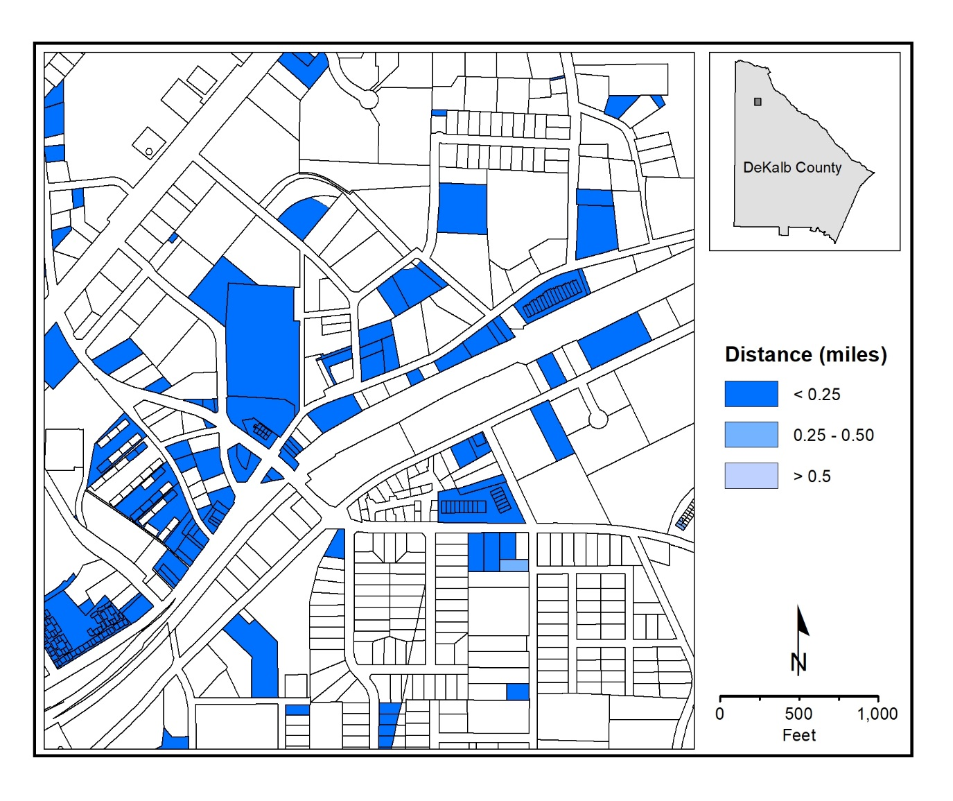
(a) Distance to Road
Map 8.4 DeKalb County Suitability Factors, 2014

Slide 46
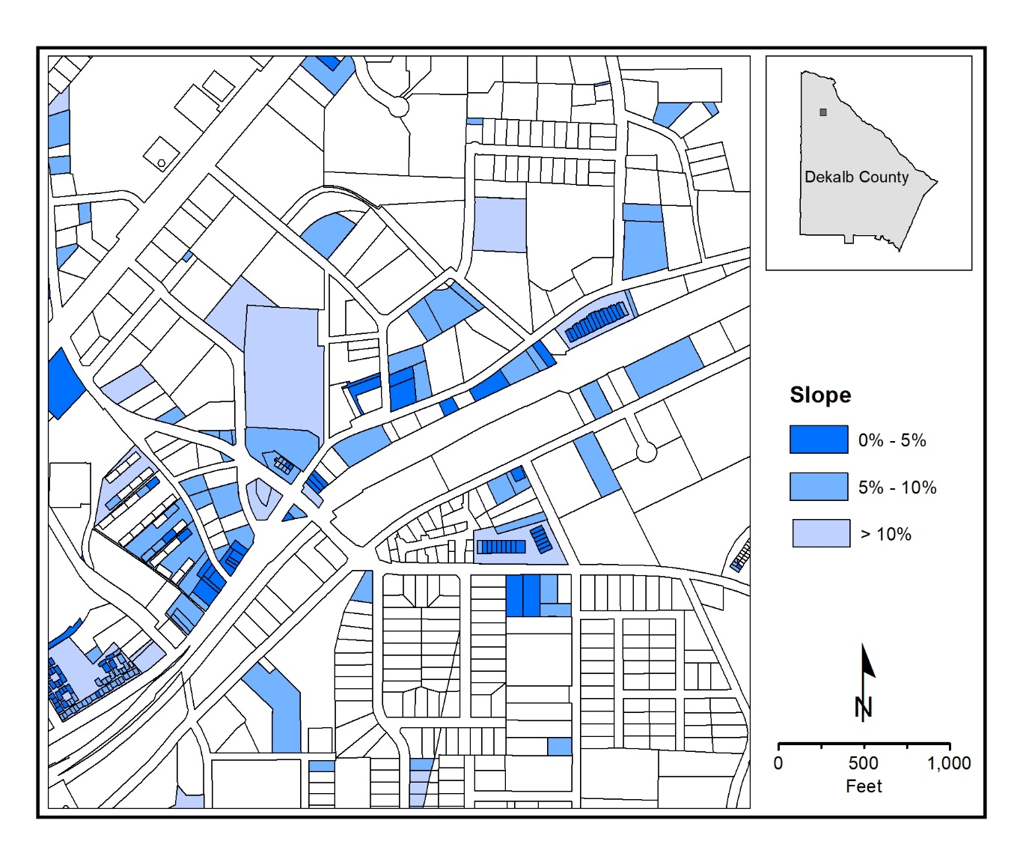
(b) Slope
Map 8.4 DeKalb County Suitability Factors, 2014

Slide 47
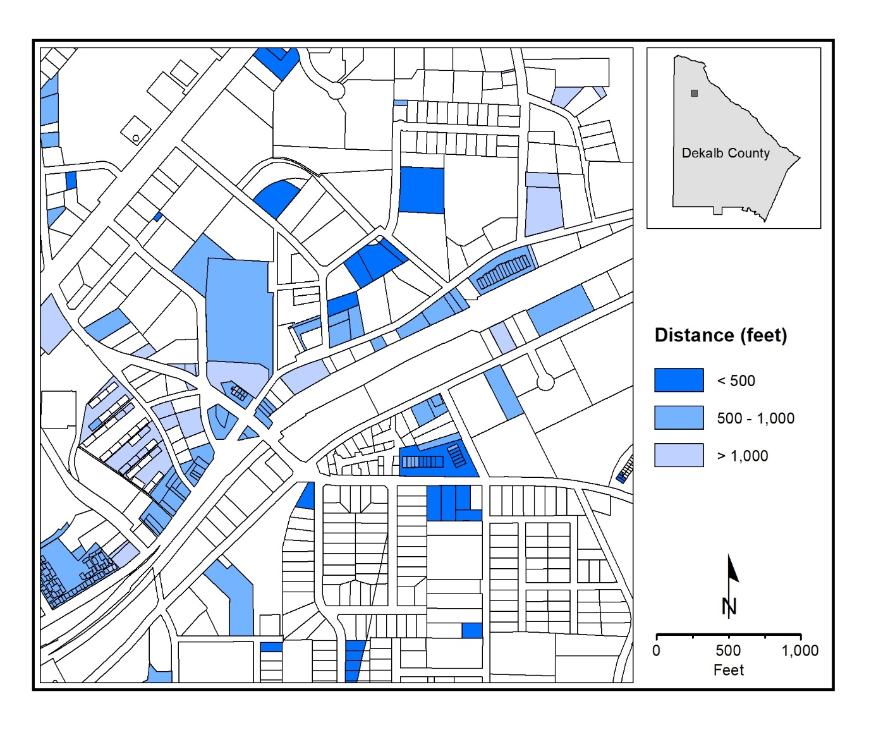
(c) Distance to Water
Map 8.4 DeKalb County Suitability Factors, 2014

Slide 49
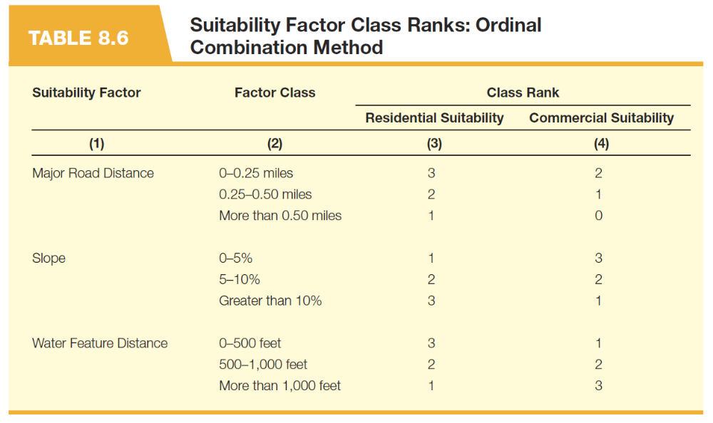

Slide 50
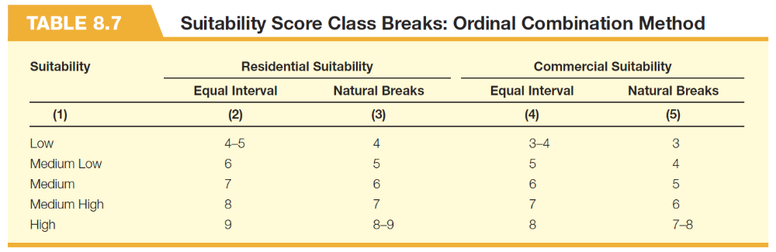

Slide 51
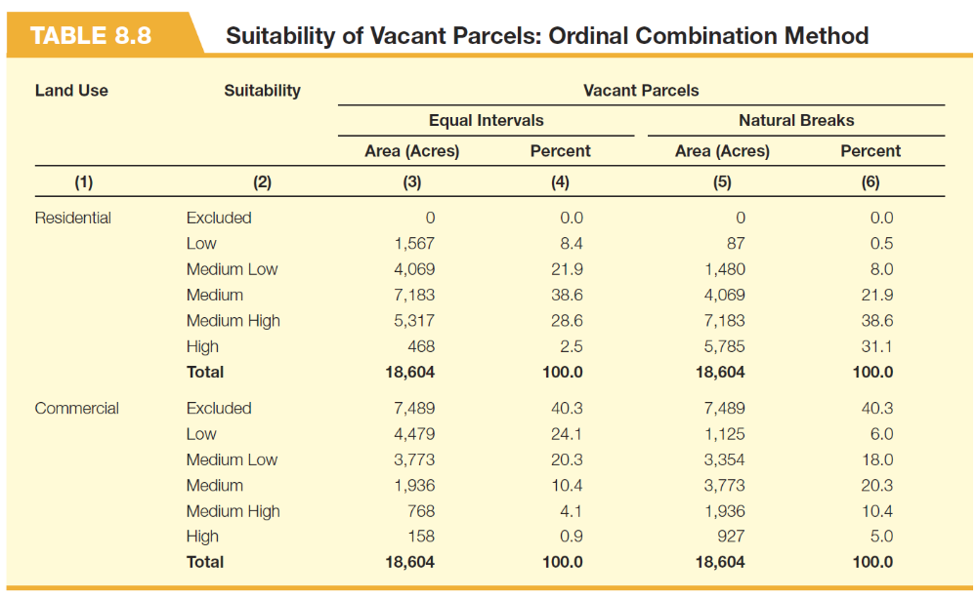

Slide 52
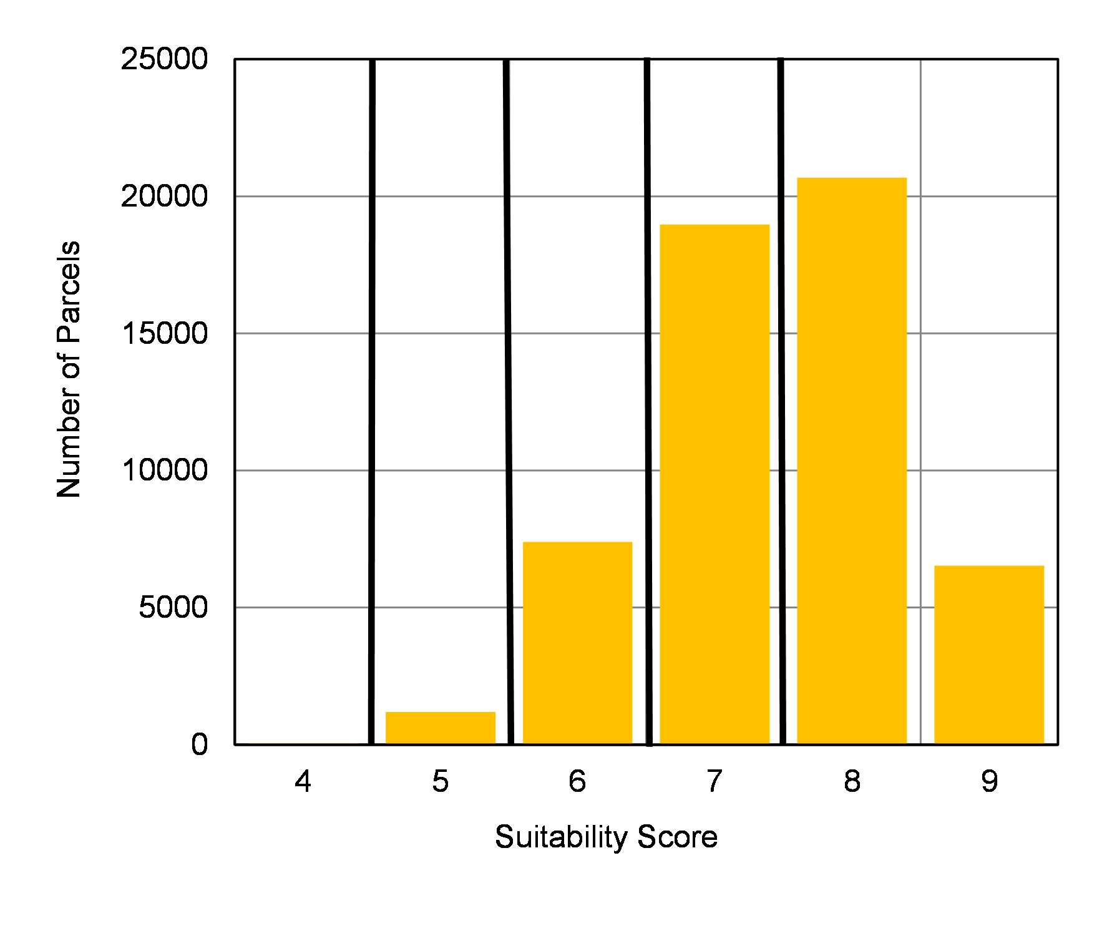
(a) Residential Suitability
Figure 8.8 Vacant Parcels and Suitability Scores: Ordinal Combination Method

Slide 53
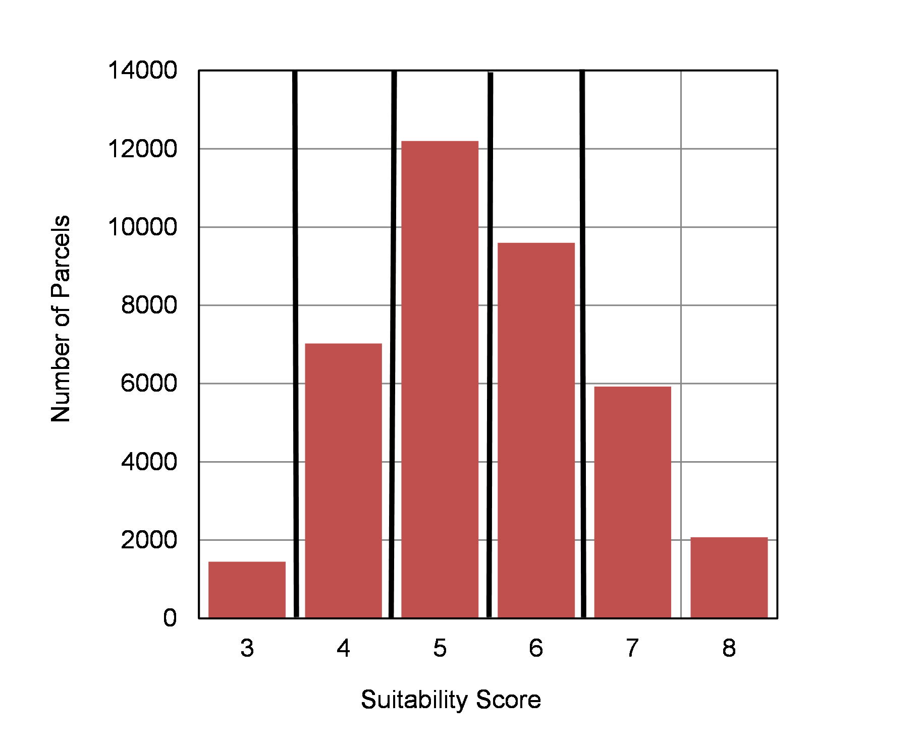
(b) Commercial Suitability
Figure 8.8 Vacant Parcels and Suitability Scores: Ordinal Combination Method

Slide 54
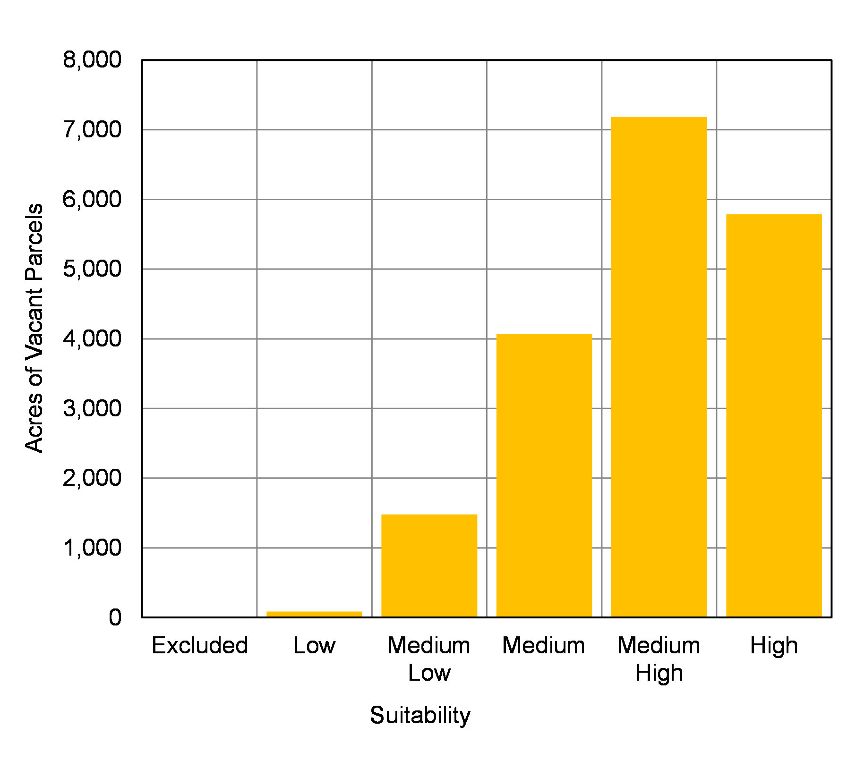
(a) Residential Suitability
Figure 8.9 Acres of Suitable Parcels: Ordinal Combination Method

Slide 55
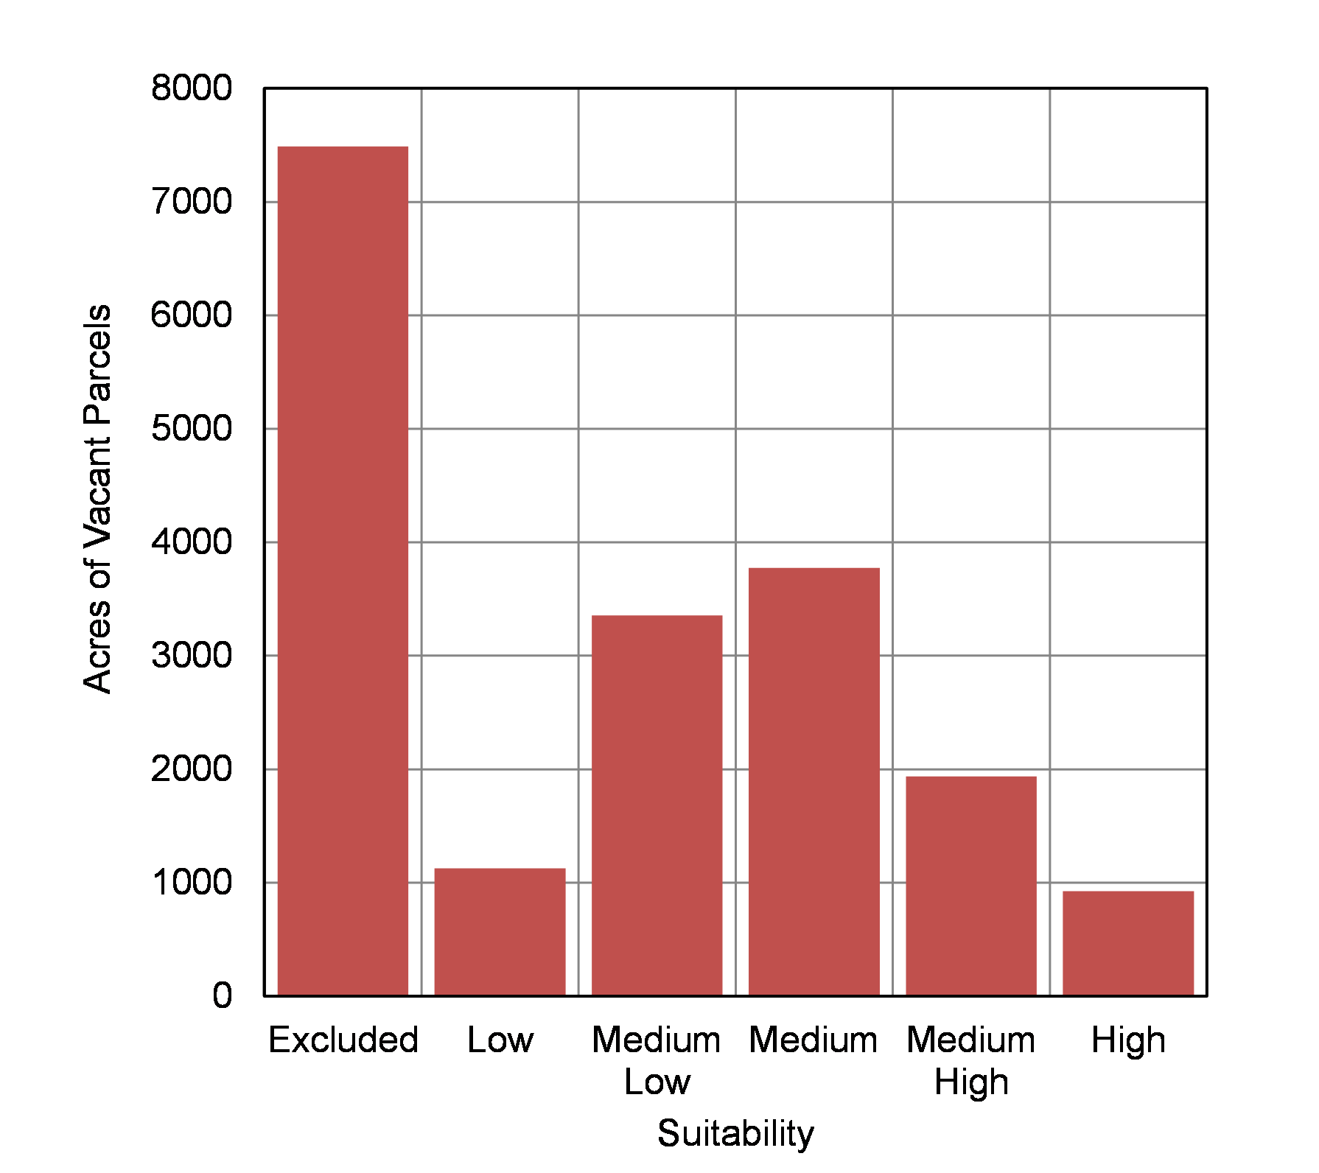
(b) Commercial Suitability
Figure 8.9 Acres of Suitable Parcels: Ordinal Combination Method

Slide 56
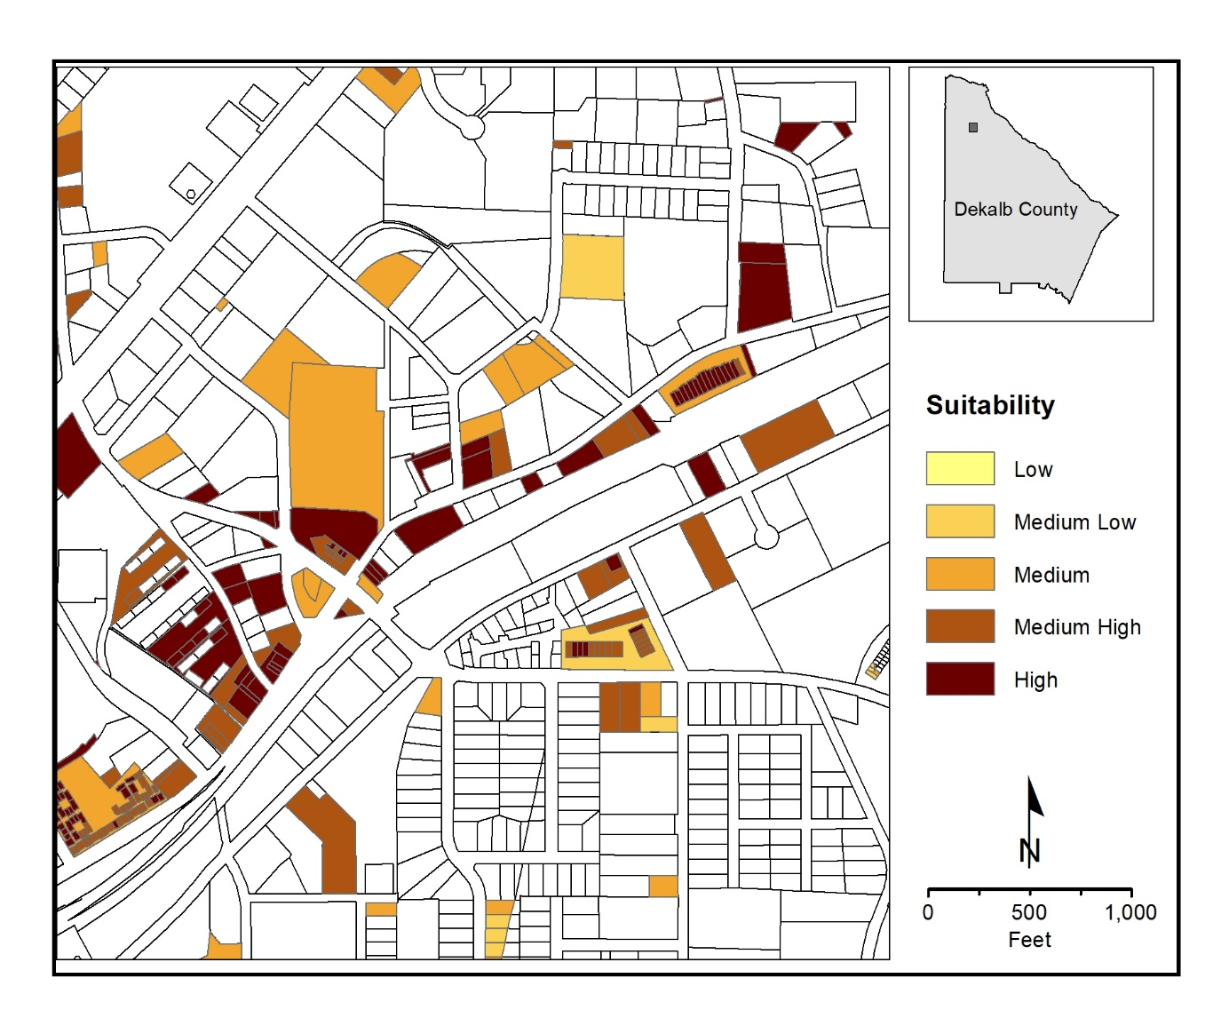
(a) Residential Suitability
Map 8.5 Suitable Parcels: Ordinal Combination Method

Slide 57
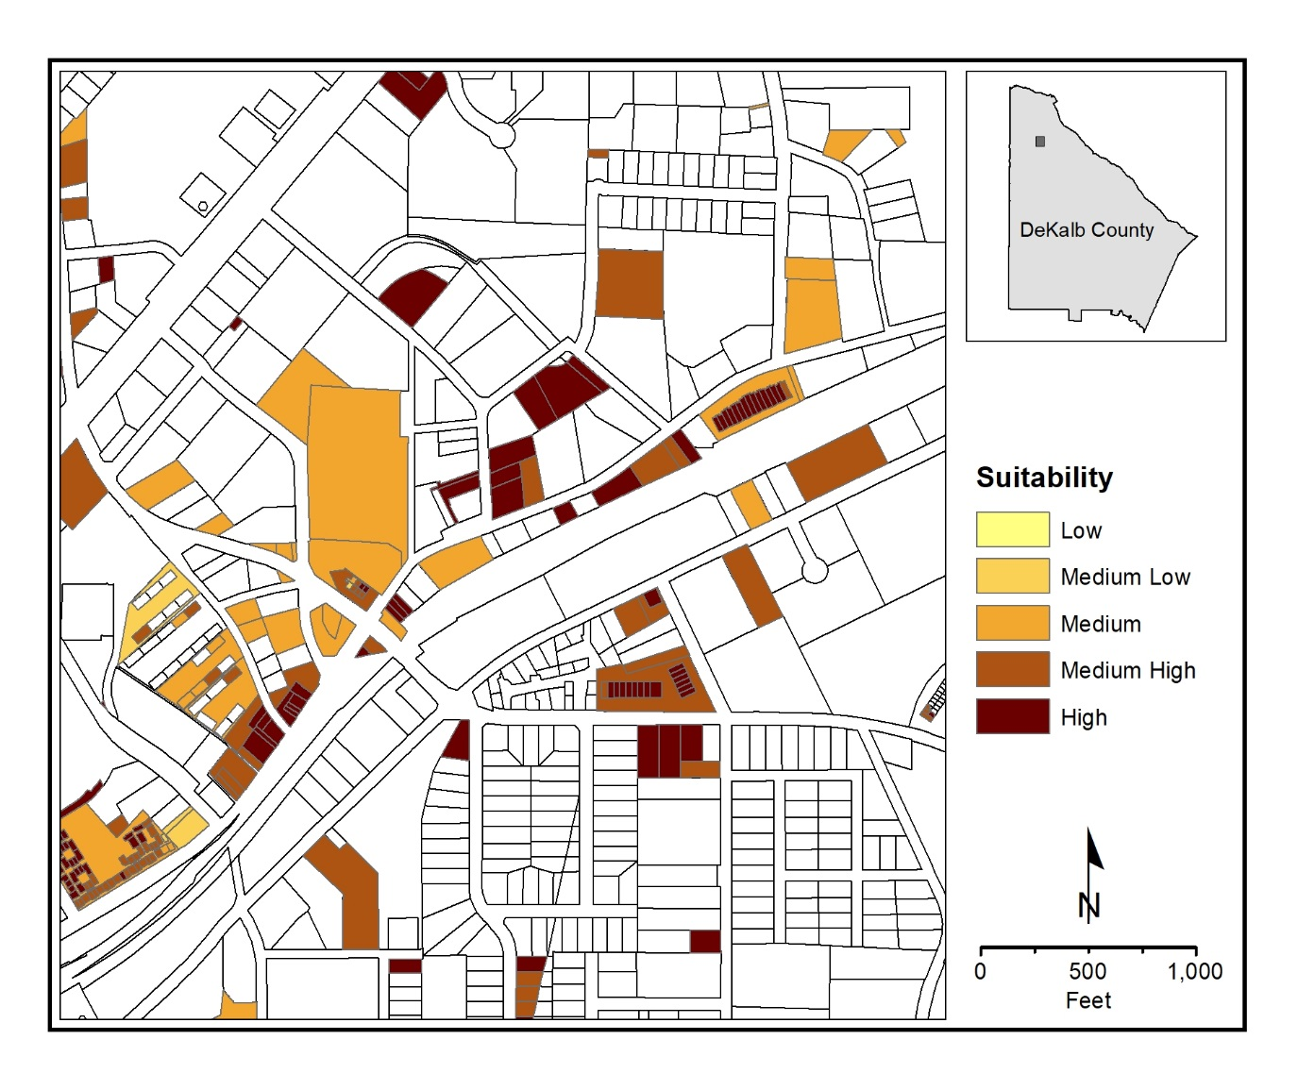
(b) Commercial Suitability
Map 8.5 Suitable Parcels: Ordinal Combination Method

Slide 59
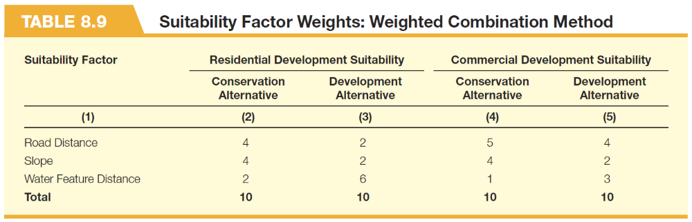

Slide 60
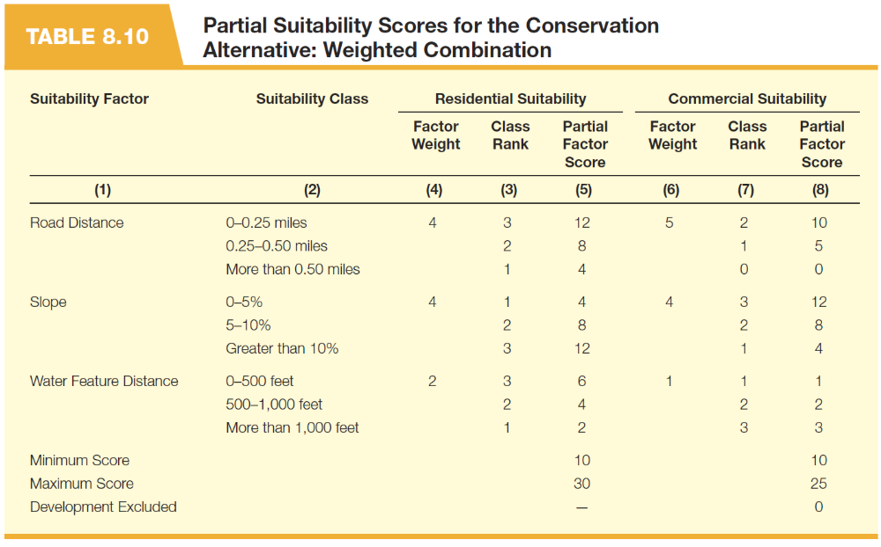

Slide 61
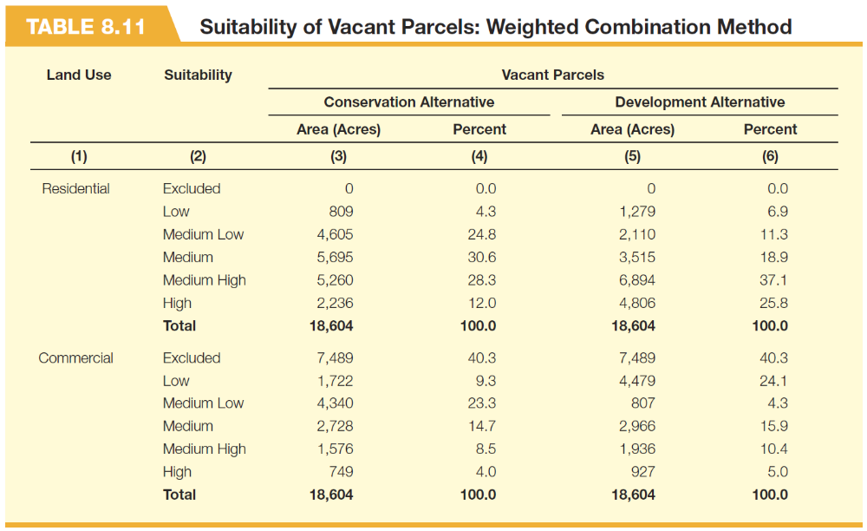

Slide 62
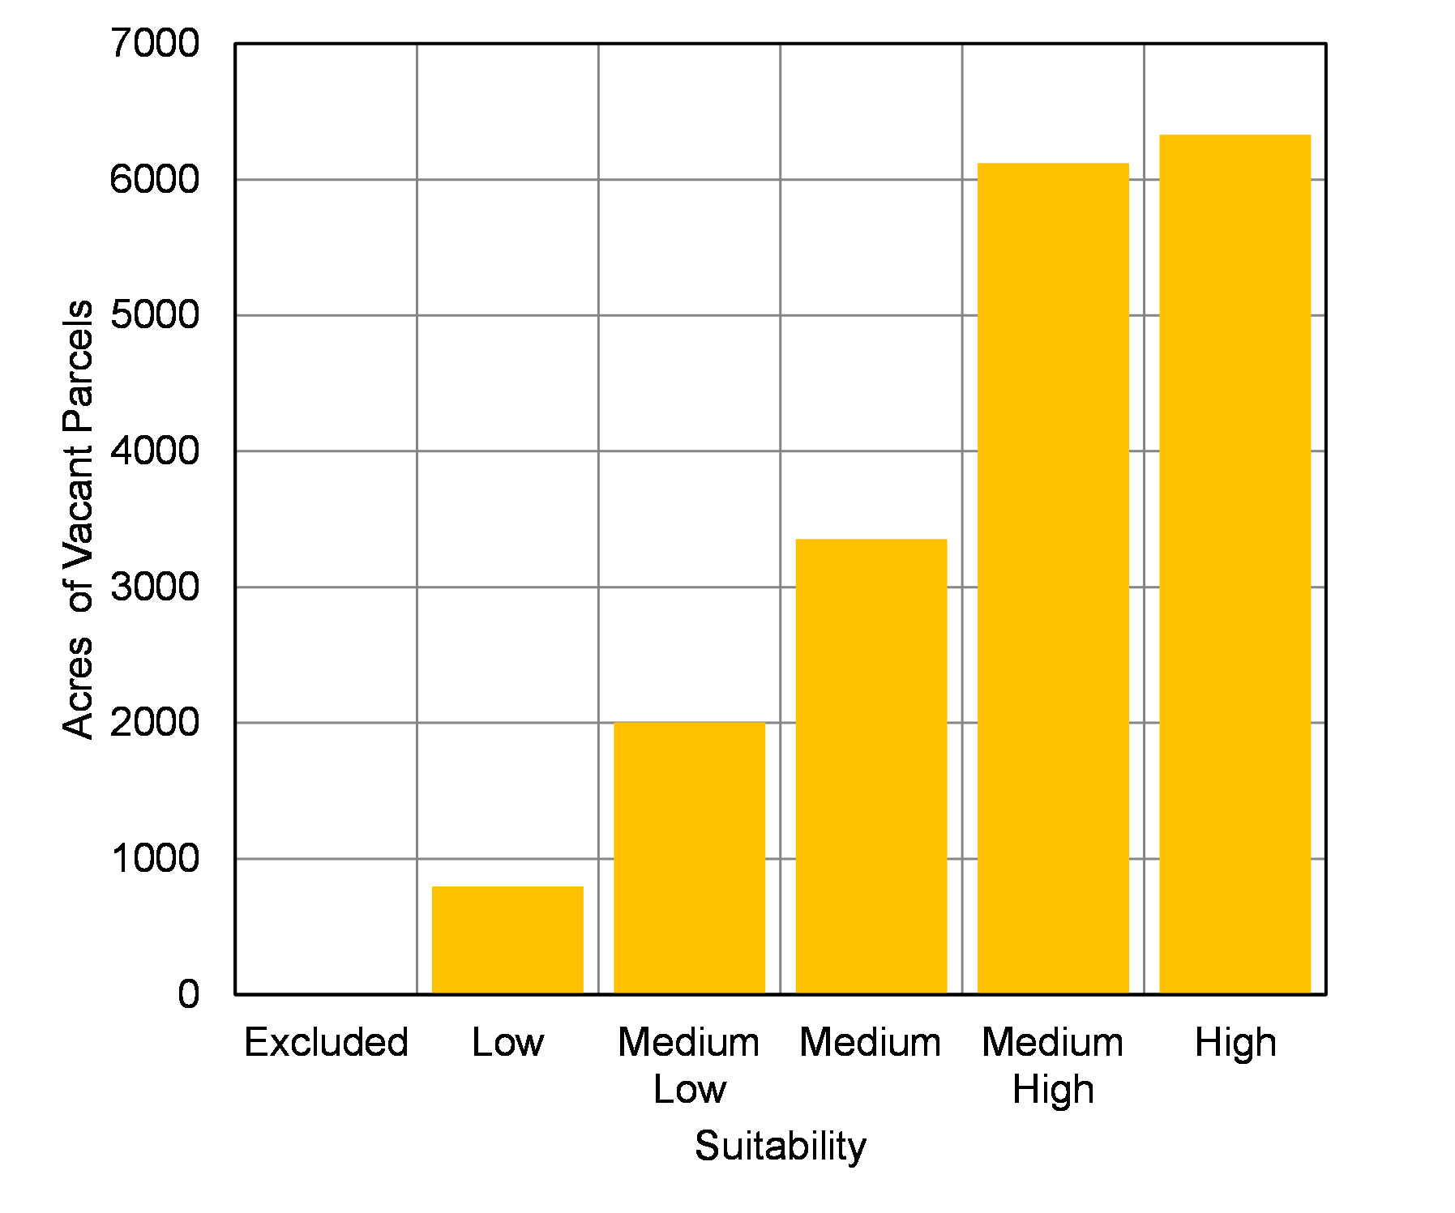
(a) Residential Suitability – Conservation Alternative
Figure 8.10 Acres of Suitable Residential Parcels: Weighted Combination Alternatives

Slide 63
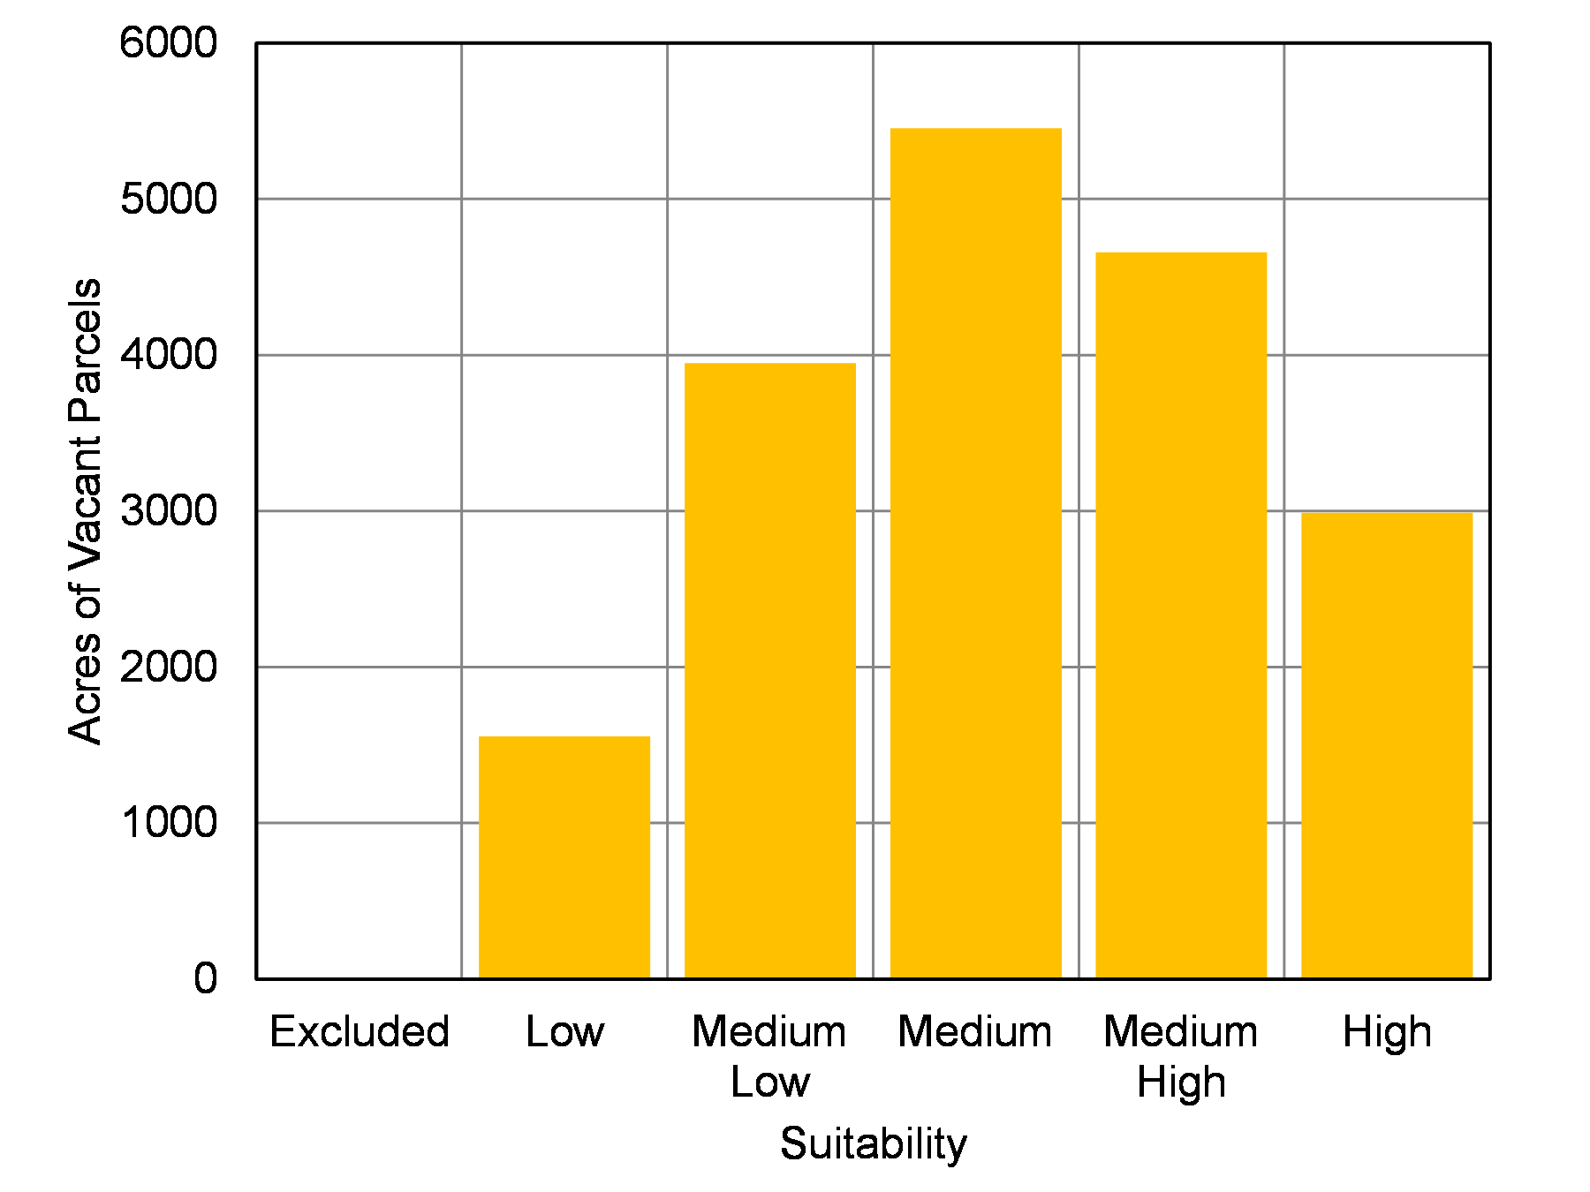
(b) Residential Suitability – Development Alternative
Figure 8.10 Acres of Suitable Residential Parcels: Weighted Combination Alternatives

Slide 64
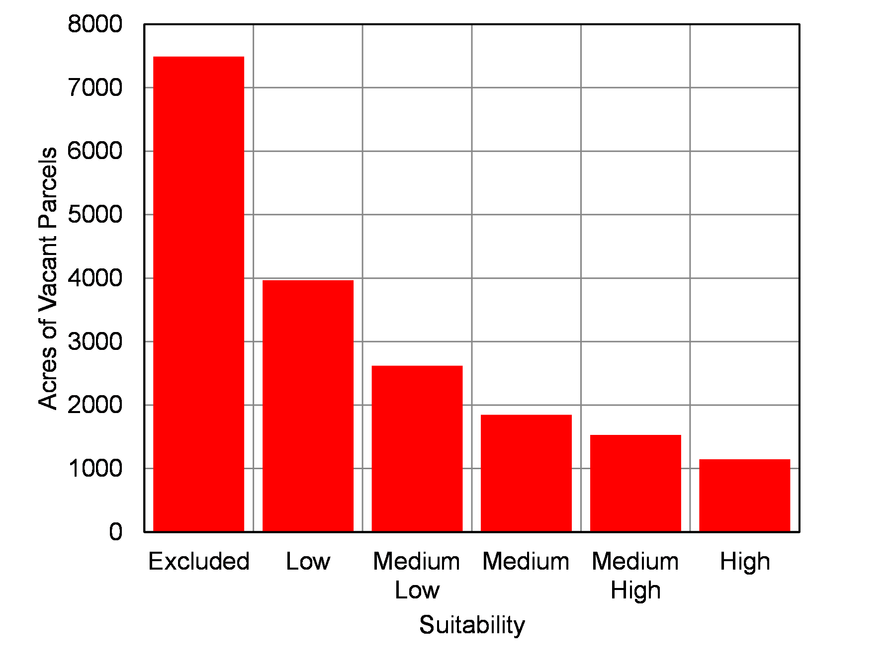
(a) Commercial Suitability – Conservation Alternative
Figure 8.11 Acres of Suitable Commercial Parcels: Weighted Combination Alternatives

Slide 65
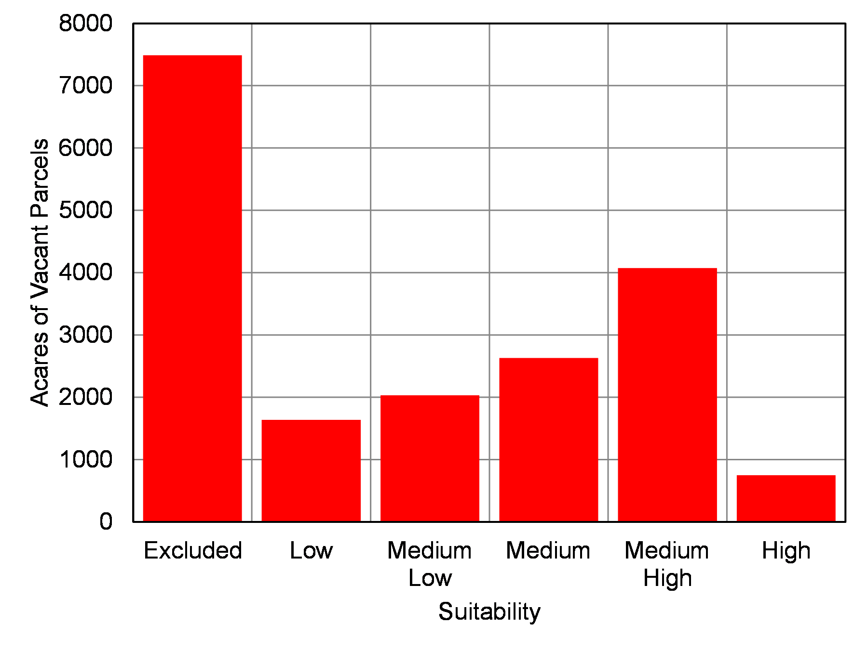
(b) Commercial Suitability – Development Alternative
Figure 8.11 Acres of Suitable Commercial Parcels: Weighted Combination Alternatives

Slide 66
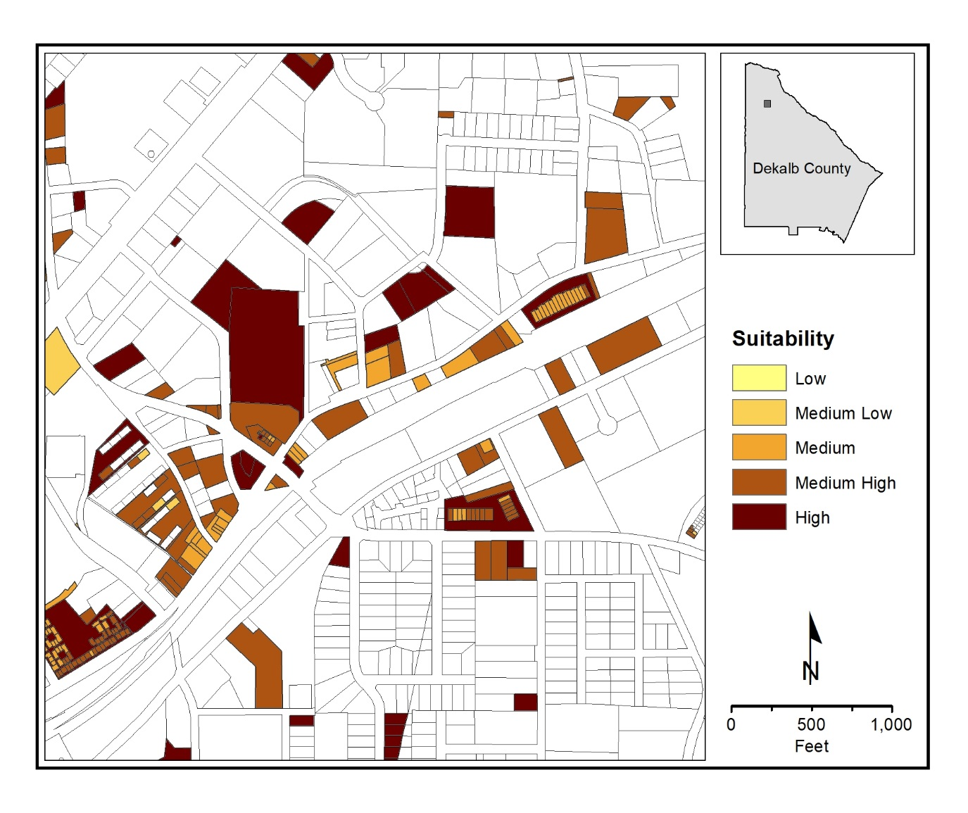
(a) Residential Suitability – Conservation Alternative
Map 8.6 Suitable Residential Parcels: Weighted Combination Alternatives

Slide 67
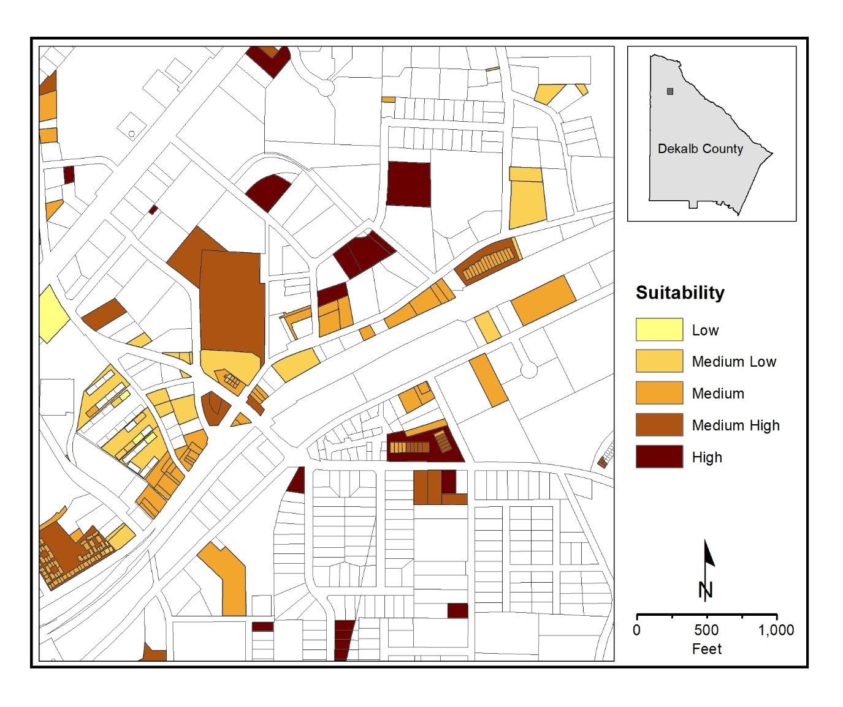
(b) Residential Suitability – Development Alternative
Map 8.6 Suitable Residential Parcels: Weighted Combination Alternatives

Slide 68
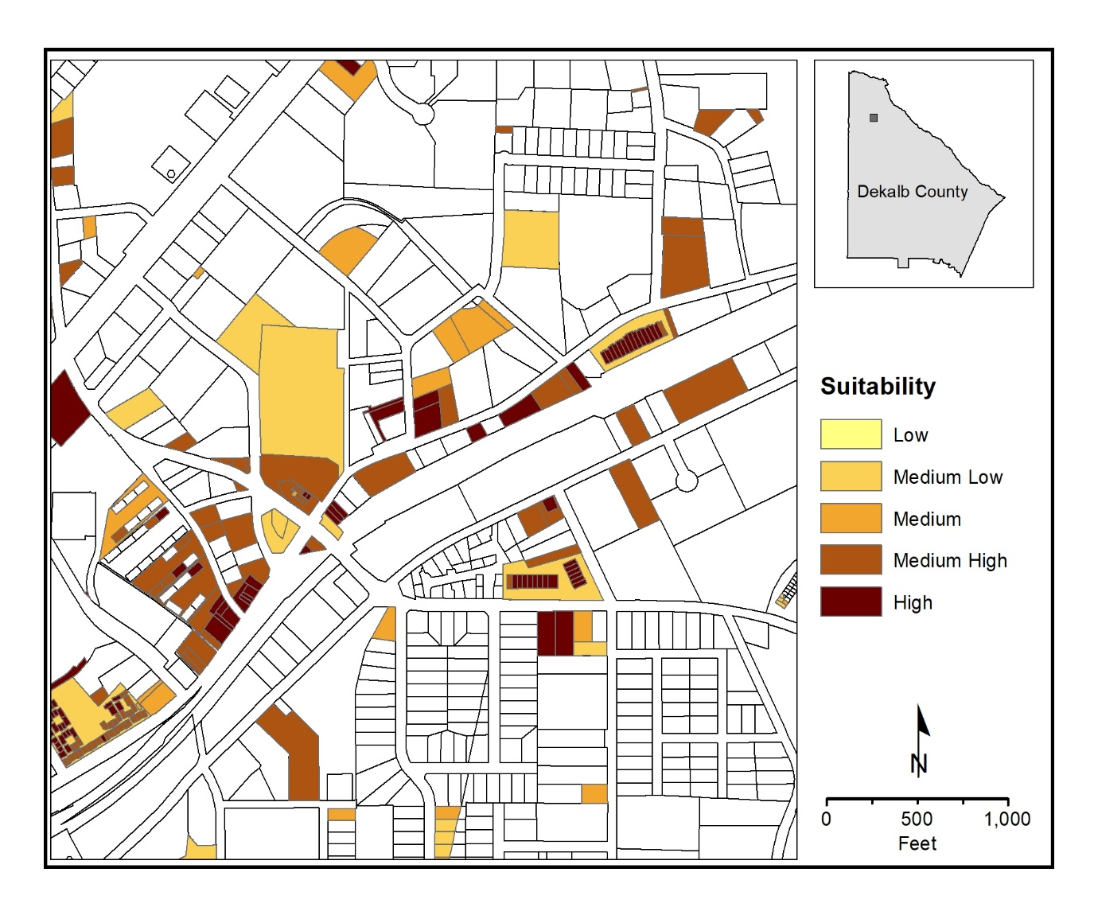
(a) Commercial Suitability – Conservation Alternative
Map 8.7 Suitable Commercial Parcels: Weighted Combination Alternatives

Slide 69
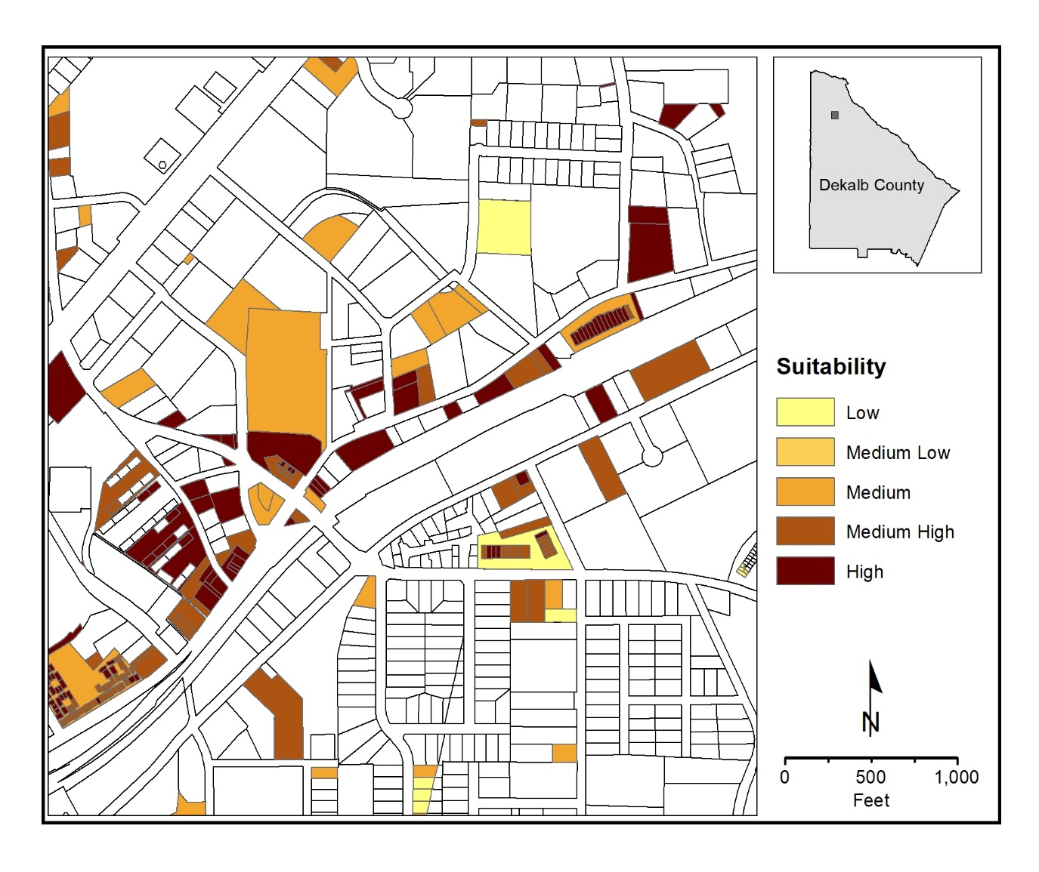
(b) Commercial Suitability – Development Alternative
Map 8.7 Suitable Commercial Parcels: Weighted Combination Alternatives

Slide 70
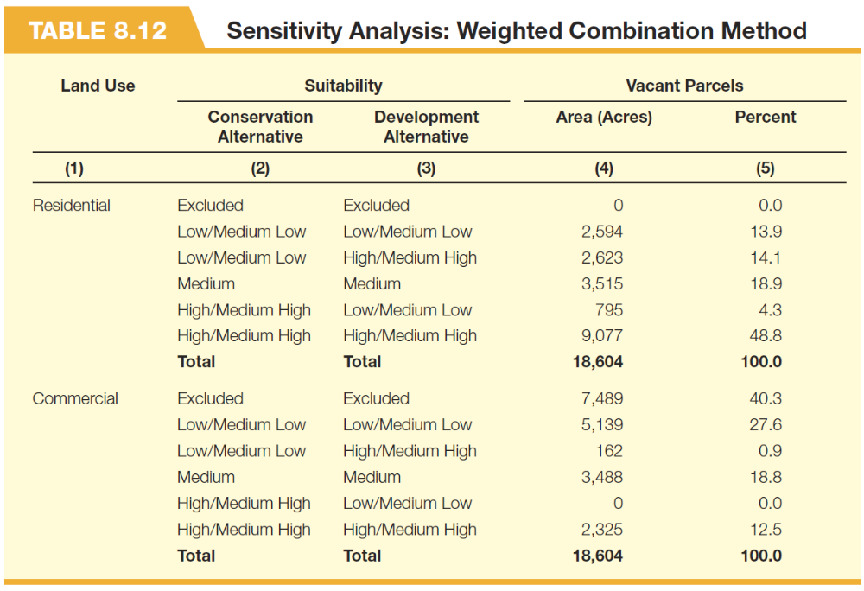

Slide 71

(a) Combined Suitability – Commercial Alternatives
Map 8.8 Suitable Parcels: Combined Weighted Combination Alternatives

Slide 72

(b) Combine Suitability – Residential Alternatives
Map 8.8 Suitable Parcels: Combined Weighted Combination Alternatives

Slide 74


Slide 75


Slide 77


Slide 78


