Slide 1


Slide 2


Slide 5


Slide 6


Slide 8


Slide 10


Slide 12


Slide 16


Slide 17


Slide 18


Slide 20
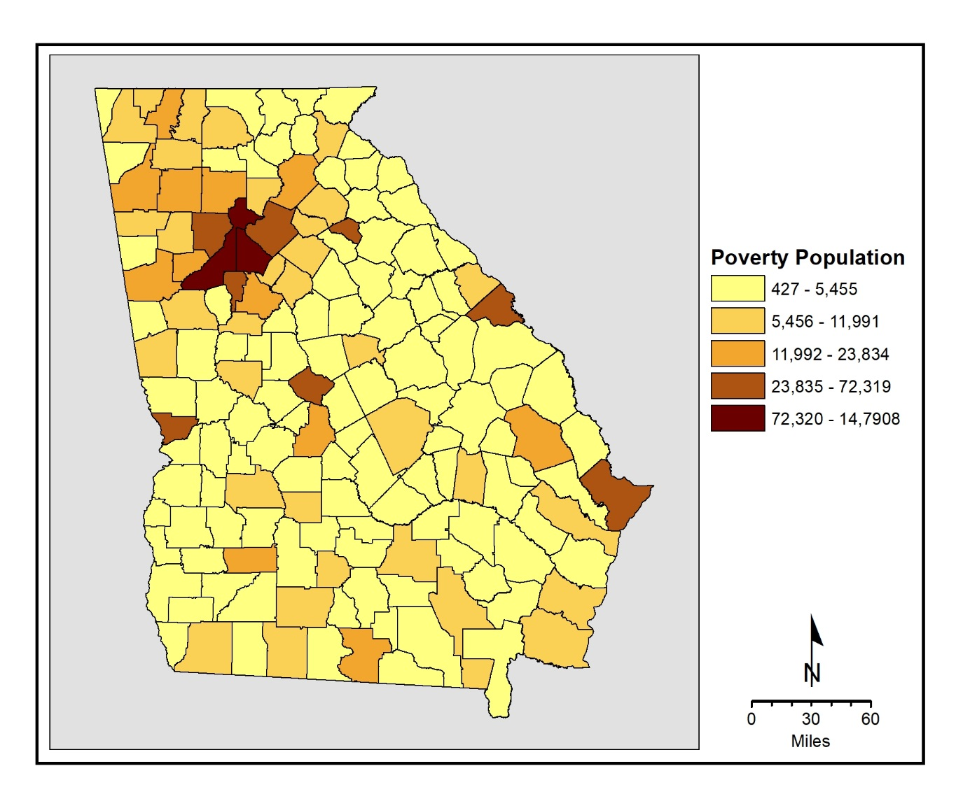
Map 7.1 Persons in Poverty: Georgia Counties, 2010

Slide 21
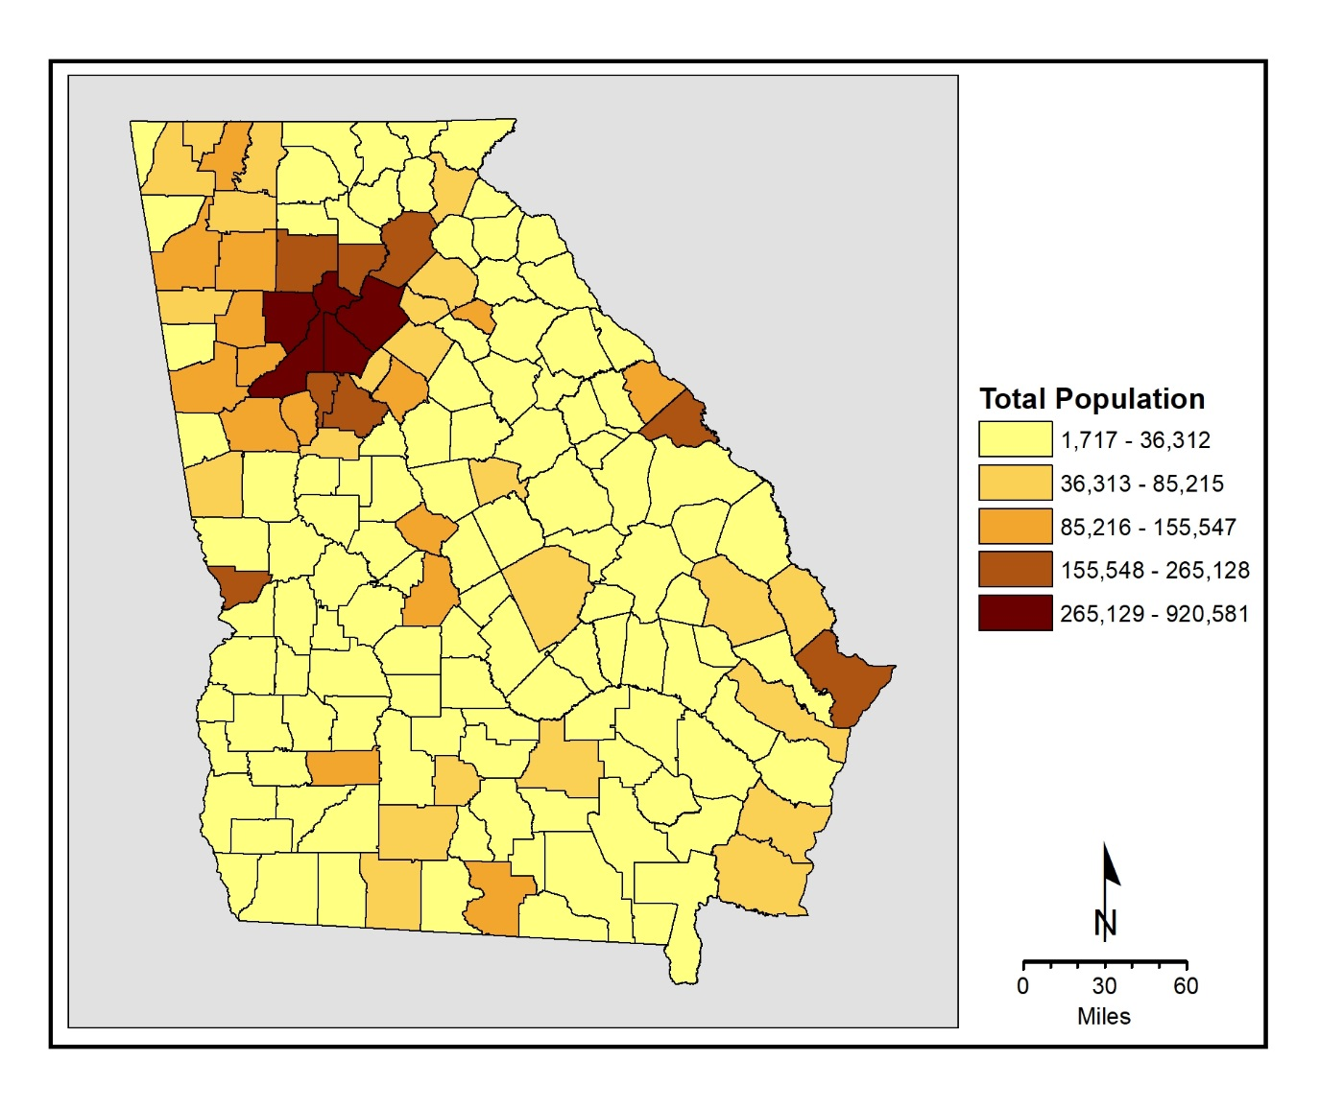
Map 7.2 Total Population: Georgia Counties, 2010

Slide 22
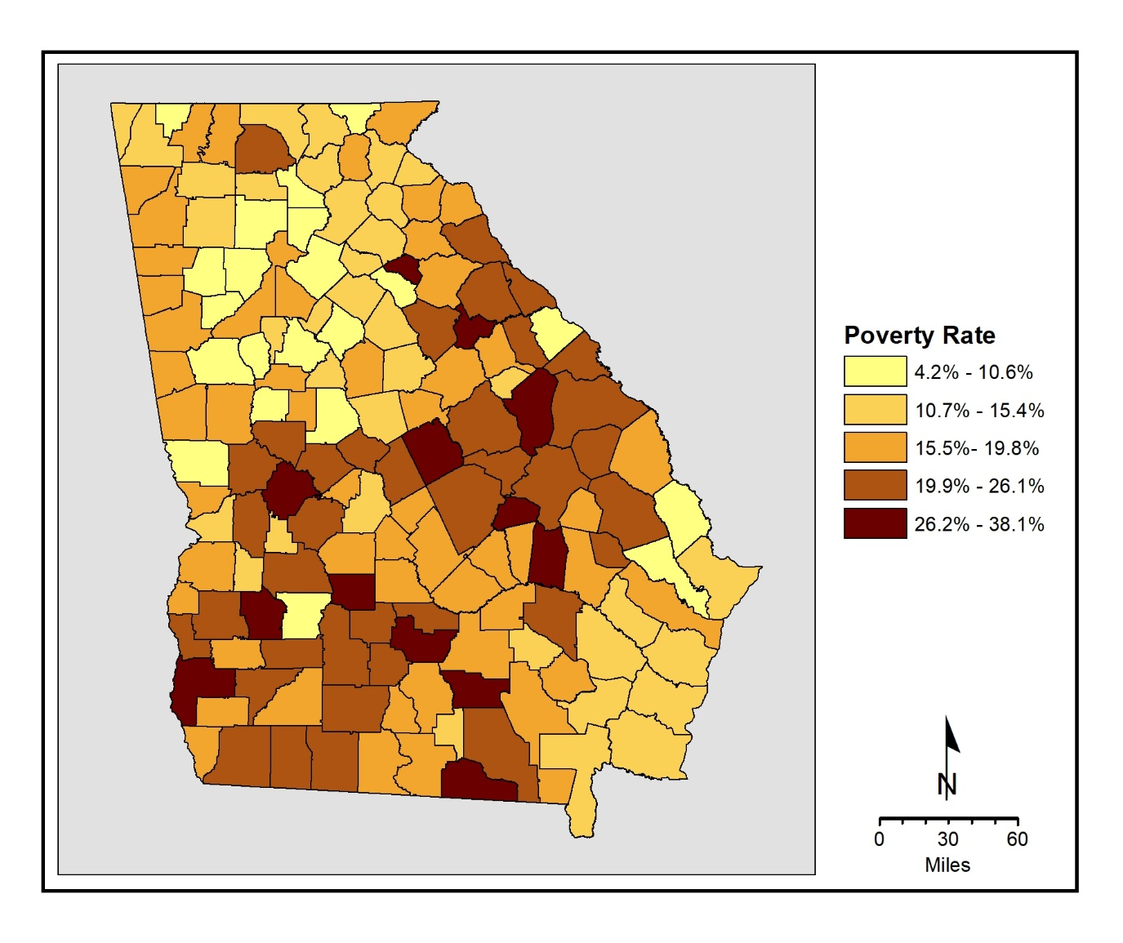
Map 7.3 Poverty Rate: Georgia Counties, 2010

Slide 23


Slide 24
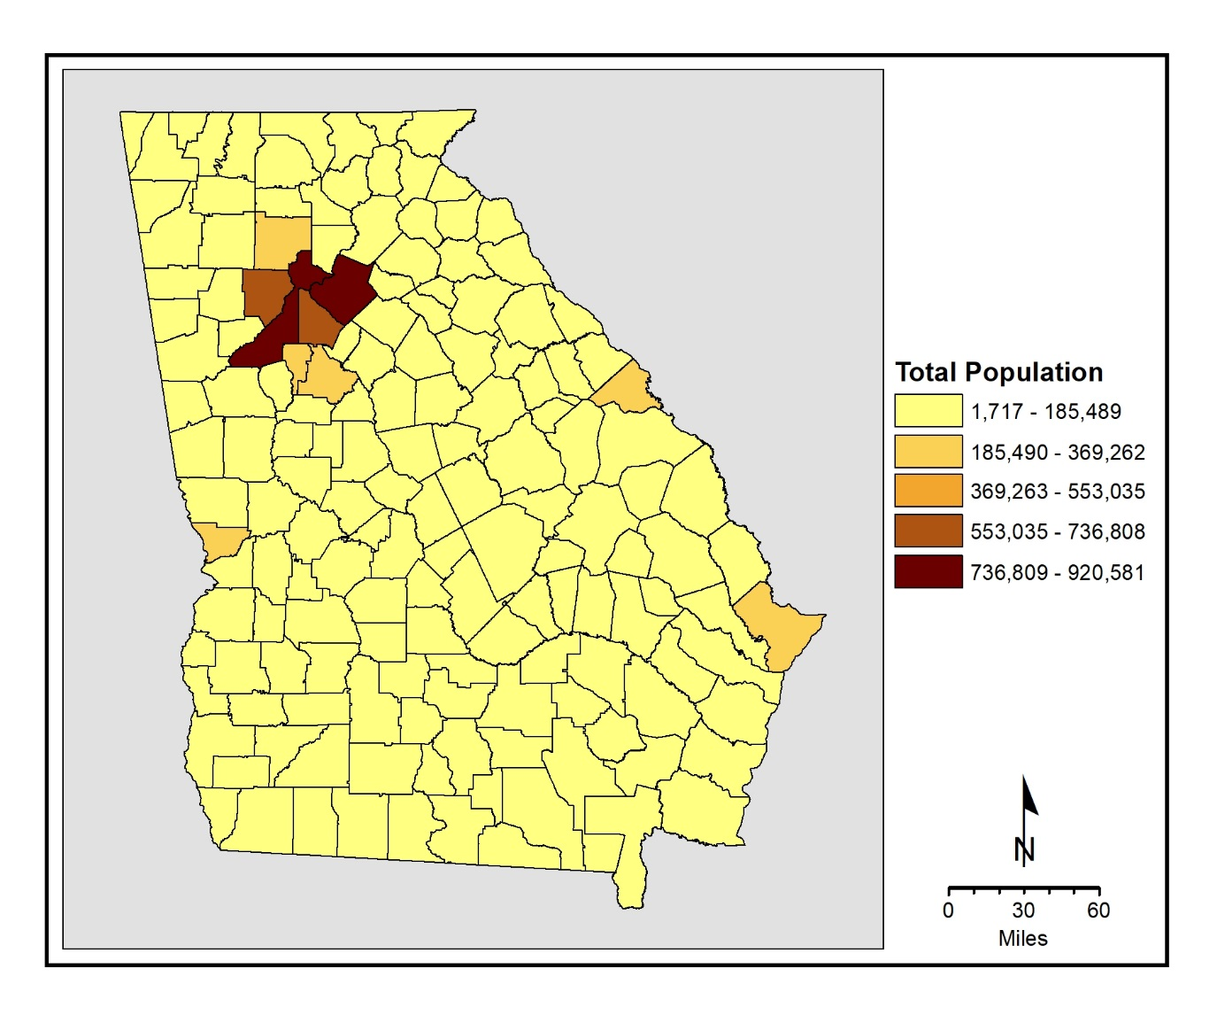
Map 7.4 Equal Interval Classification: Georgia County Populations, 2010

Slide 25
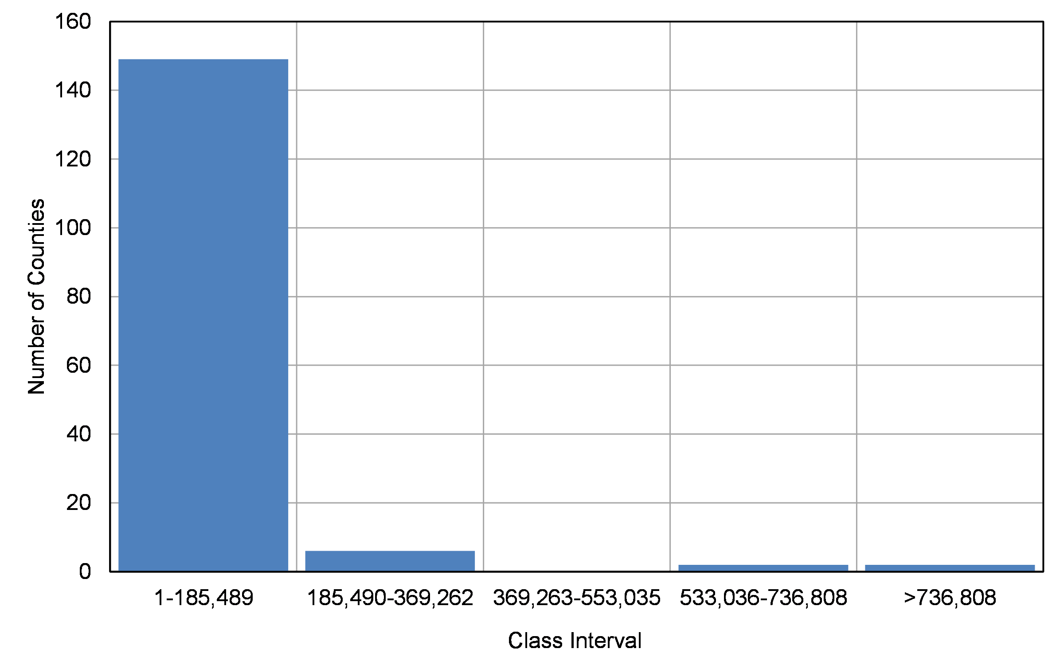
Figure 7.1 Equal Interval Class Break Distributions: Georgia County Populations. 2010

Slide 26
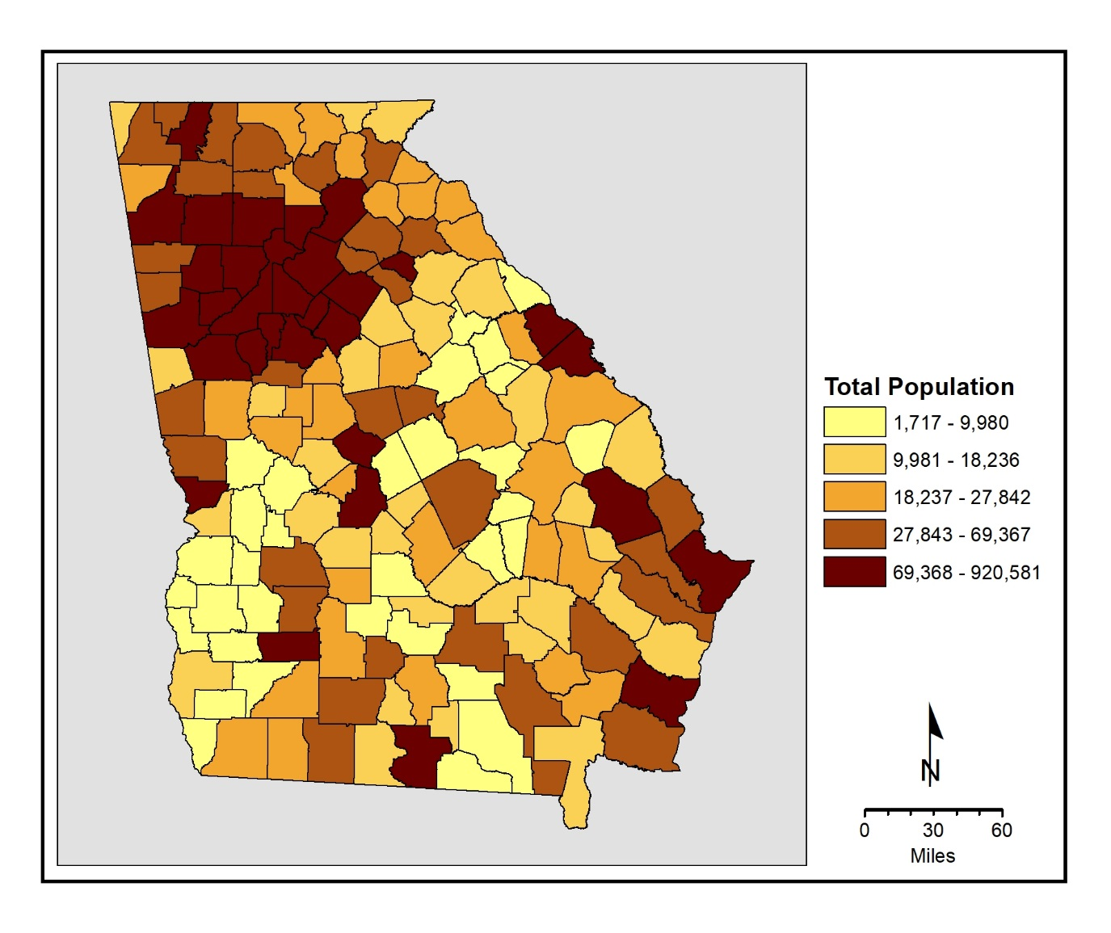
Map 7.5 Quantiles Classification: Georgia County Populations, 2010

Slide 27
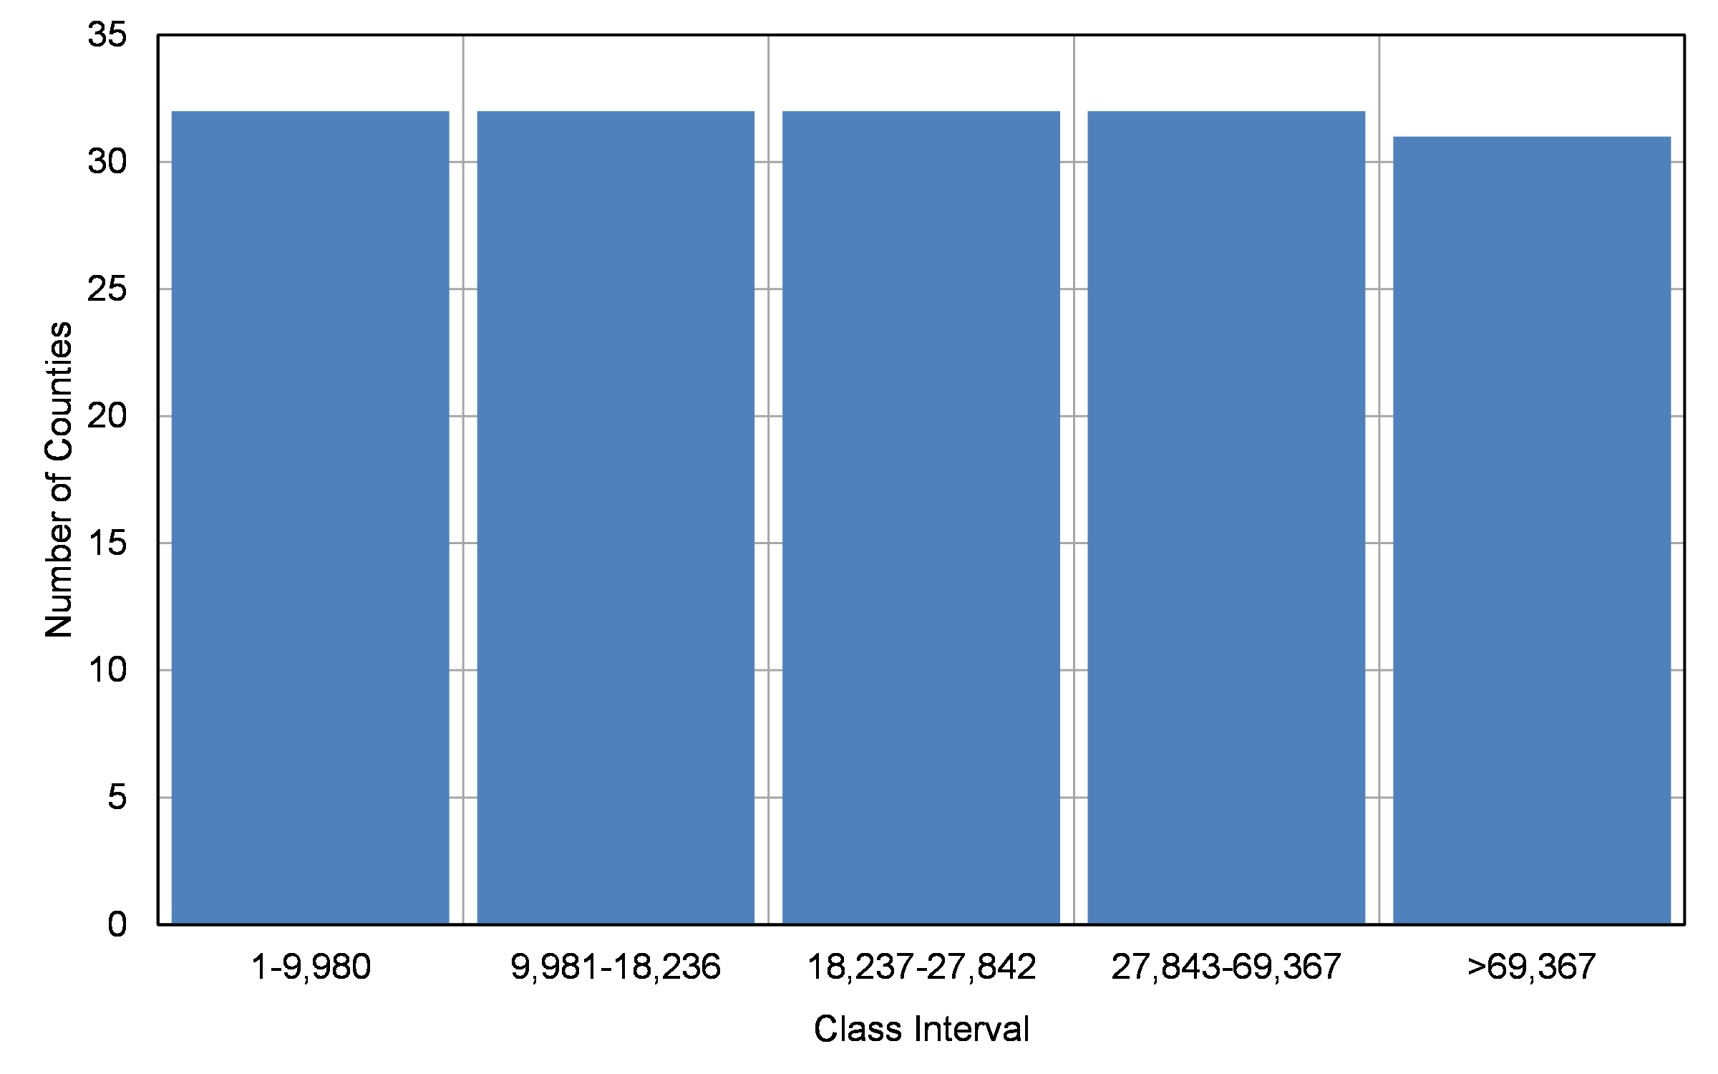
Figure 7.2 Quantiles Class Break Distributions: Georgia County Populations, 2010

Slide 28
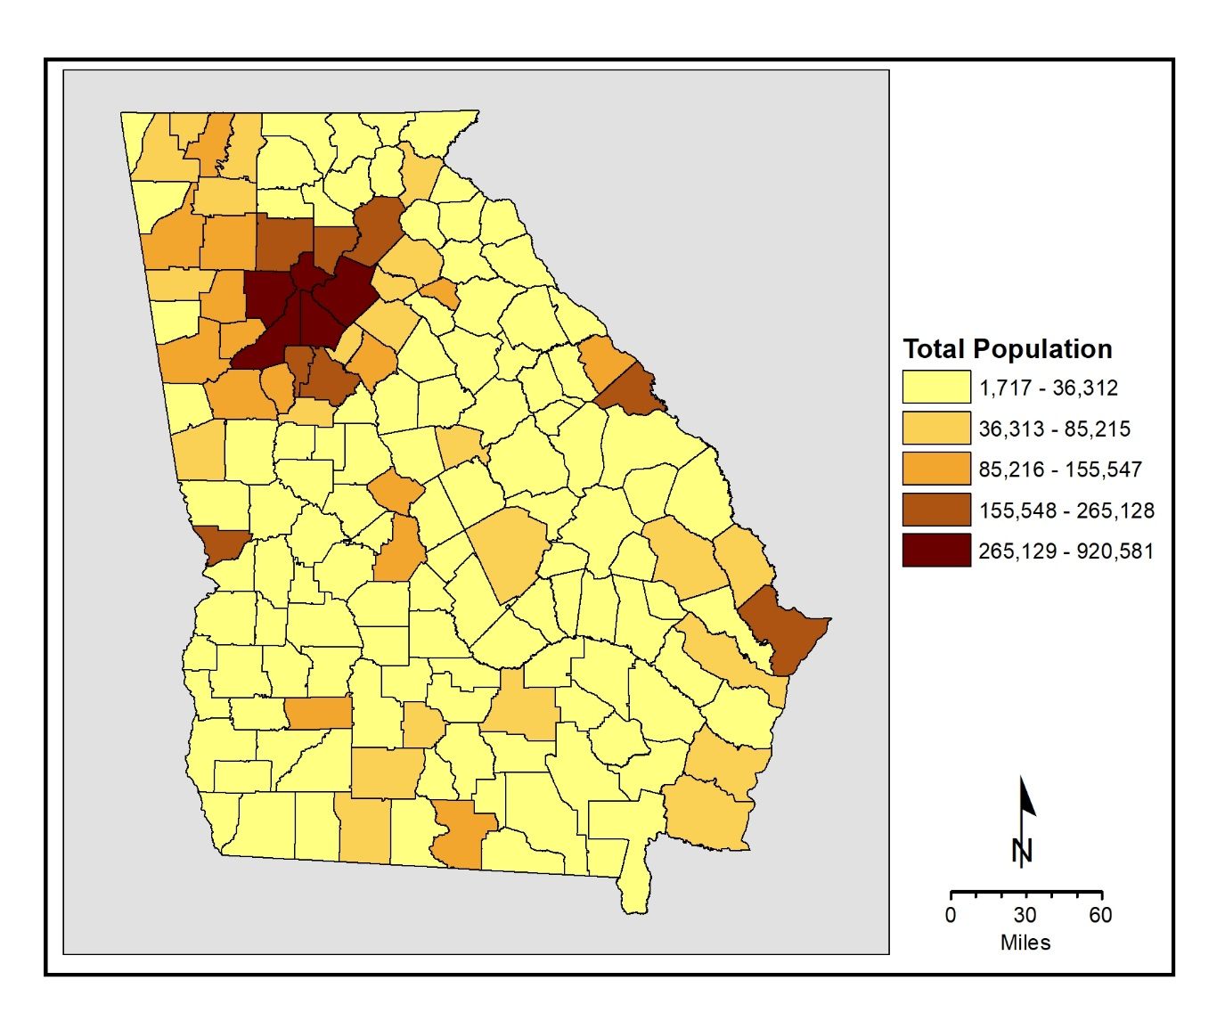
Map 7.6 Natural Breaks Classification: Georgia County Populations, 2010

Slide 29
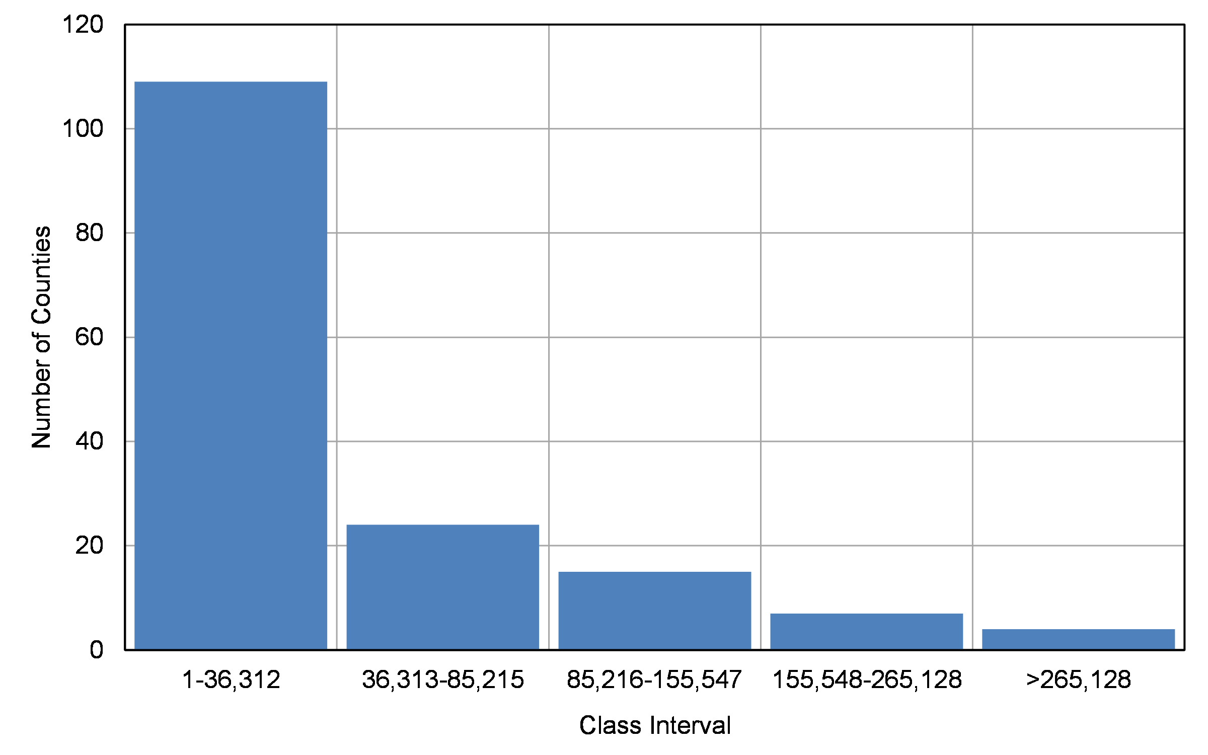
Figure 7.3 Natural Breaks Class Distributions: Georgia County Populations, 2010

Slide 31


Slide 32


Slide 33
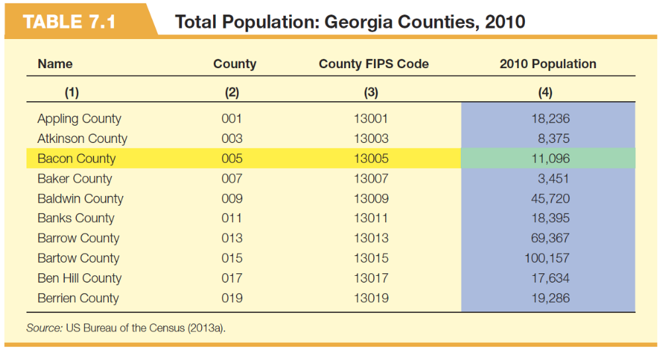

Slide 36


Slide 37


Slide 38
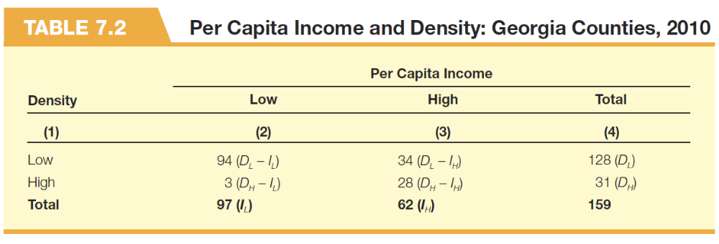

Slide 39
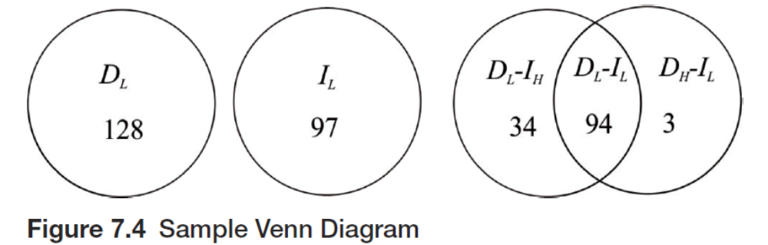

Slide 40
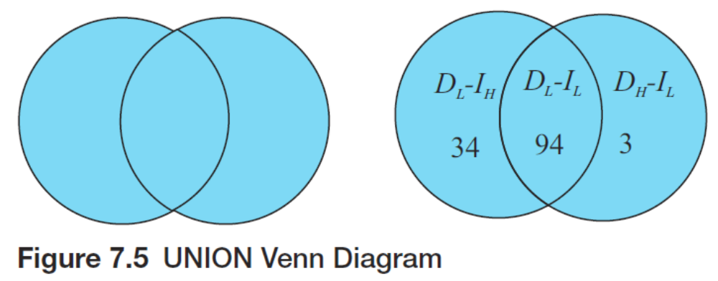

Slide 41
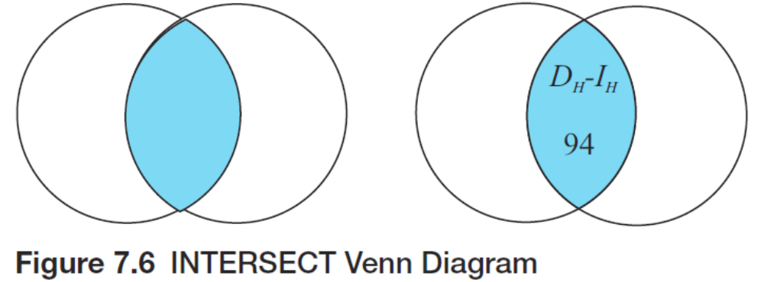

Slide 42
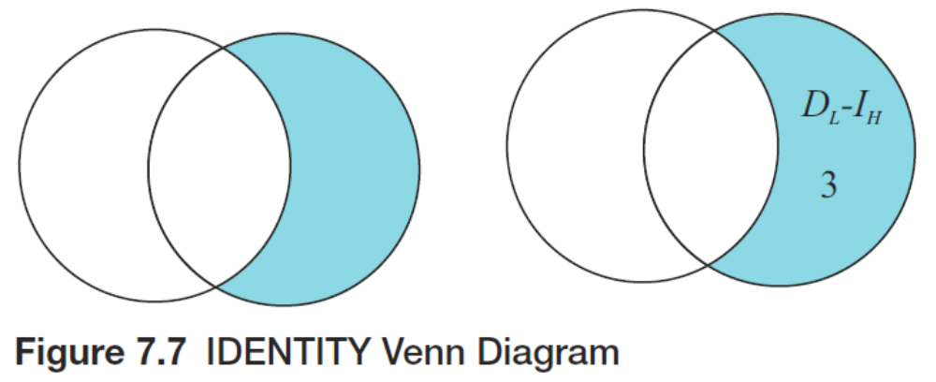

Slide 43
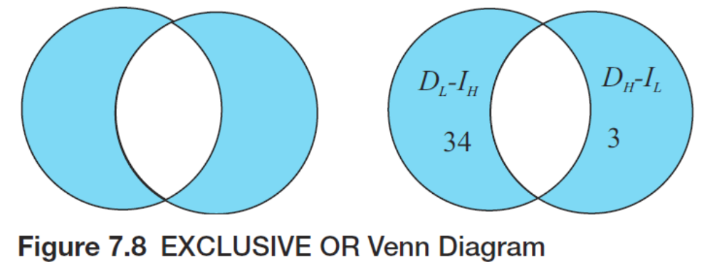

Slide 45


Slide 46


Slide 48


Slide 49


Slide 51
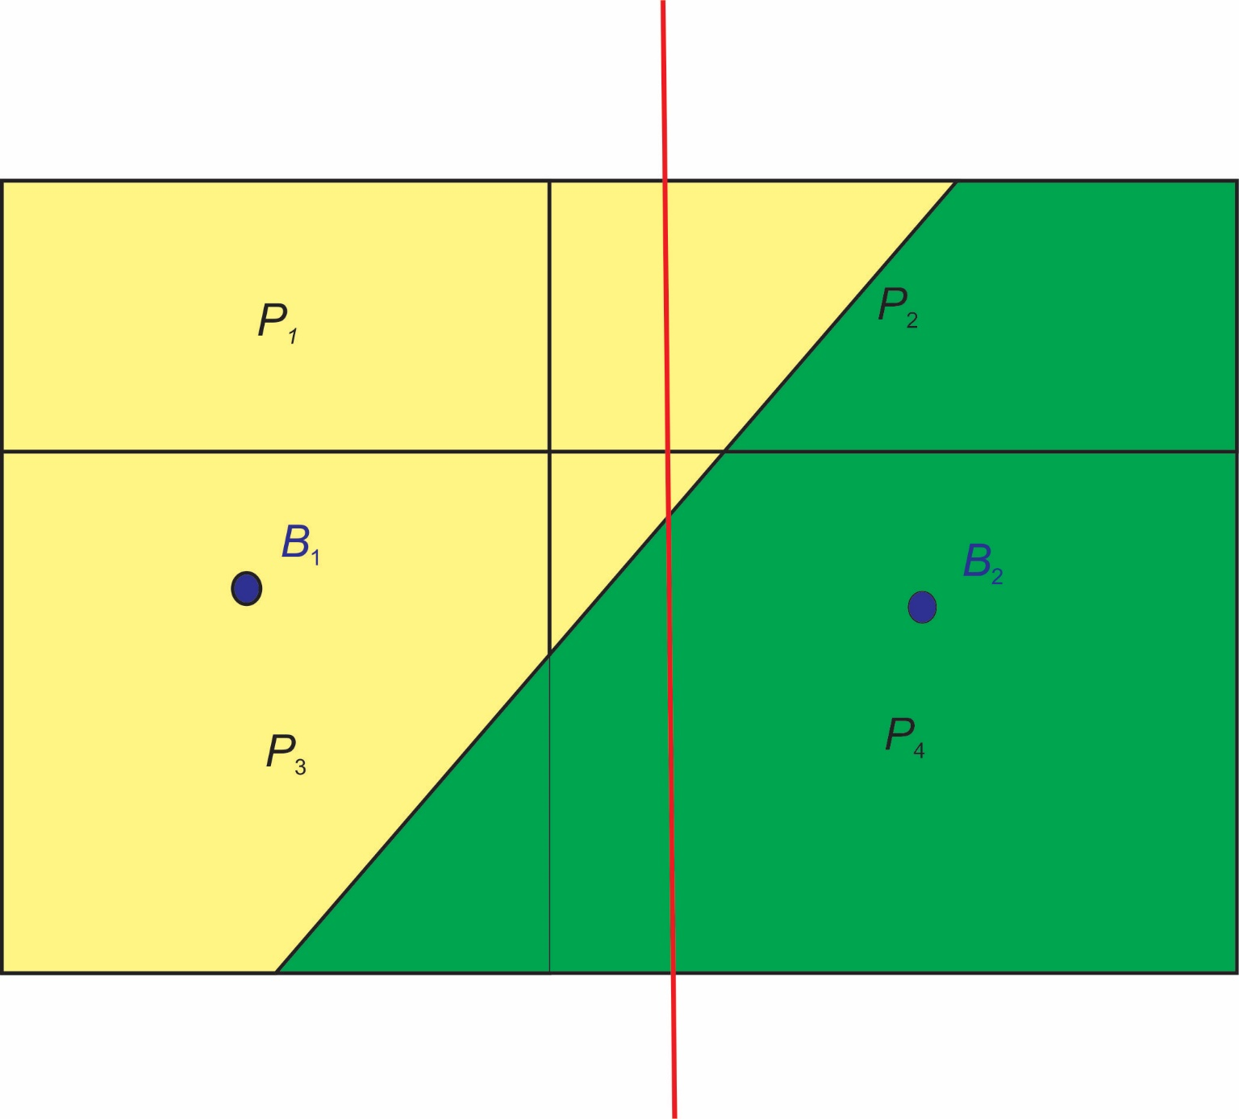
Figure 7.9 Point, Line, and Polygon Overlay

Slide 52
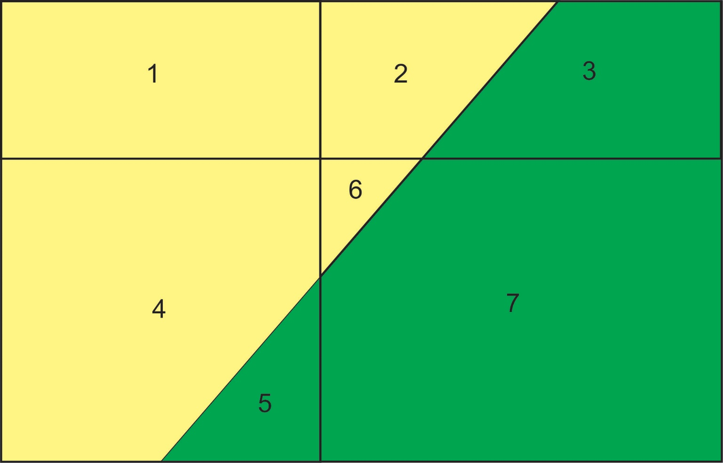
Figure 7.10 Polygon-on-Polygon Overlays

Slide 53


Slide 54


Slide 55


Slide 56
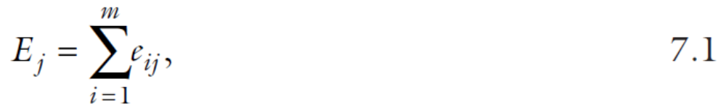

Slide 57
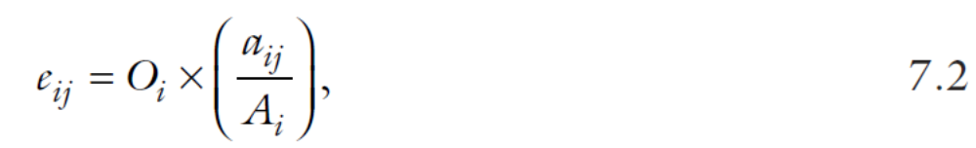

Slide 58
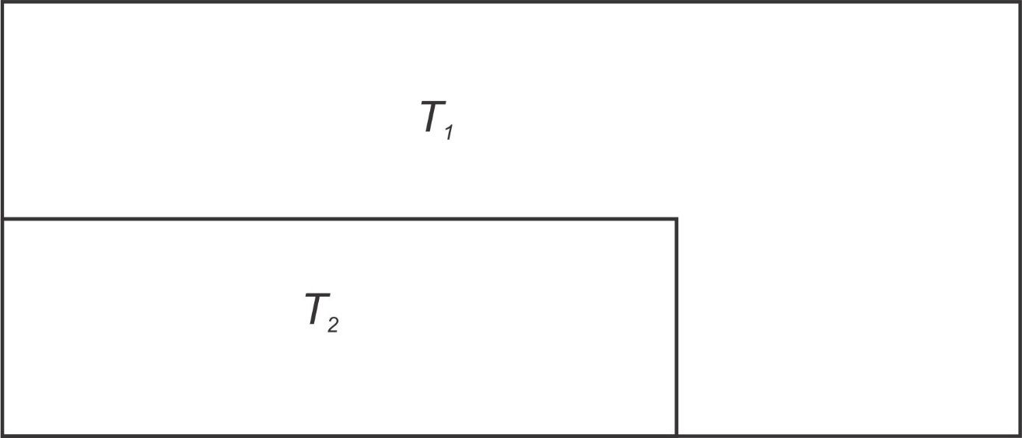
Figure 7.11 Census Tract Layer

Slide 59
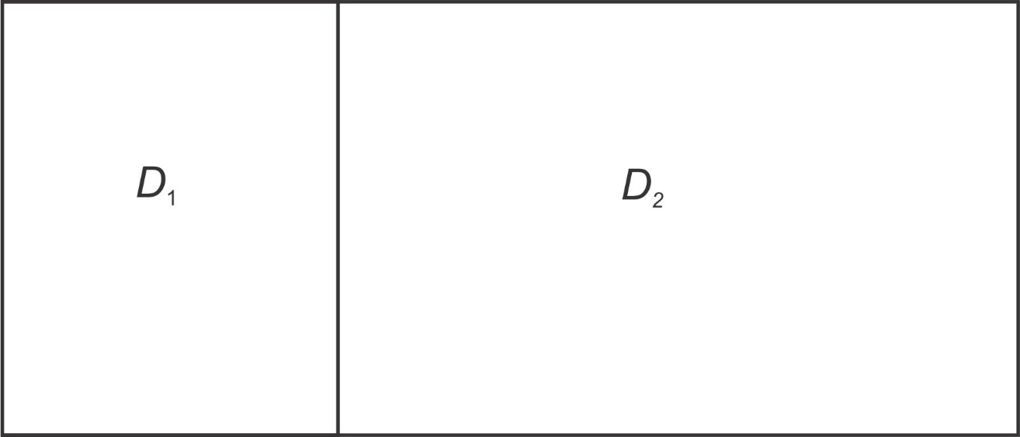
Figure 7.12 School District Layer

Slide 60
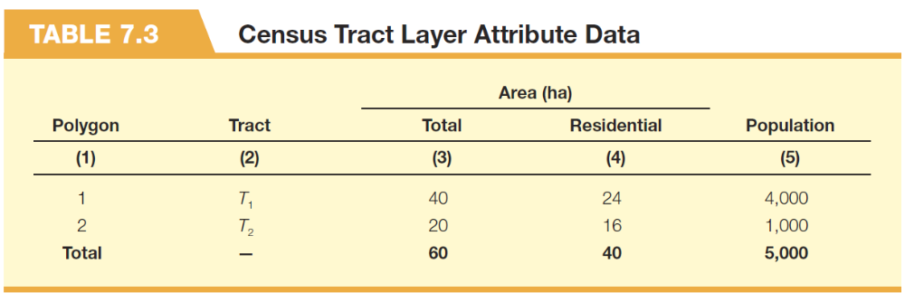

Slide 61
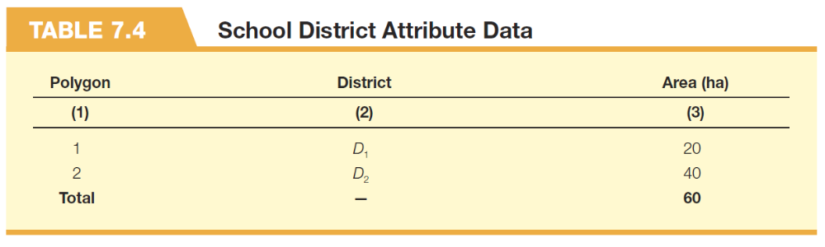

Slide 62
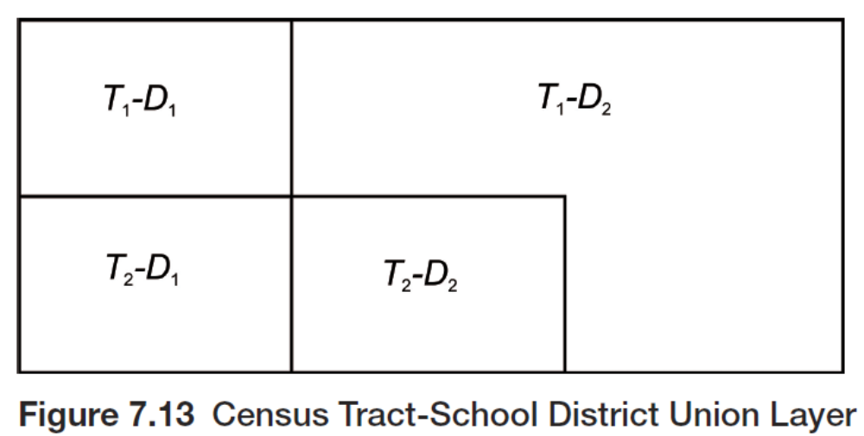

Slide 63
