Slide 4


Slide 5
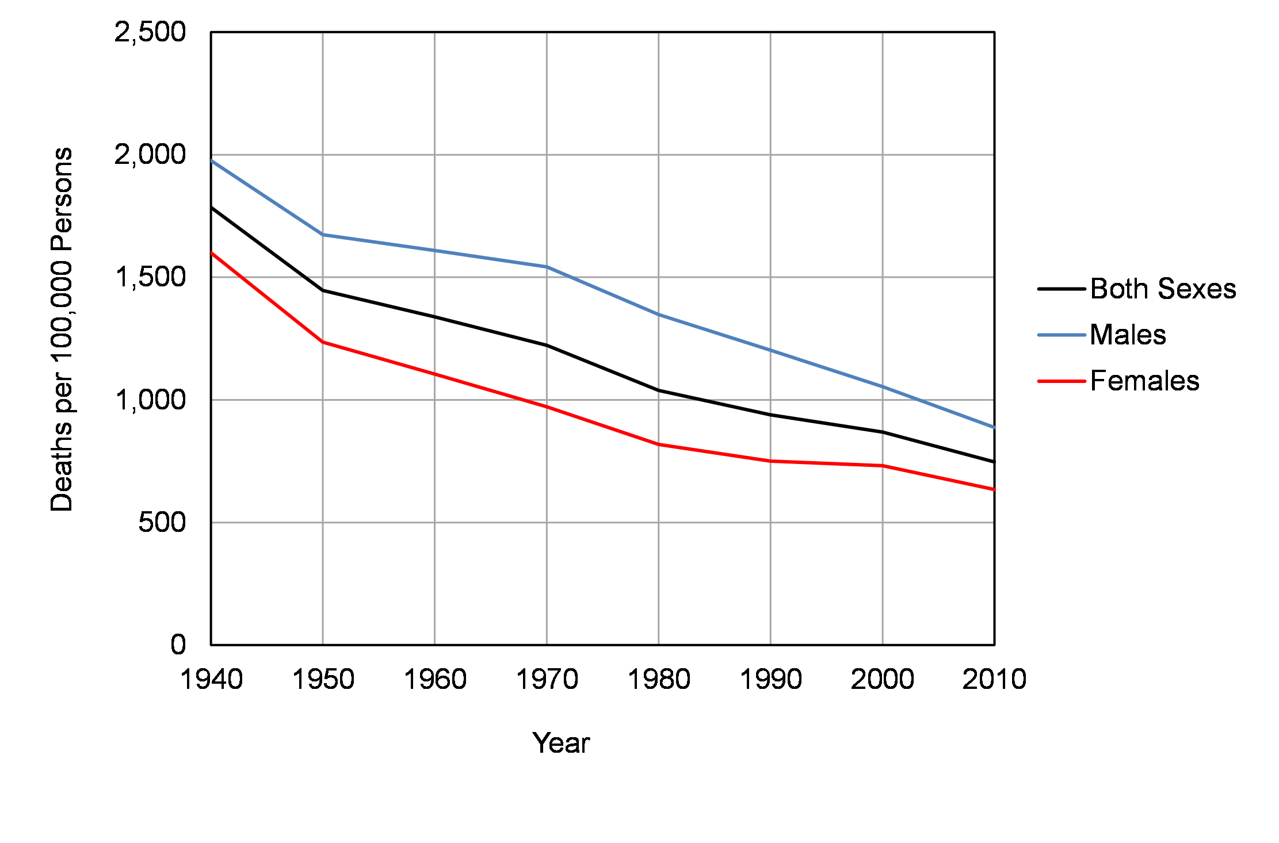
Figure 5.1 Trends in Age-adjusted Mortality Rates, United States, 1940 to 2010

Slide 6
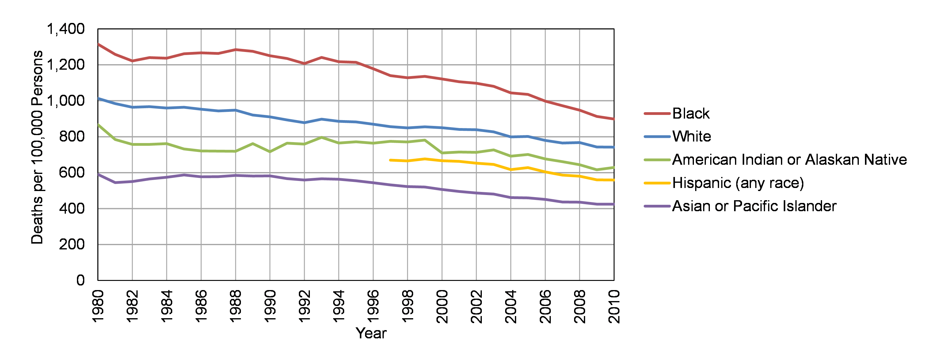
Figure 5.2 Mortality Rates by Race and Ethnicity: United States, 1980 to 2010

Slide 7


Slide 8
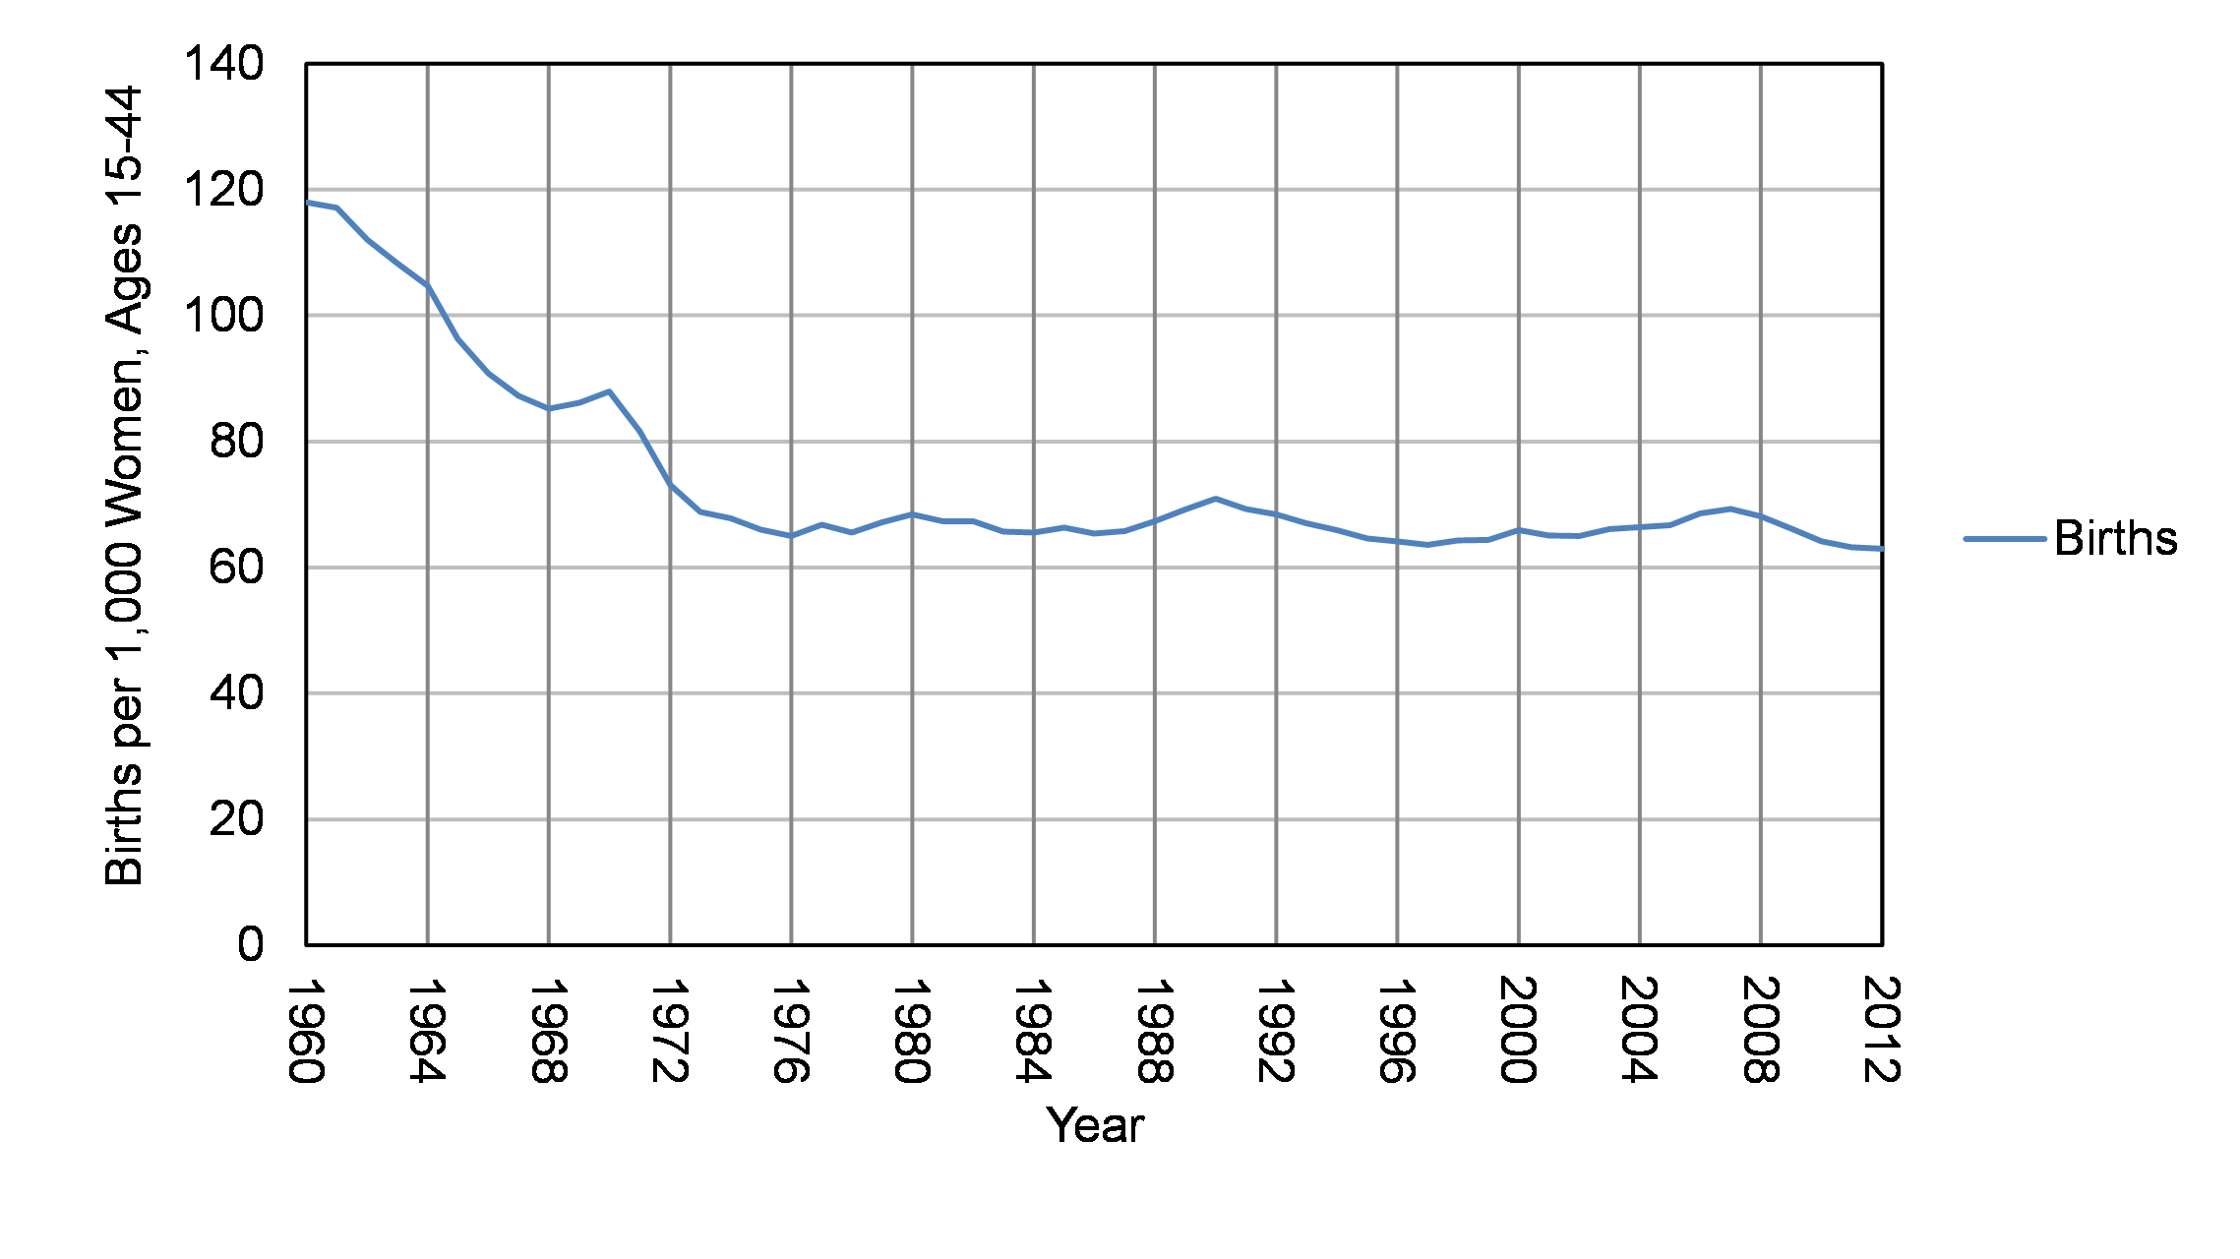
Figure 5.3 Total Fertility Rate: United States, 1960 to 2012

Slide 9
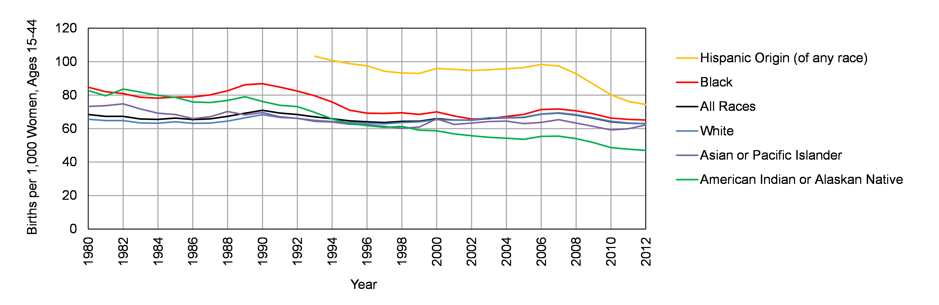
Figure 5.4 Total Fertility Rates by Race: United States, 1980 to 2012

Slide 10


Slide 11
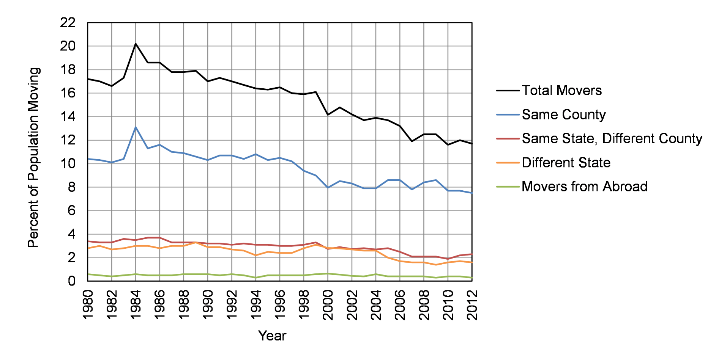
Figure 5. 5 Percent of Migrants by Age: United States, 1980 to 2012

Slide 12
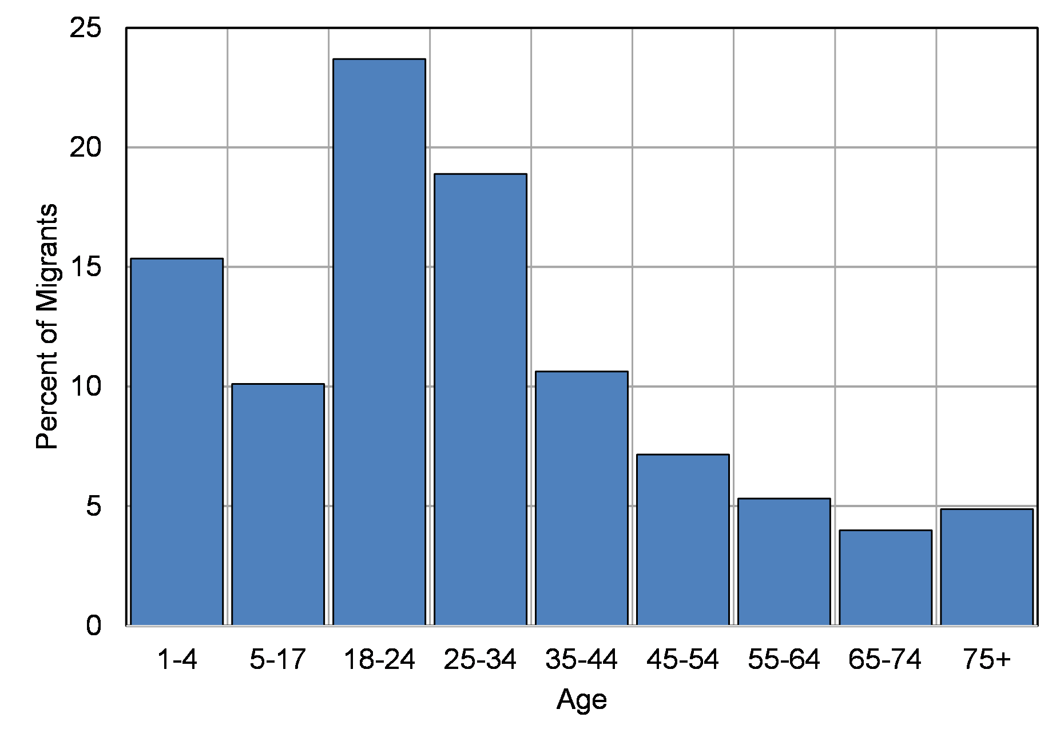
Figure 5.6 Age of Migrants: United States, 2012

Slide 14


Slide 16
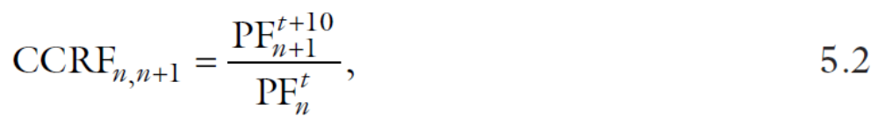

Slide 17
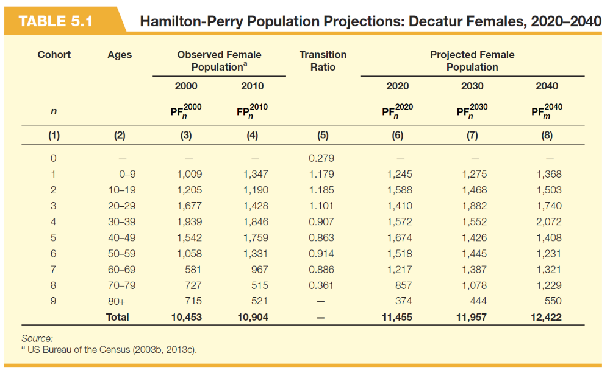

Slide 19
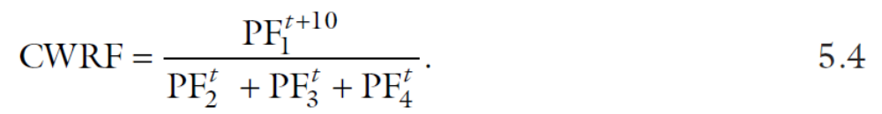

Slide 21
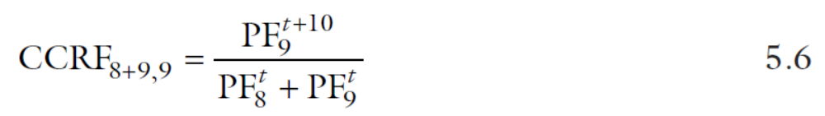

Slide 22
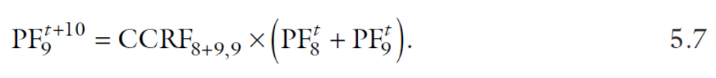

Slide 24
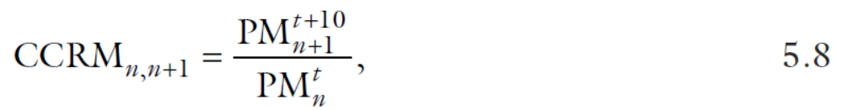

Slide 25
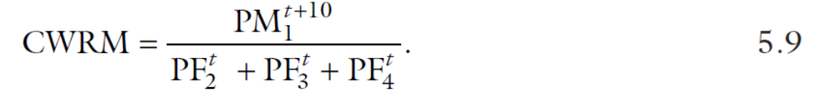

Slide 27
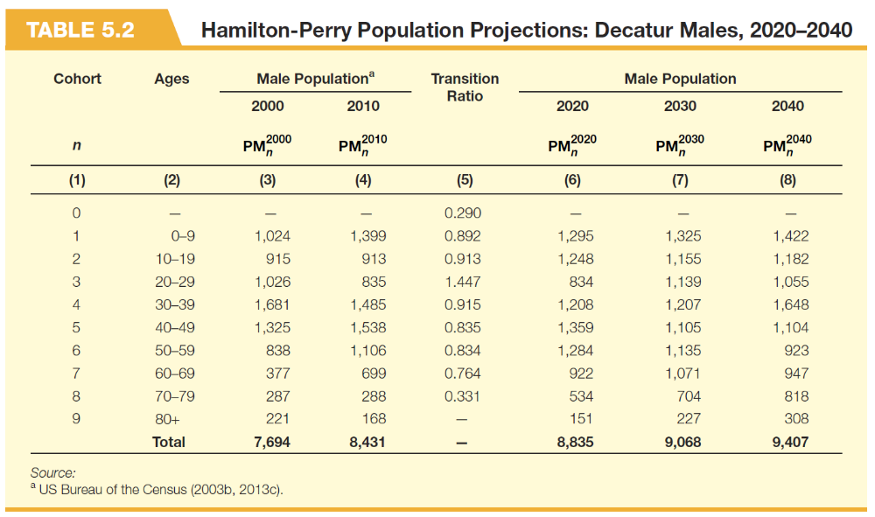

Slide 28
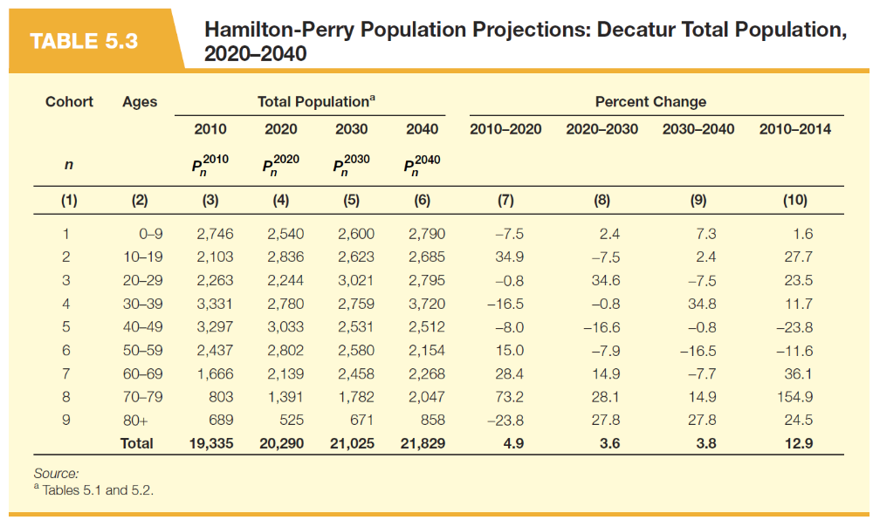

Slide 29
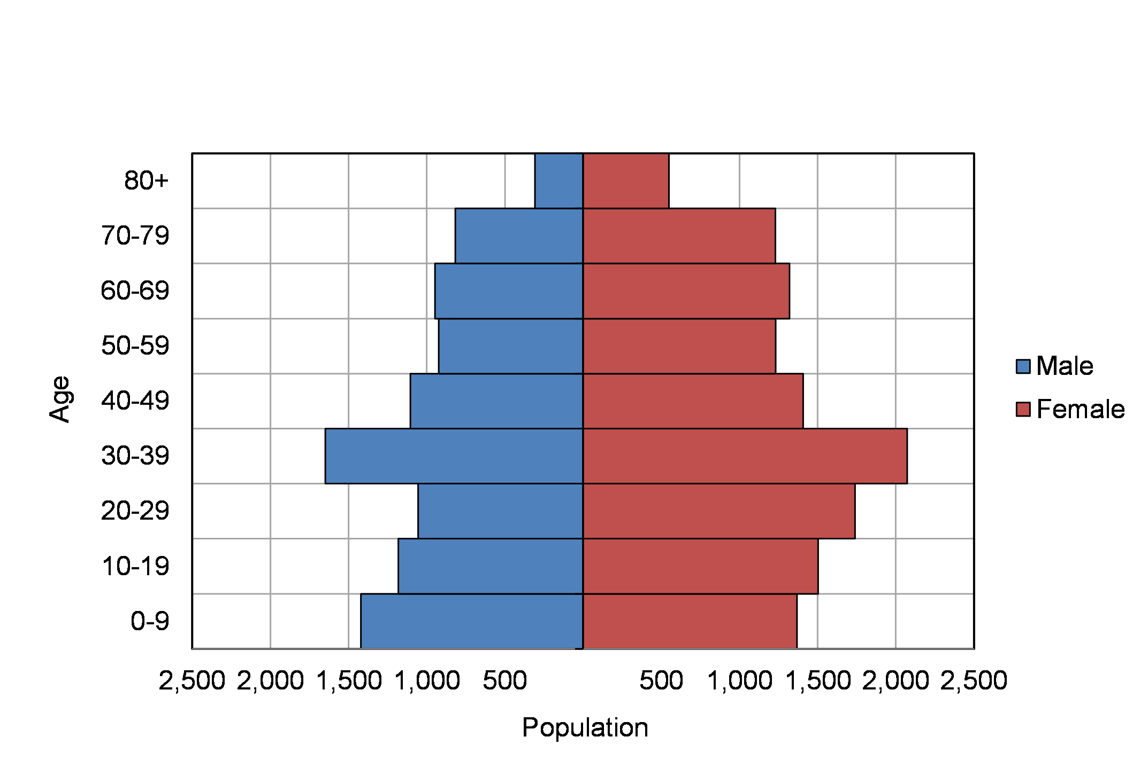
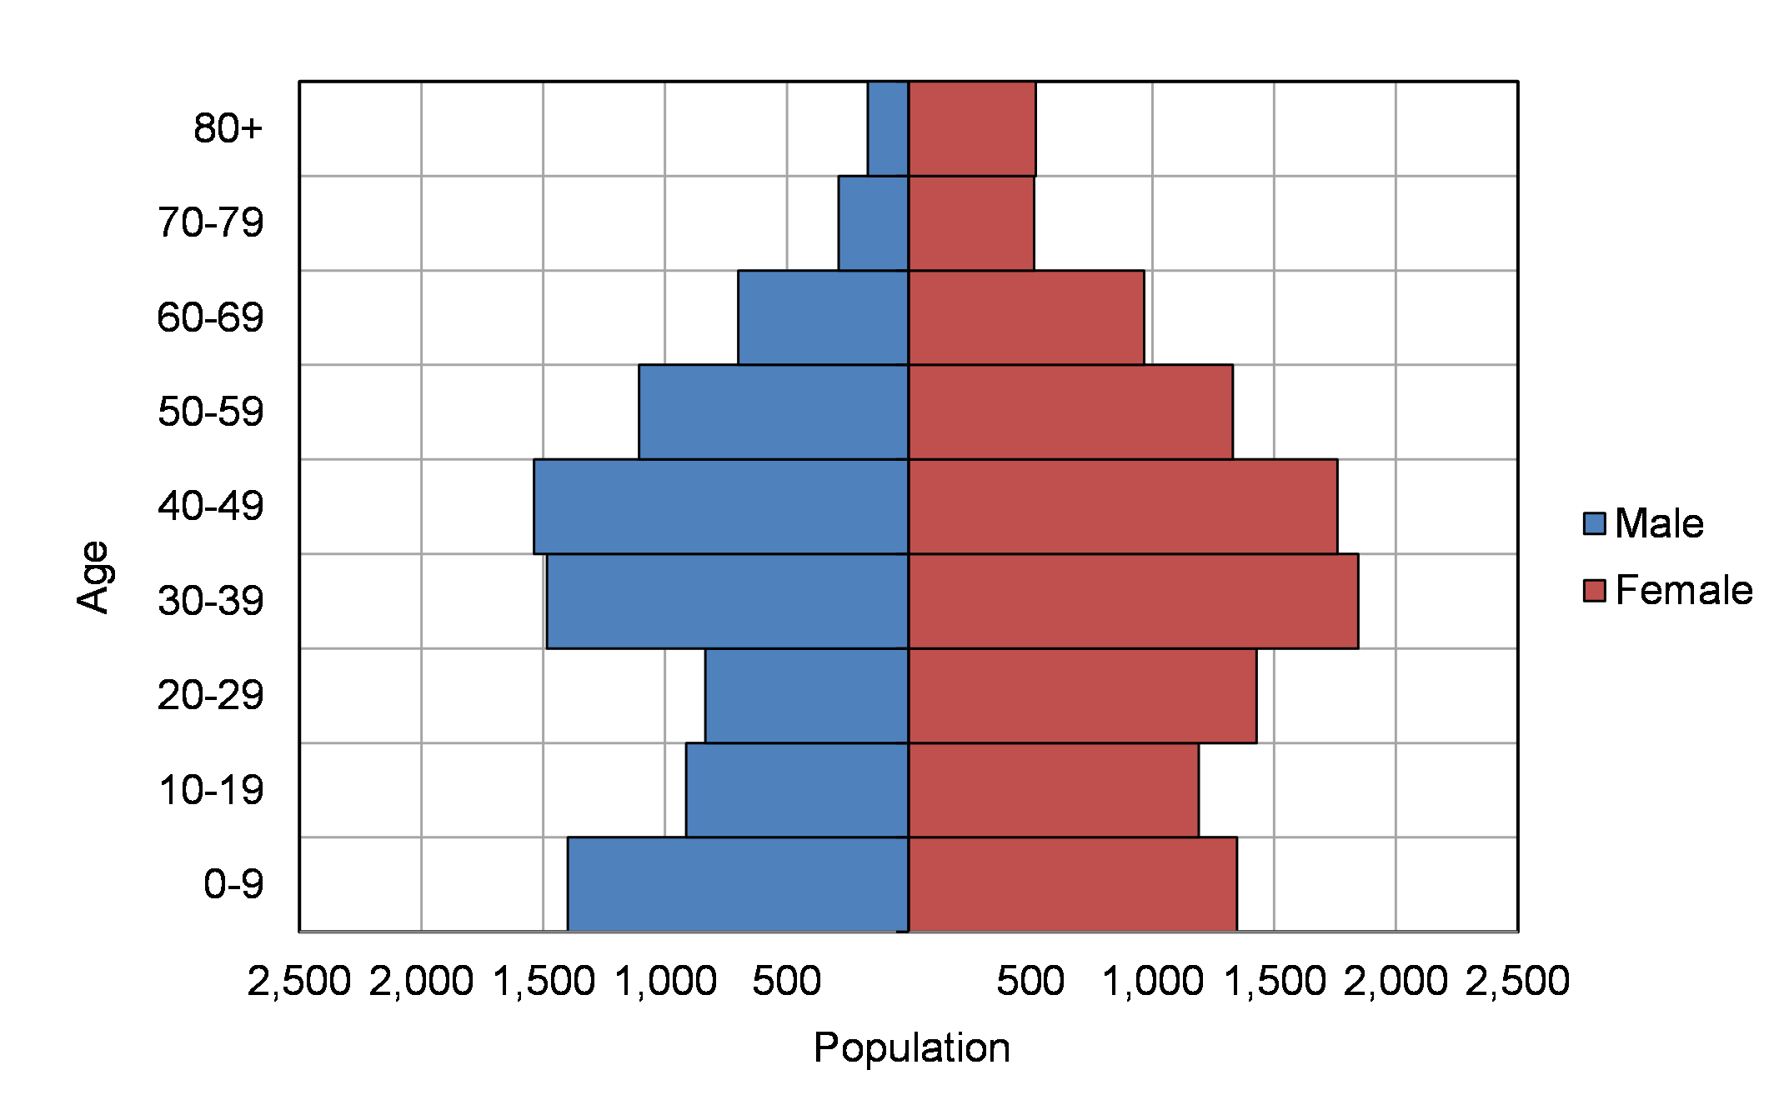
(a) 2010 Population
(b) 2040 Population
Figure 5.7 Population Pyramids: Decatur 2010 and 2040

Slide 31


Slide 32


Slide 33
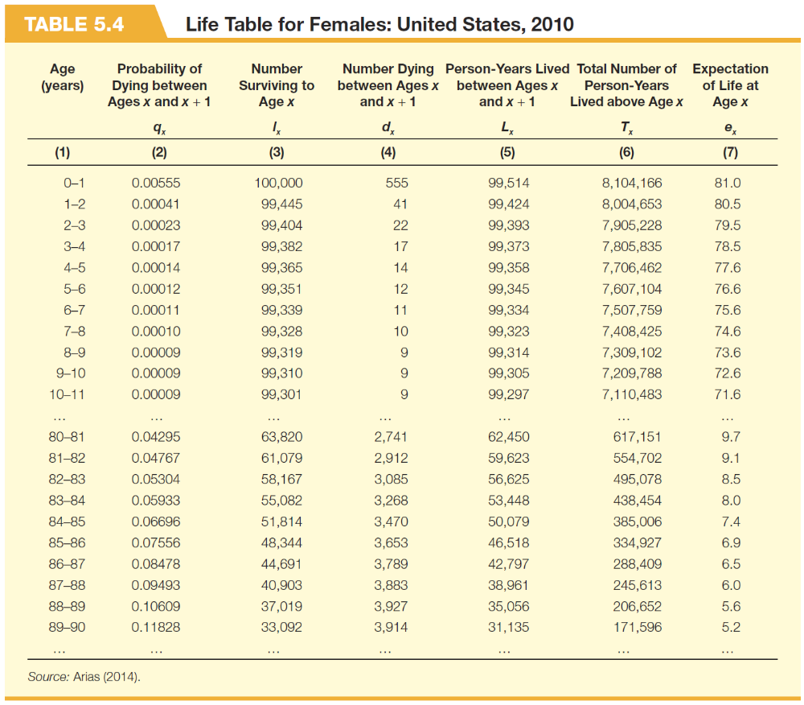

Slide 35
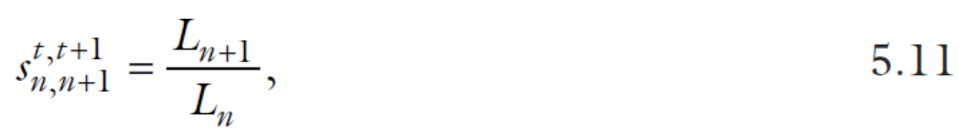

Slide 36
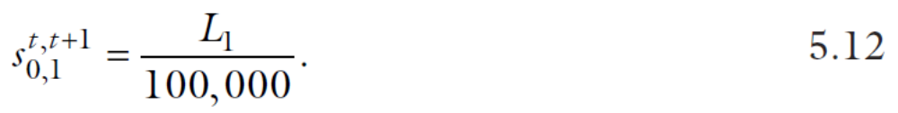

Slide 37
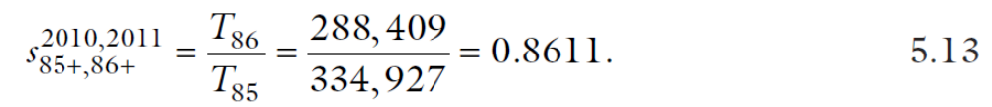

Slide 39
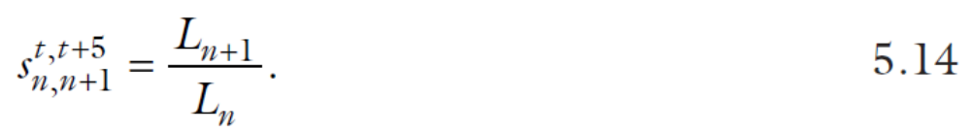

Slide 40
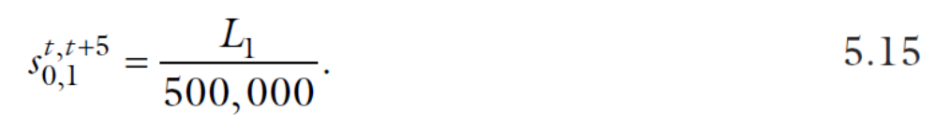

Slide 41
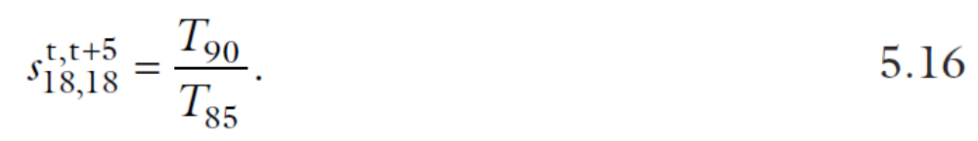

Slide 42
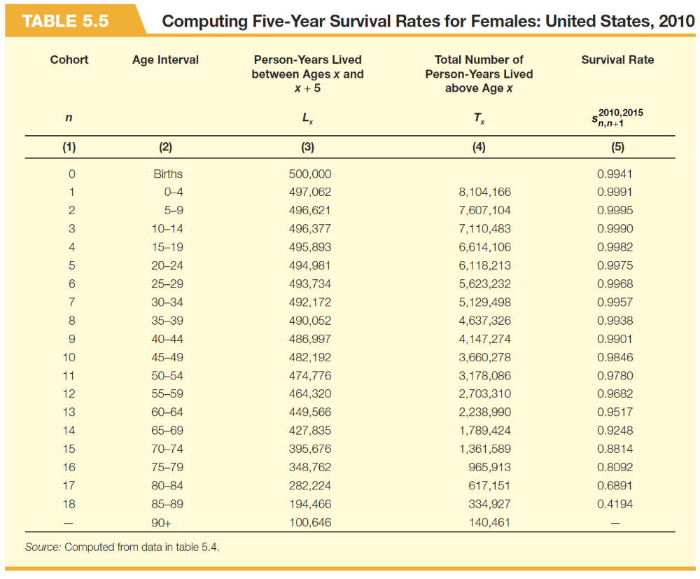

Slide 43


Slide 45
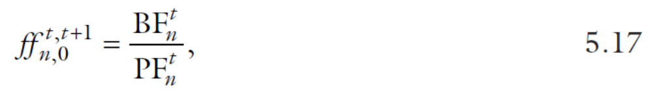

Slide 46
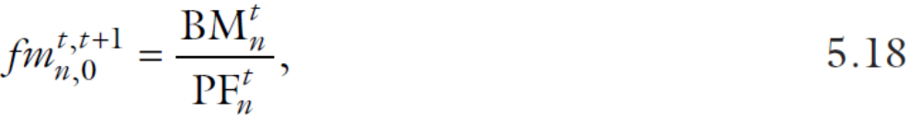

Slide 47
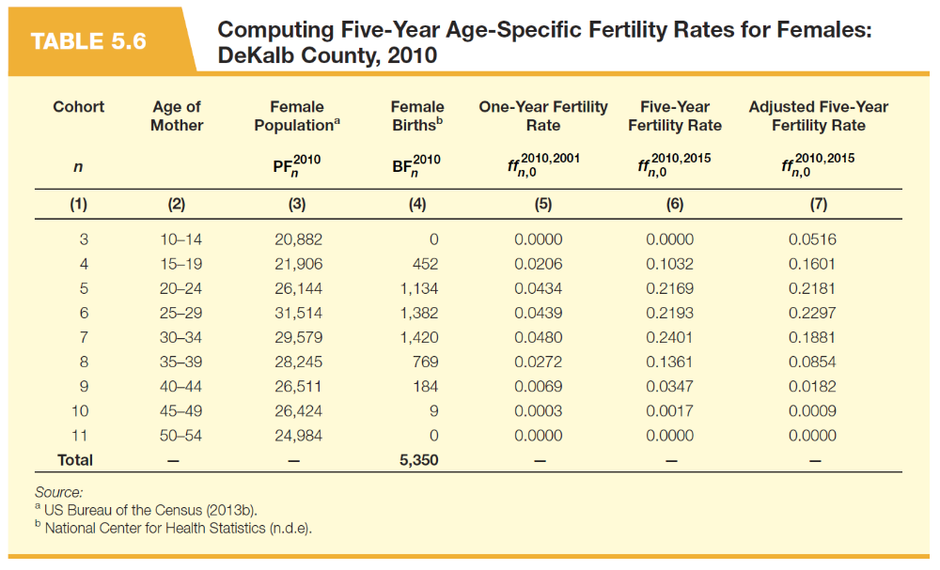

Slide 48
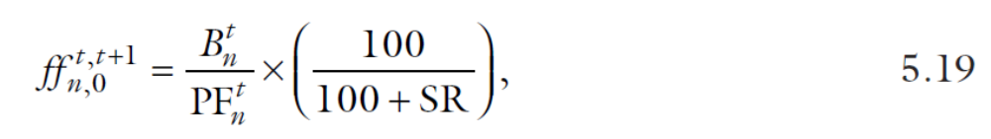

Slide 49
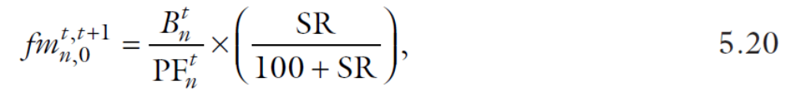

Slide 50


Slide 54
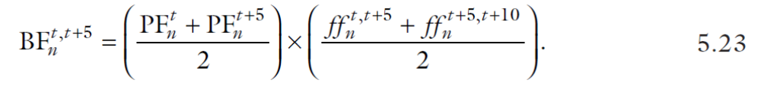

Slide 55
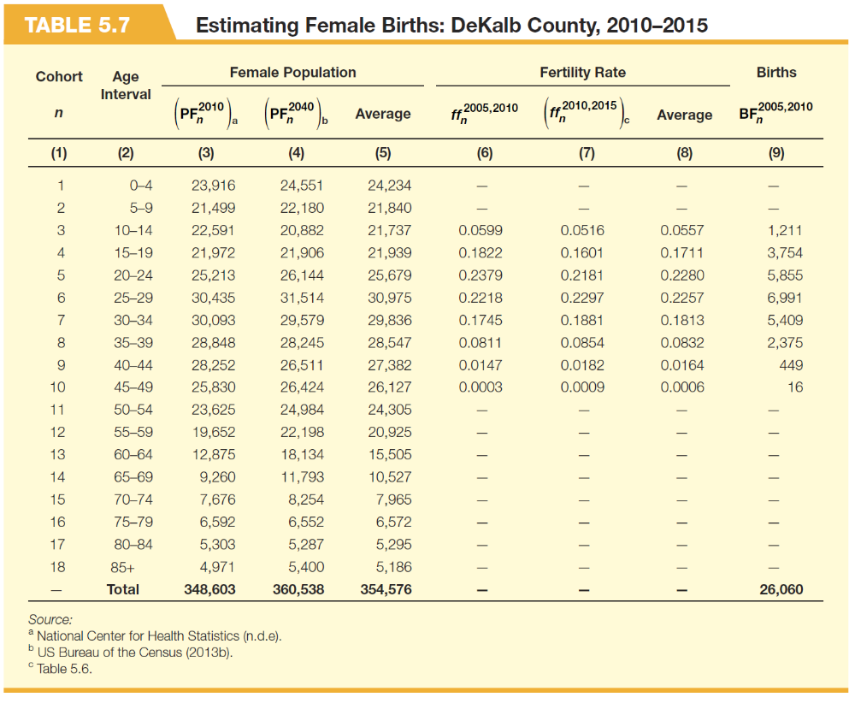

Slide 56
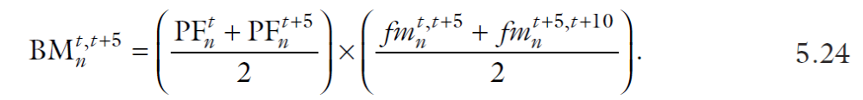

Slide 60
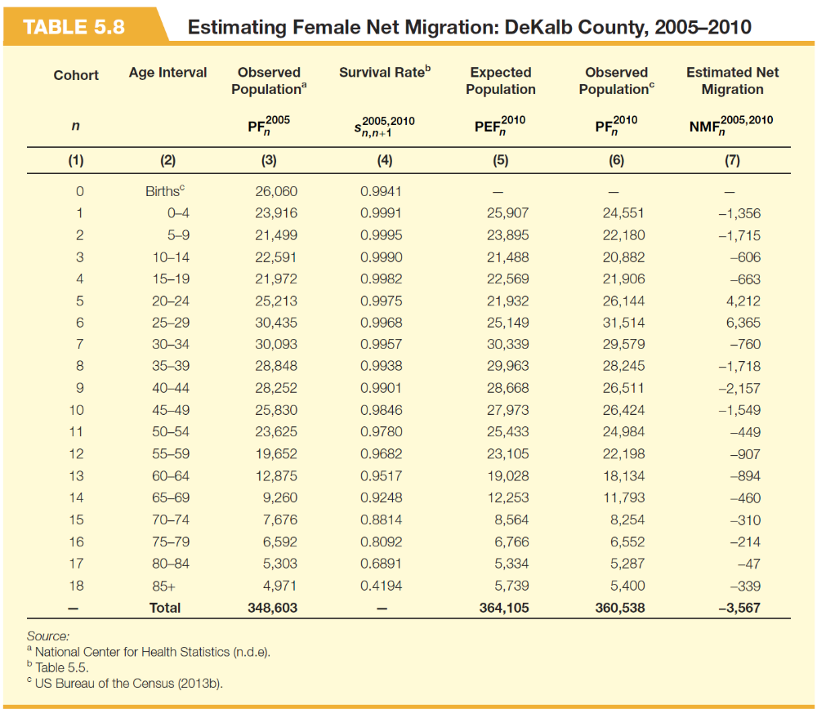

Slide 61
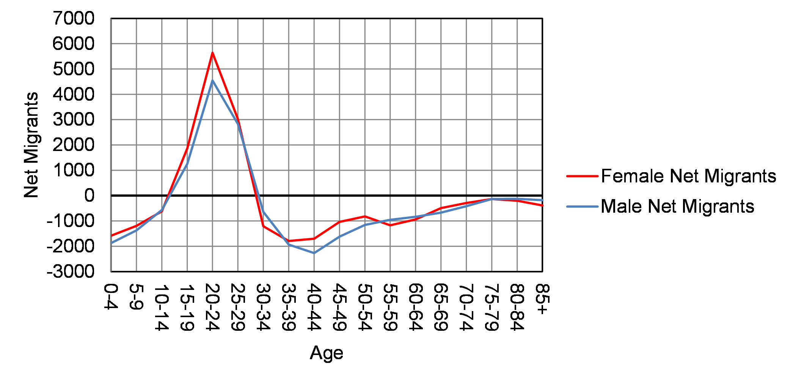
Figure 5.8 Estimated Male and Female Net Migration: DeKalb County, 2010 to 2015

Slide 62
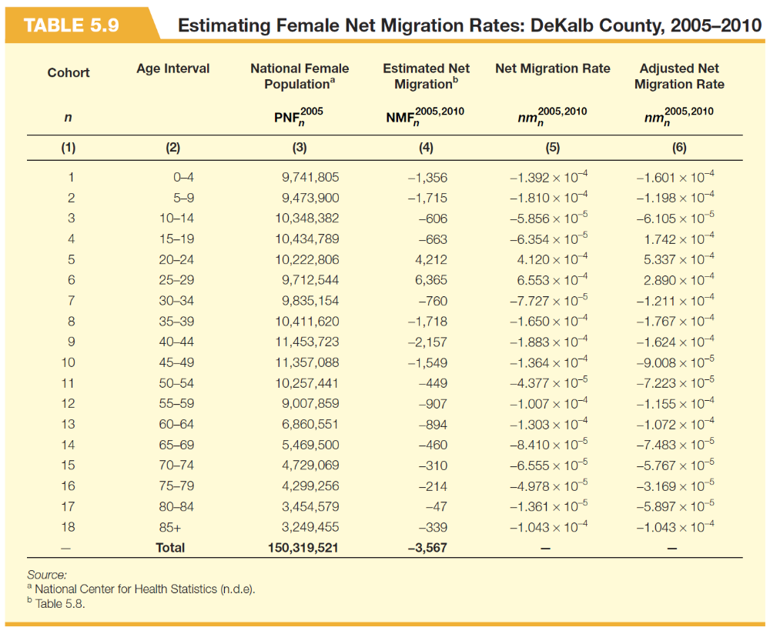

Slide 63


Slide 67
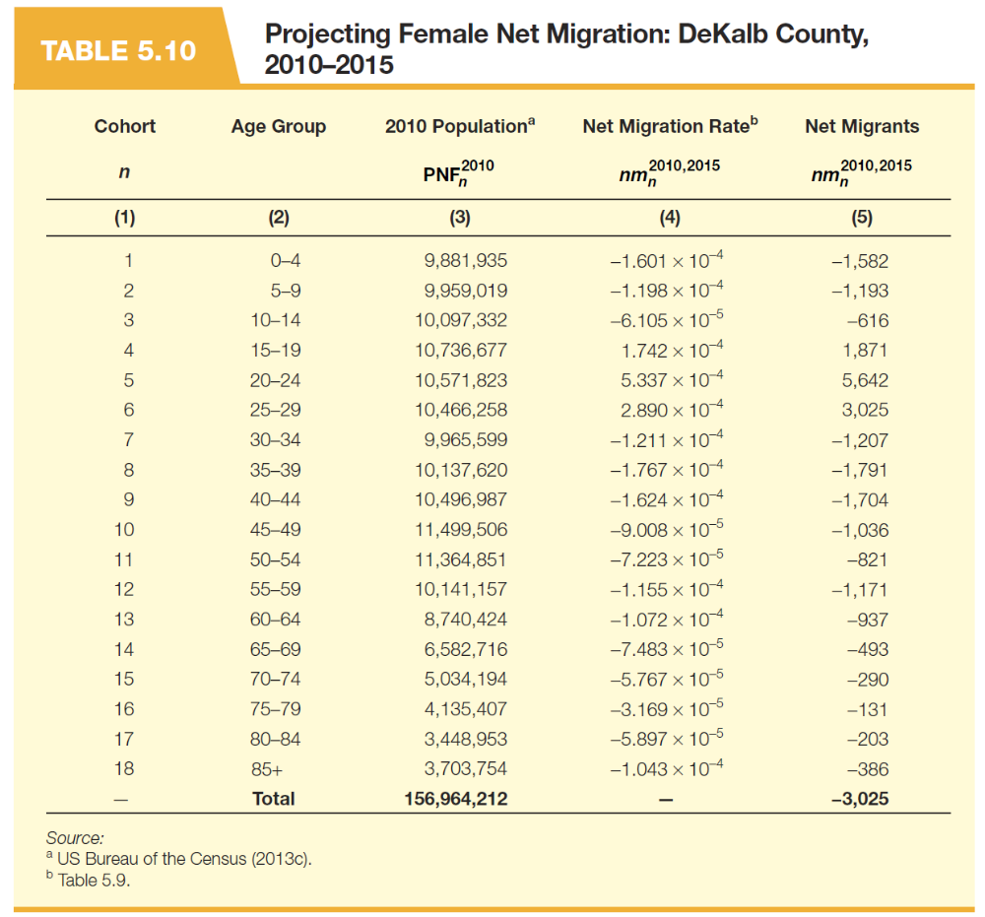

Slide 70
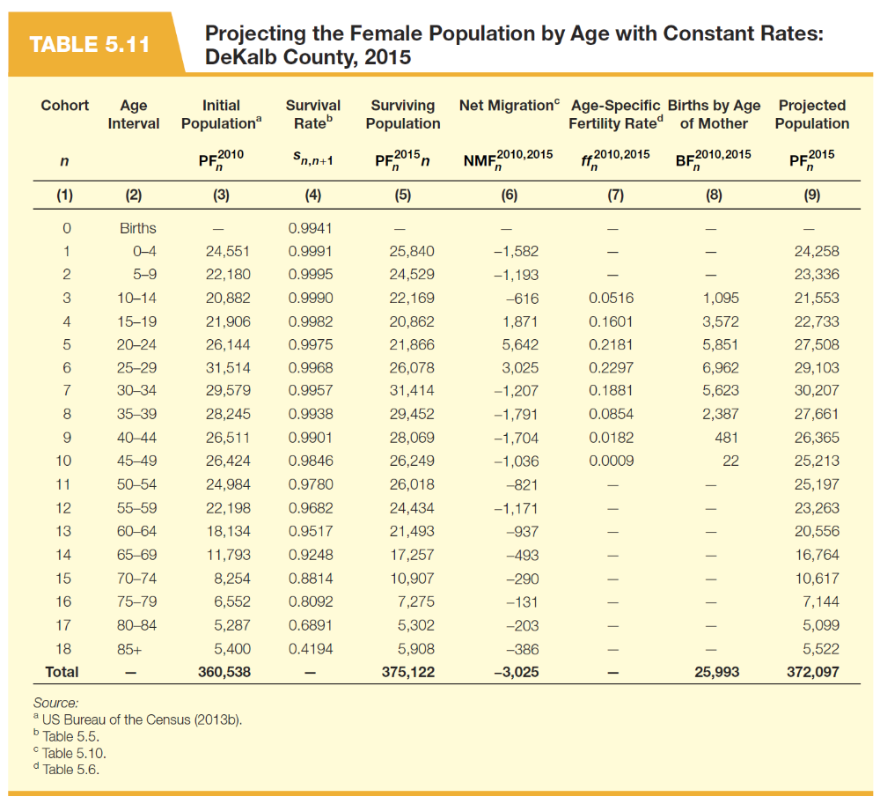

Slide 71
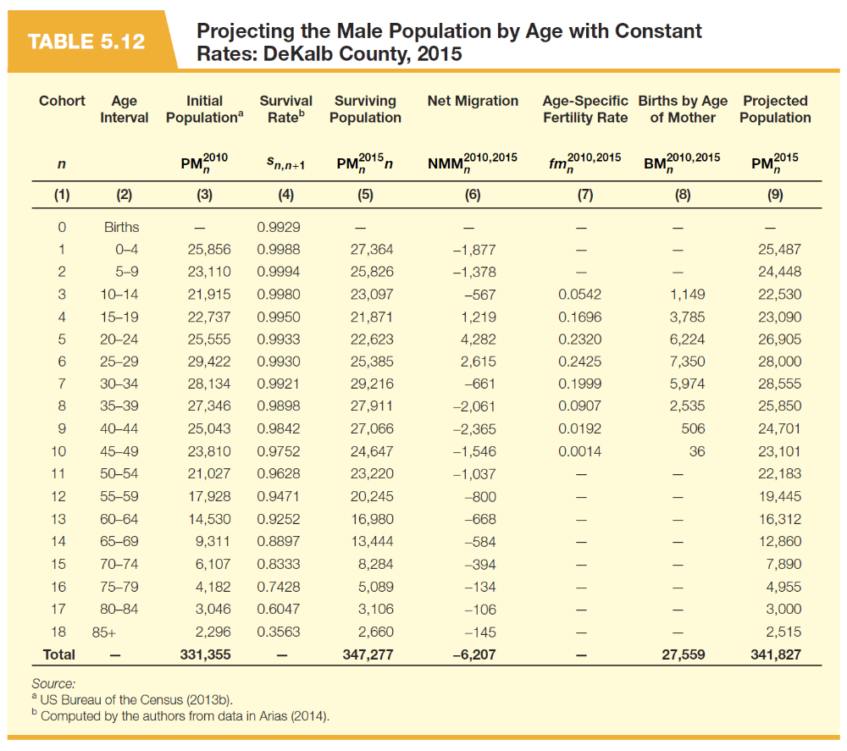

Slide 72
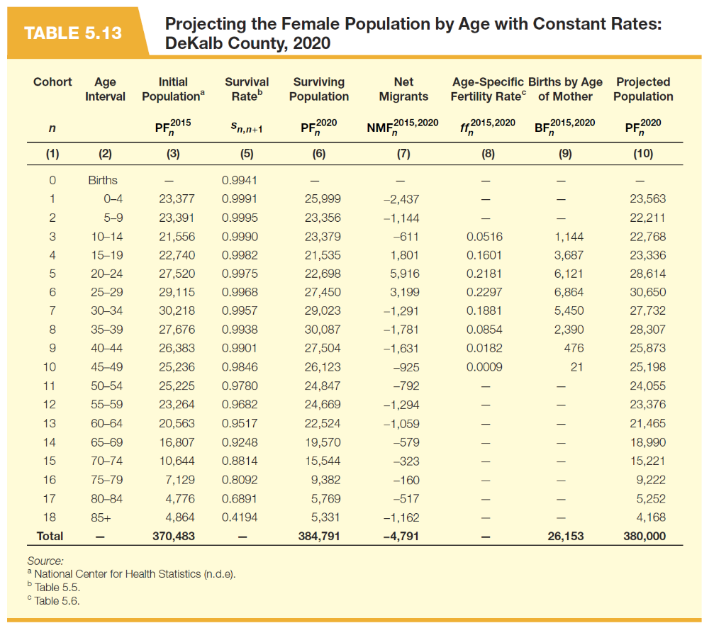

Slide 75
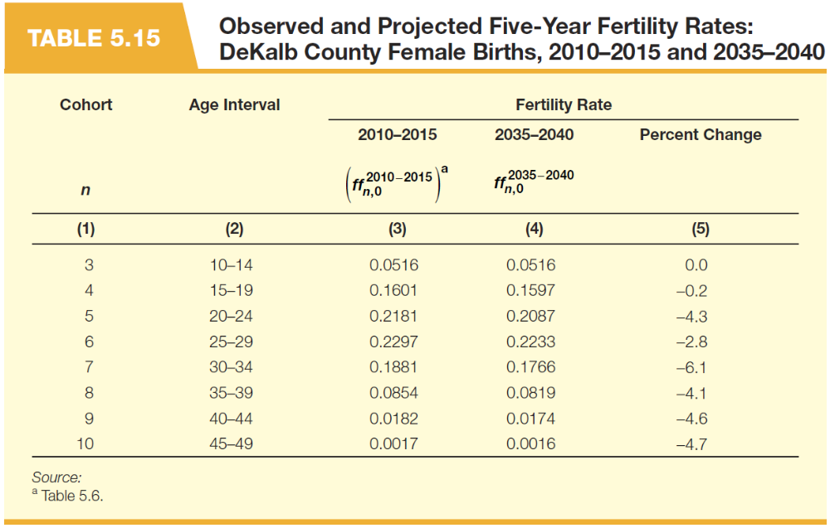

Slide 79
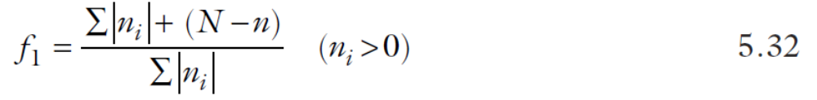

Slide 86
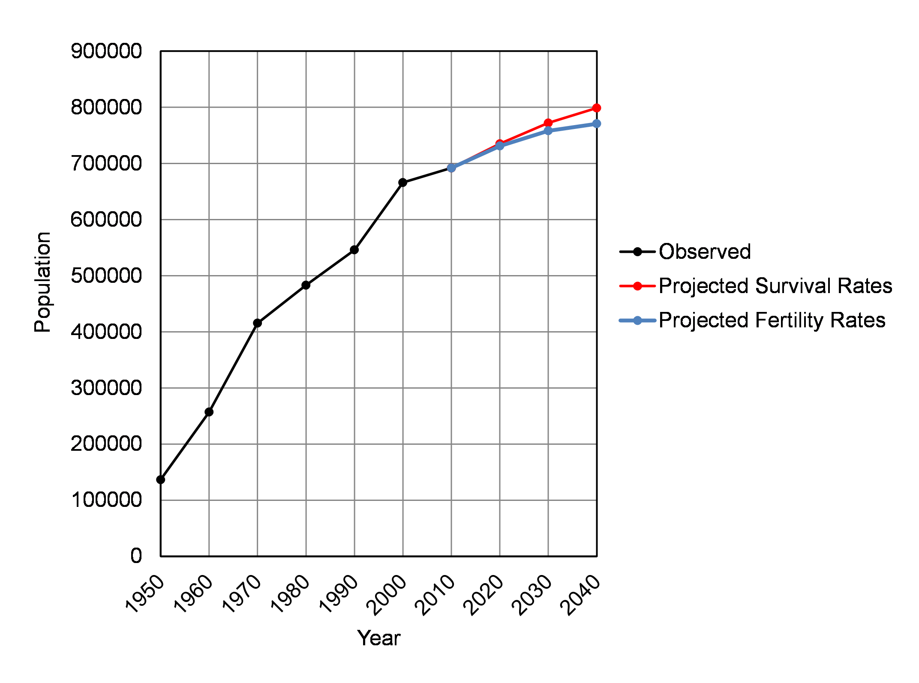
Figure 5.9 Observed and Projected Population: DeKalb County, 1950 to 2040

Slide 88
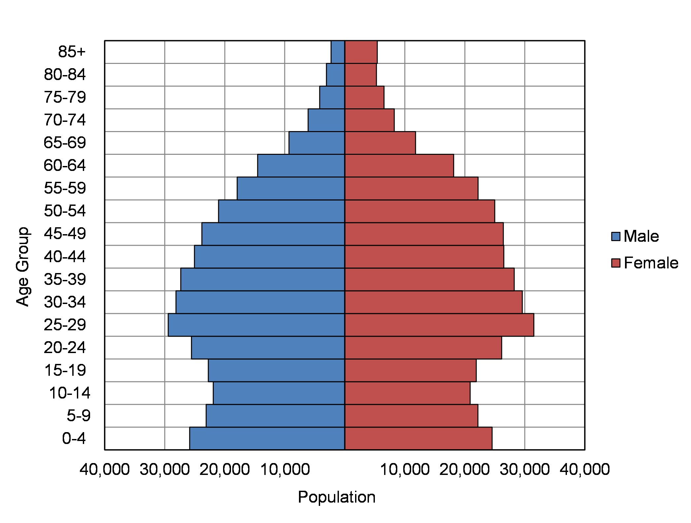
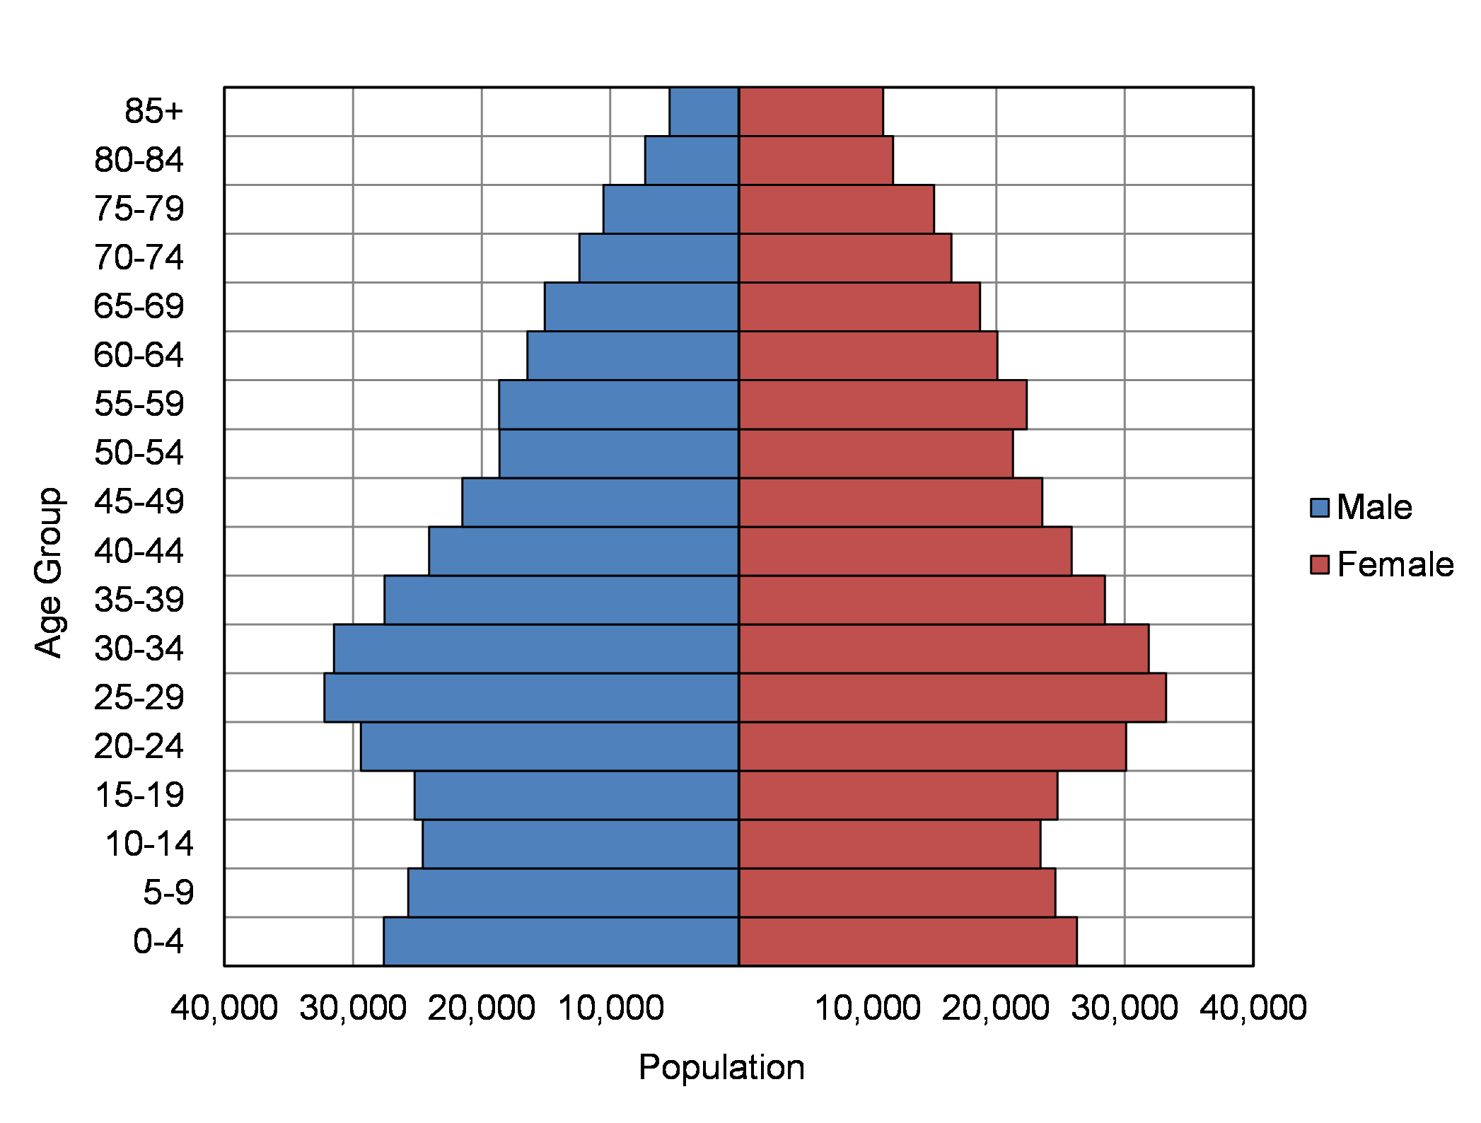
(a) 2010 Population
(b) 2040 Population
Figure 5.10 Observed and Projected Population by Age and Sex: Constant Rates Projection, DeKalb County, 2010 and 2040

Slide 89
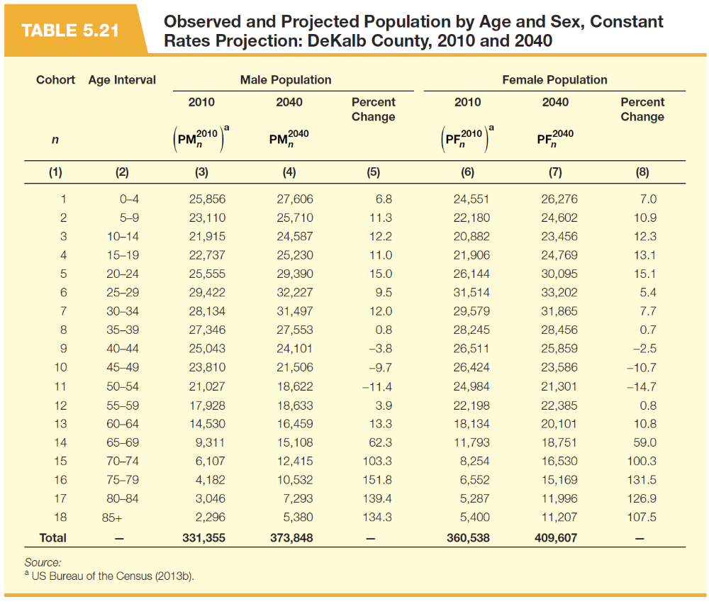

Slide 91
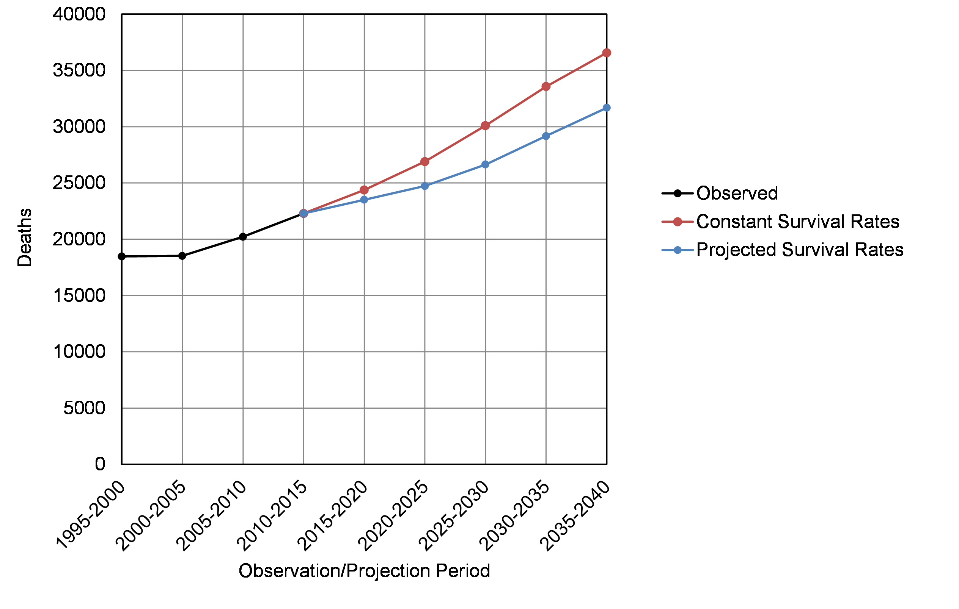
Figure 5.11 Observed and Projected Deaths: DeKalb County, 1995 to 2040

Slide 92
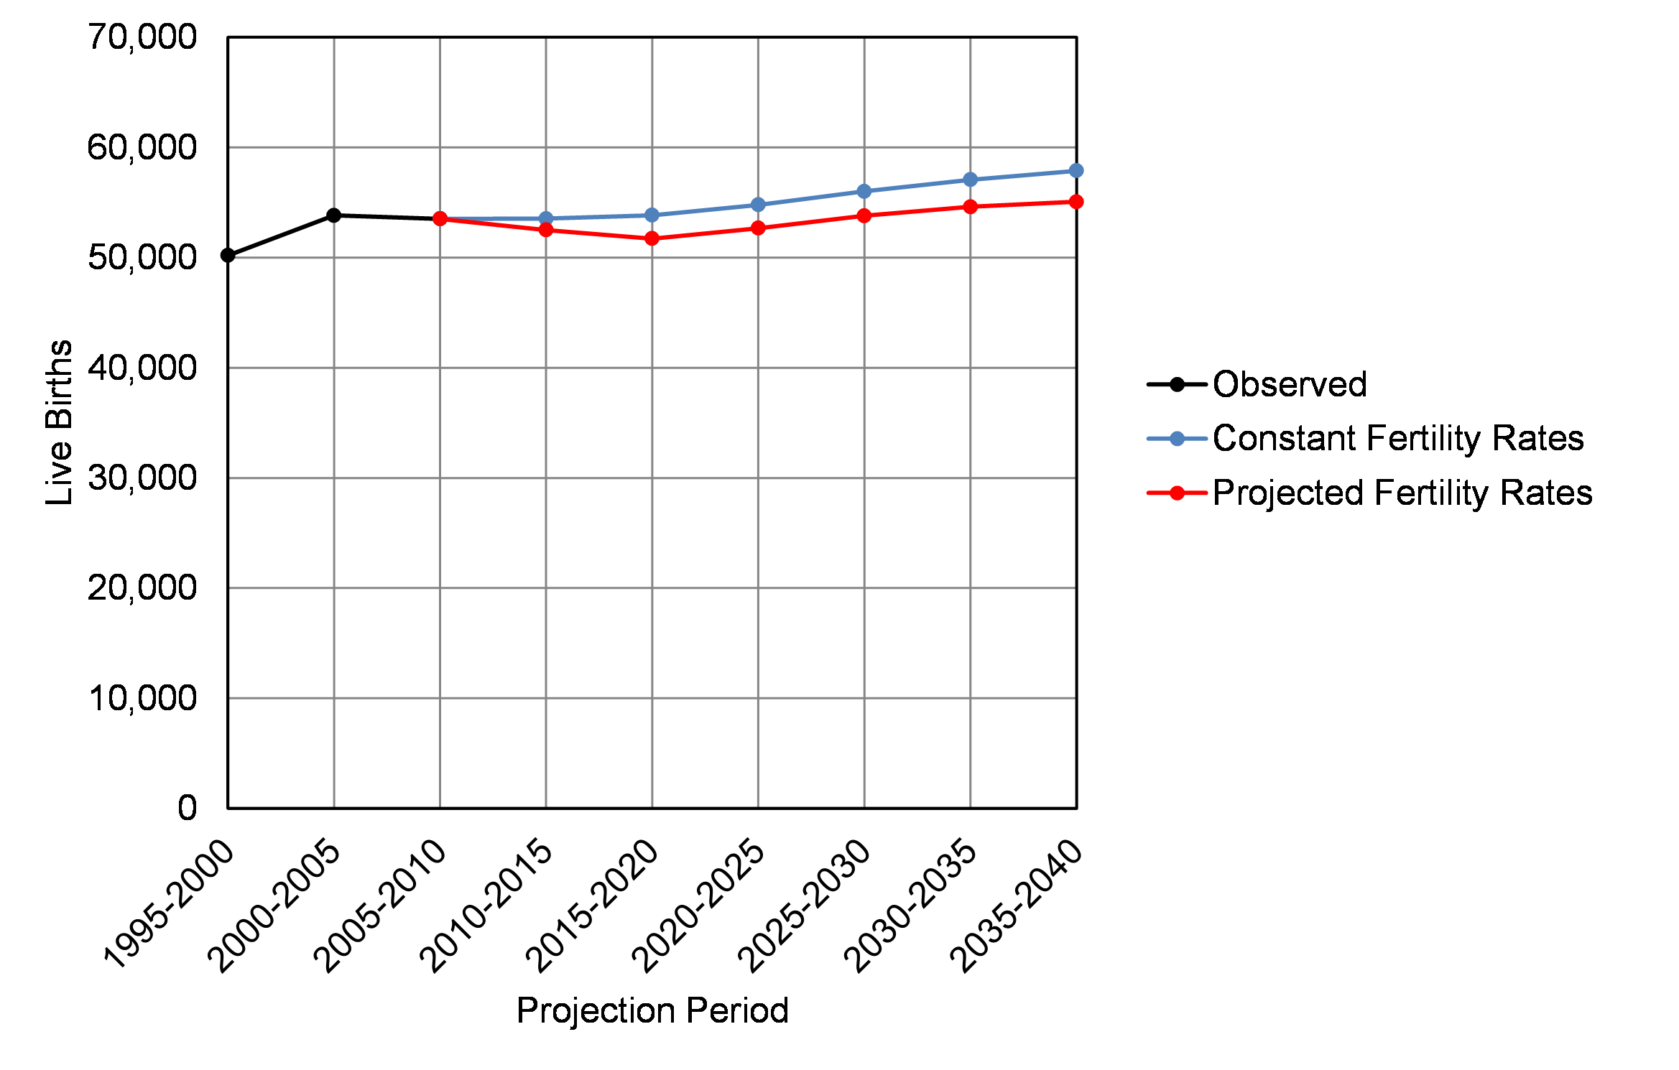
Figure 5.12 Observed and Projected Live Births: DeKalb County, 2005 to 2040

Slide 93
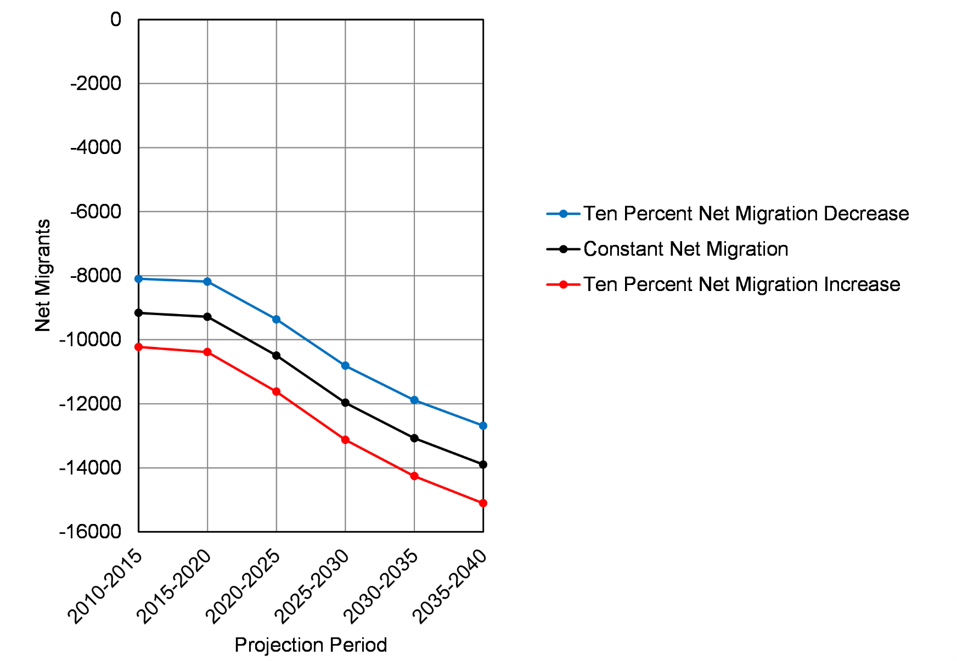
Figure 5.13 Projected Net Migration: DeKalb County, 2010 to 2040

Slide 94
