Slide 1


Slide 2


Slide 4


Slide 5
Figure 3.1 Graphical Projection: DeKalb County Population, 2040

Slide 6
Figure 3. 2 Sample Linear Curves

Slide 7
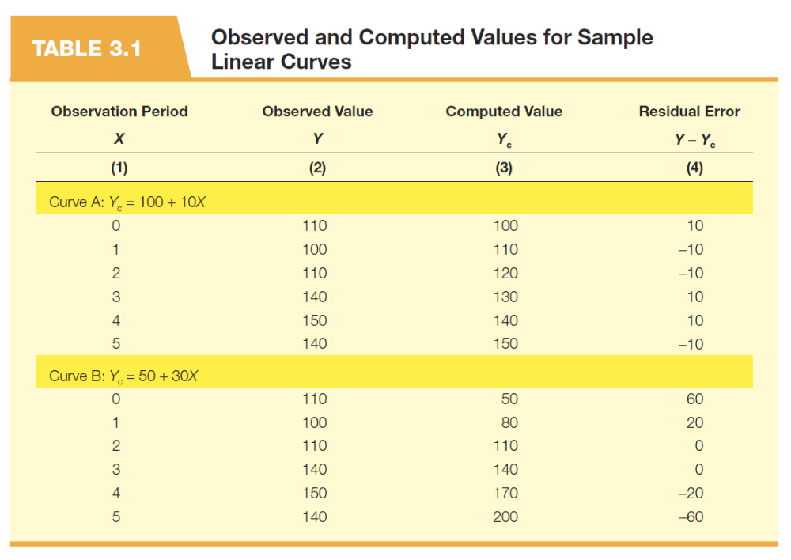

Slide 9


Slide 10


Slide 12
Figure 3. 3 Alternate Forms of the Linear Curve

Slide 13
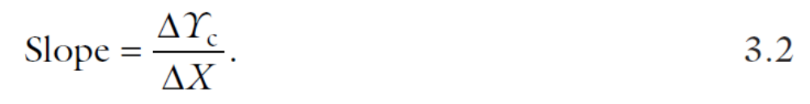

Slide 15
Figure 3. 2 Sample Linear Curves

Slide 16
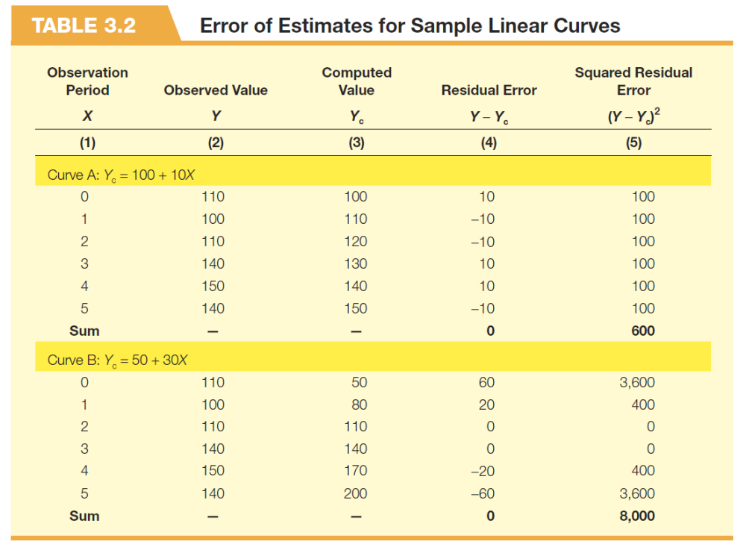

Slide 17


Slide 19
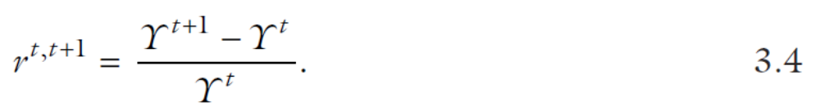

Slide 21
Figure 3.4 Alternate Forms of the Geometric Curve

Slide 22
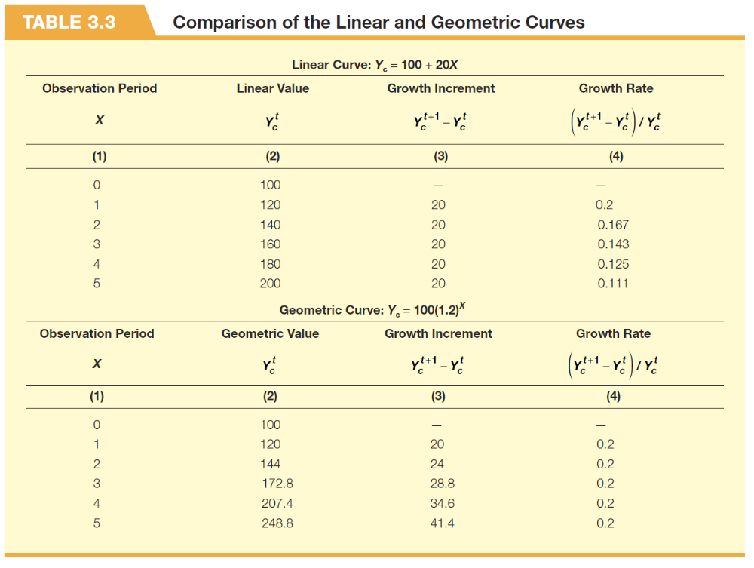

Slide 23


Slide 25
Figure 3.5 Alternate Forms of the Parabolic Curve

Slide 26
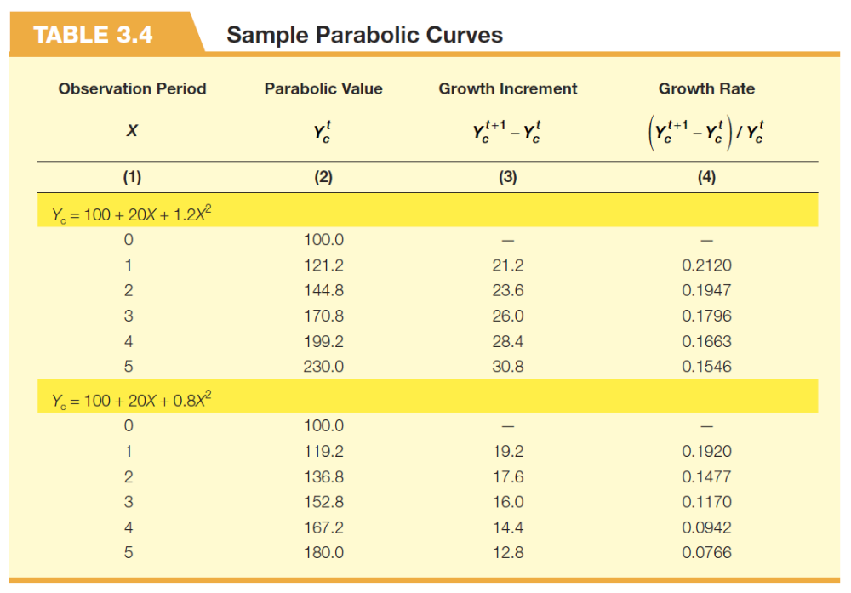

Slide 27


Slide 28
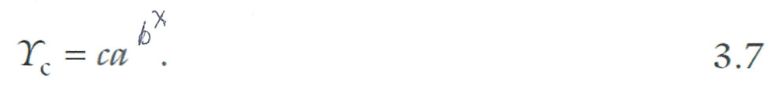

Slide 29
Figure 3.6 Alternate Forms of the Gompertz Curve

Slide 30


Slide 32
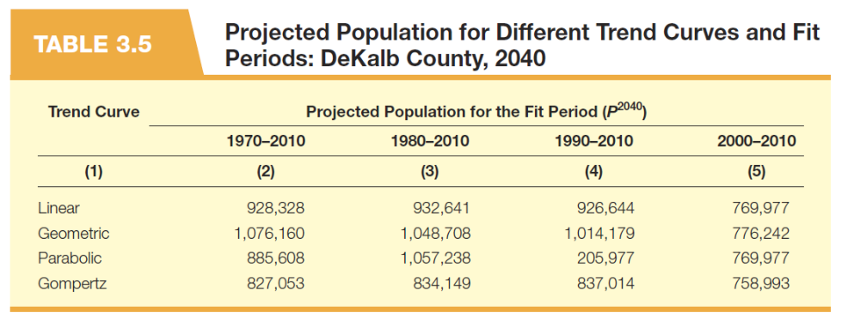

Slide 33
Figure 3.7 DeKalb County Population, 1900 to 2010

Slide 34
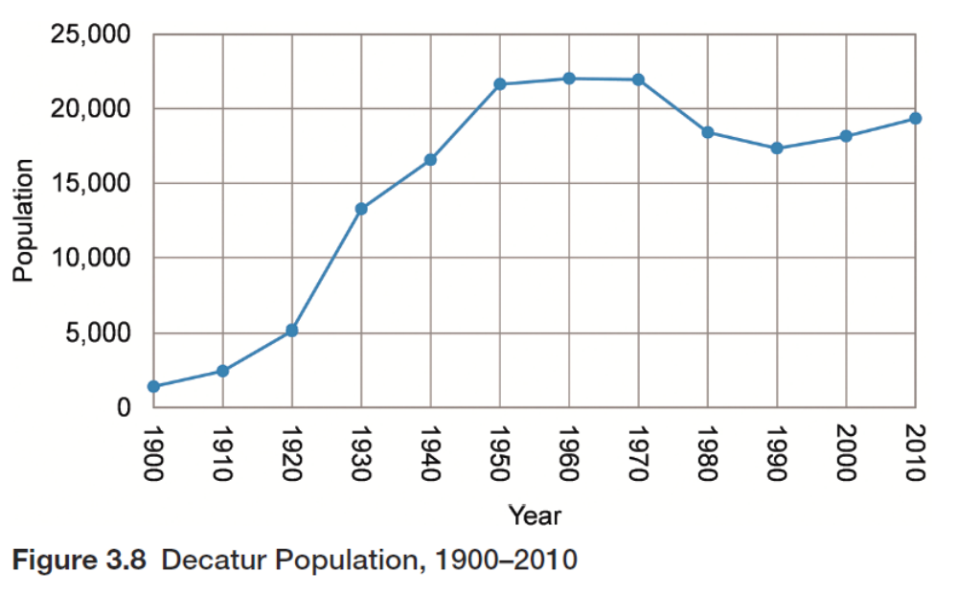

Slide 36
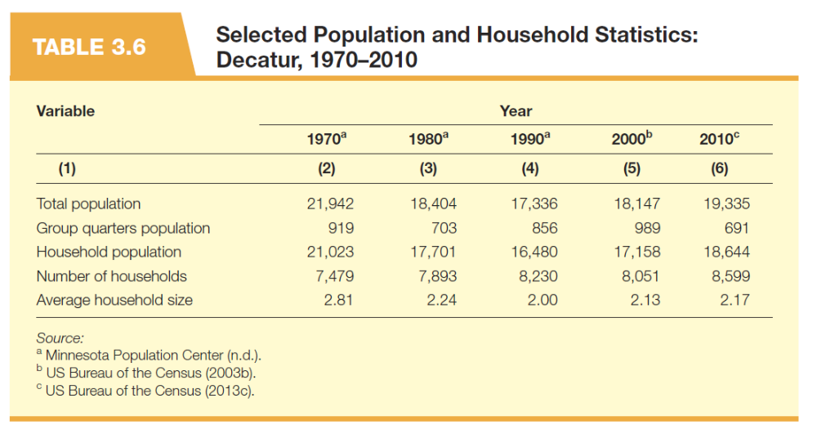

Slide 37


Slide 38
Figure 3.9 Parabolic Trend Projections: DeKalb County, 1990 to 2010

Slide 39
Figure 3.10 Trend Projections: DeKalb County Population, 1990 to 2070

Slide 40


Slide 41


Slide 42
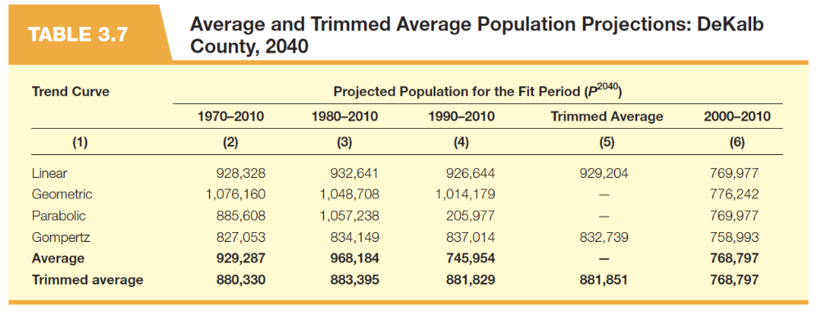

Slide 43
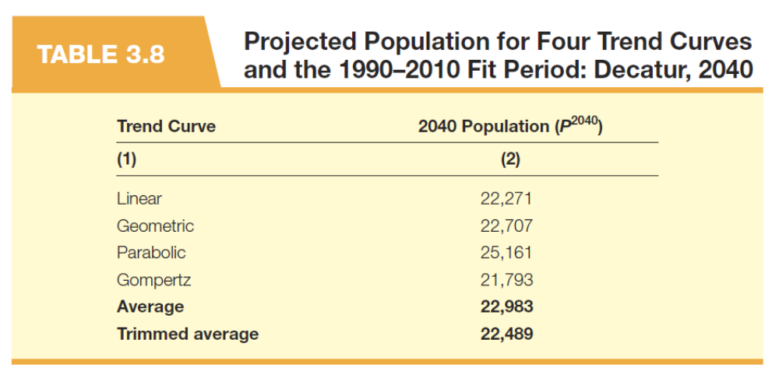

Slide 45
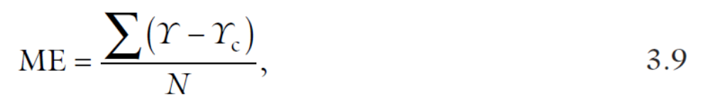

Slide 46
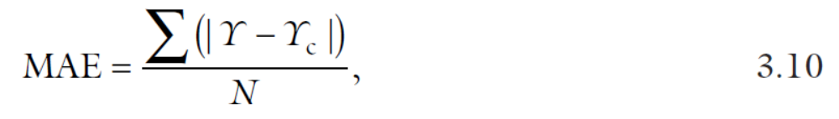

Slide 47
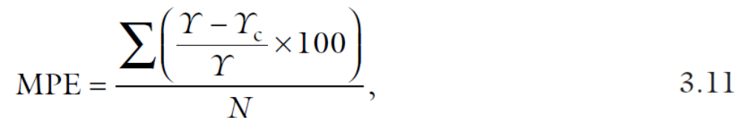

Slide 48
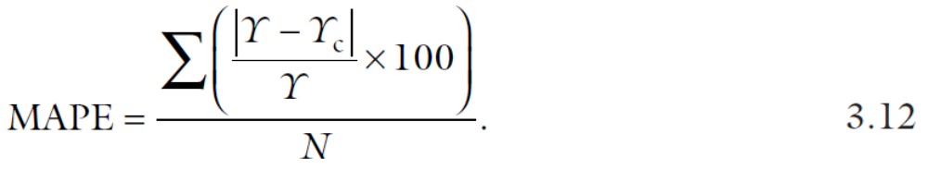

Slide 49
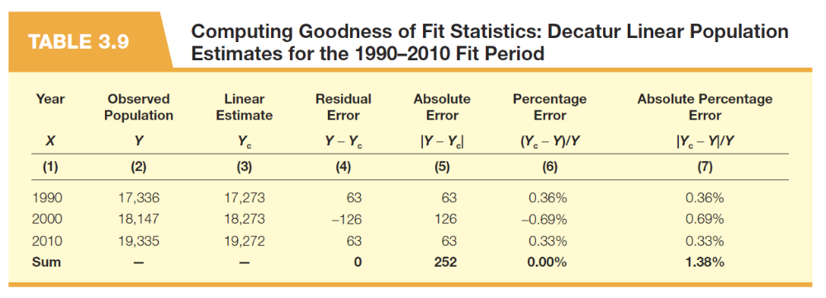

Slide 50
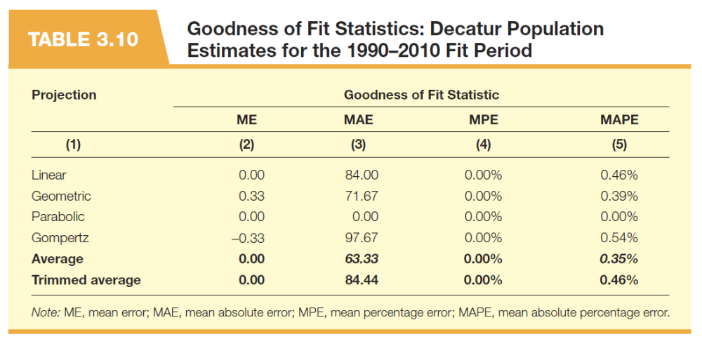

Slide 52
Figure 3.11 Trend Projections: Decatur Population 1990 to 2070

