Slide 1


Slide 2


Slide 3


Slide 4
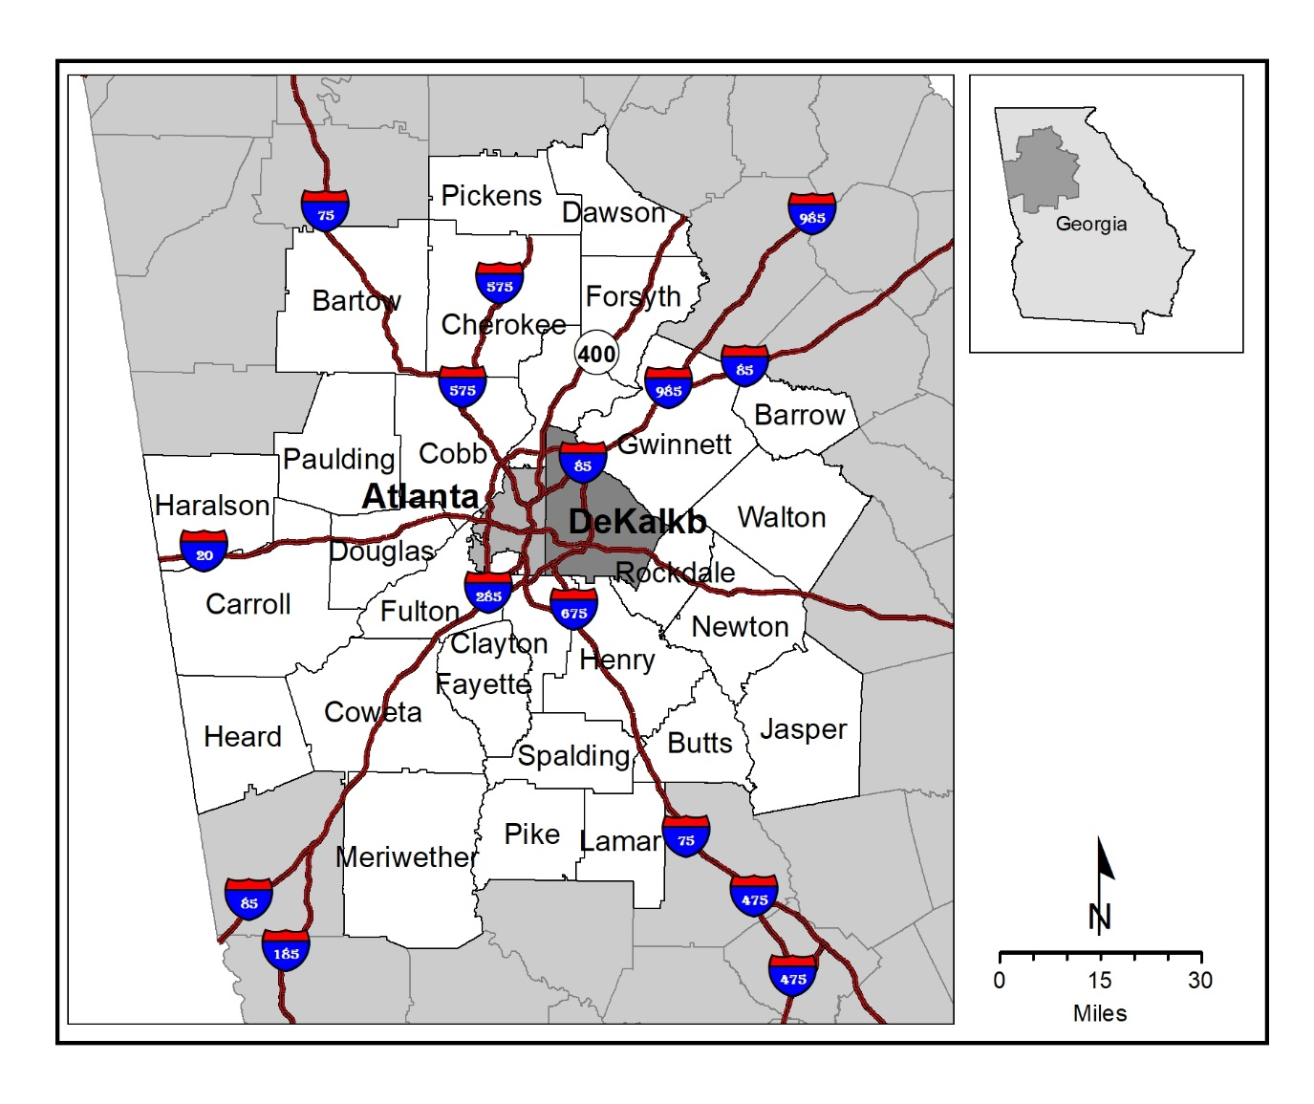
Map 2.1 Atlanta Region

Slide 5
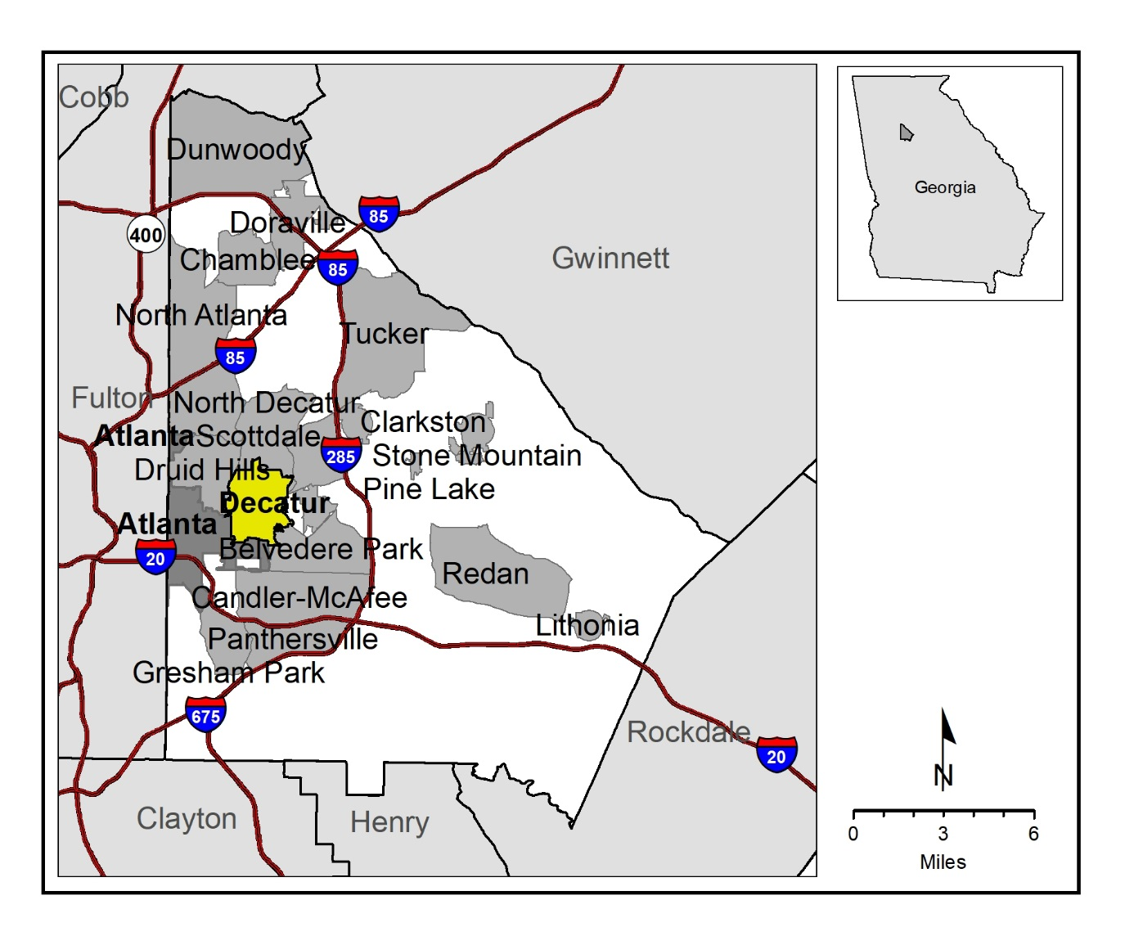
Map 2.2 DeKalb County, Georgia

Slide 6


Slide 8
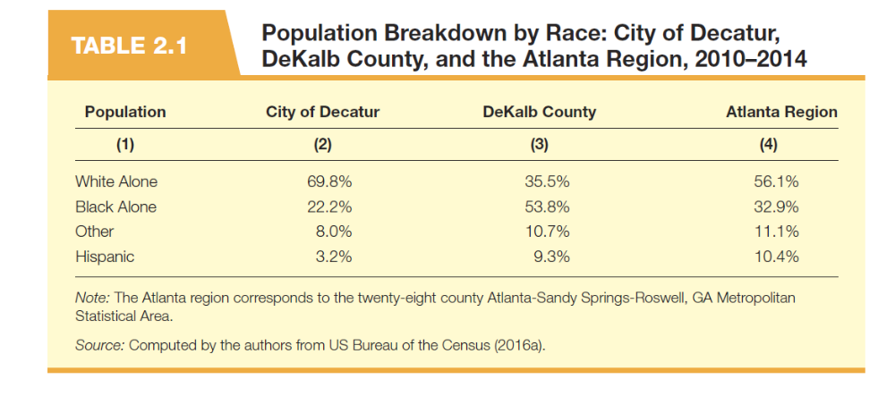

Slide 9
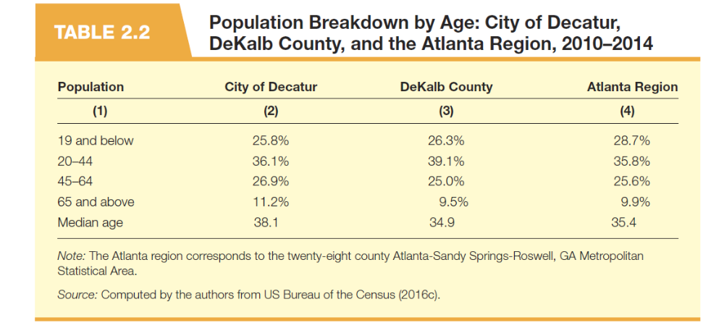

Slide 10
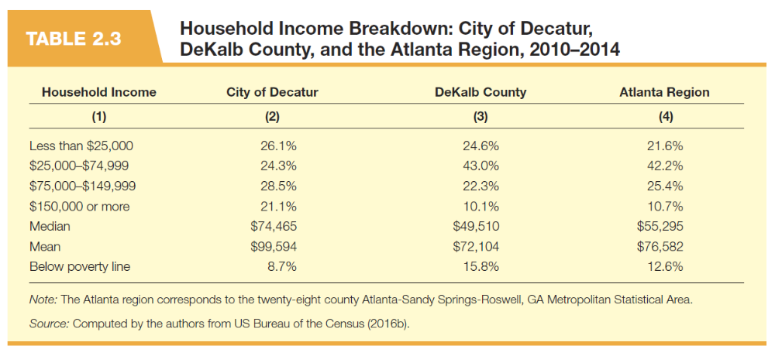

Slide 11
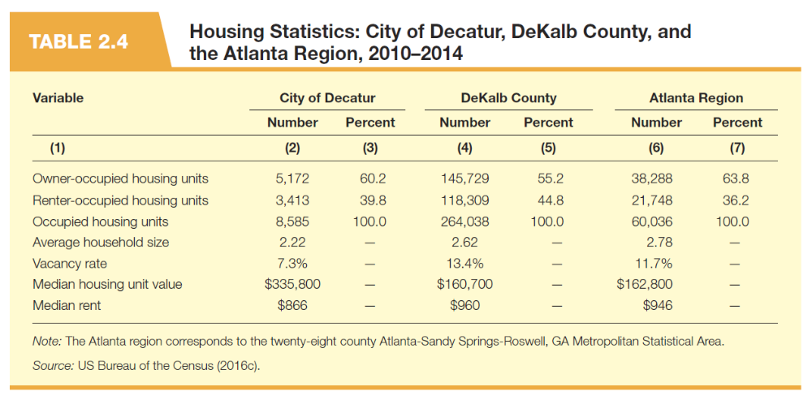

Slide 13
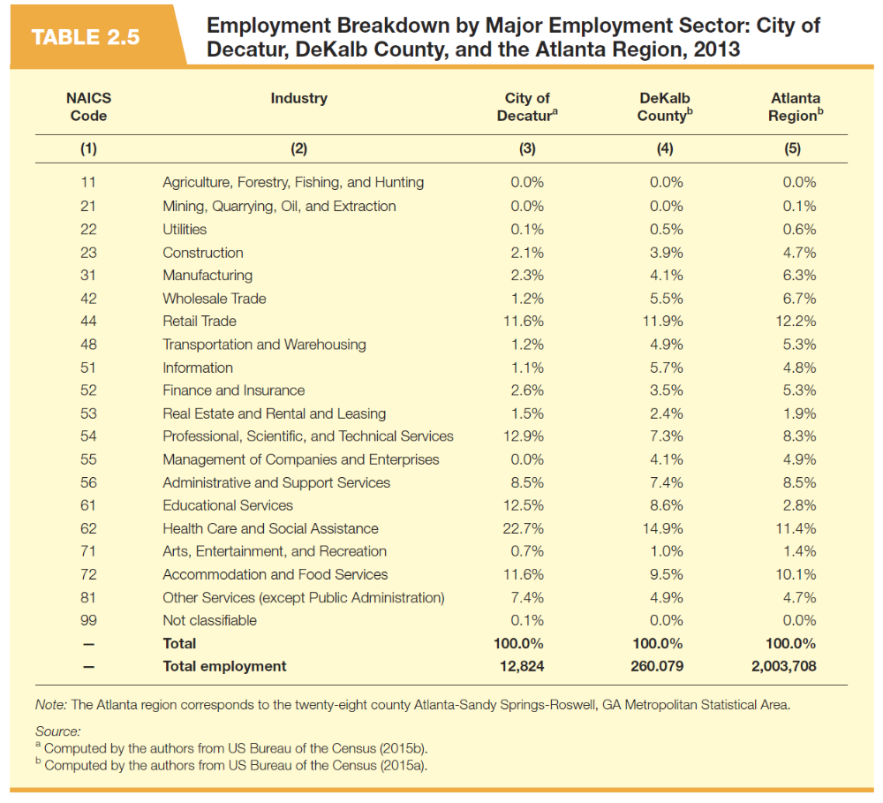

Slide 14
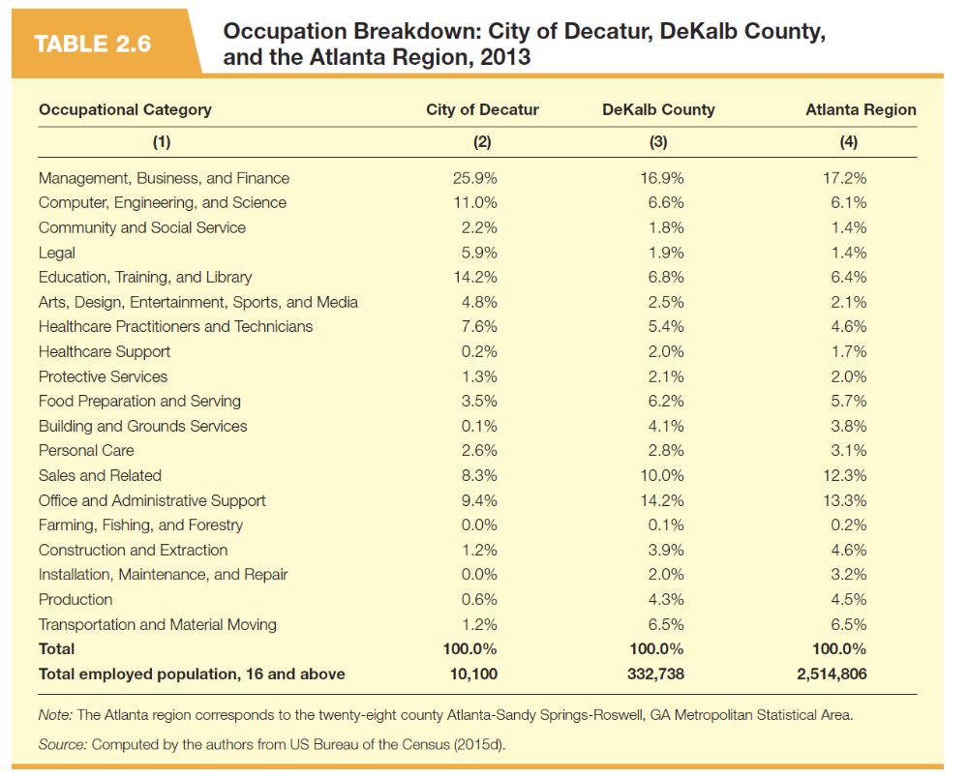

Slide 15


Slide 16
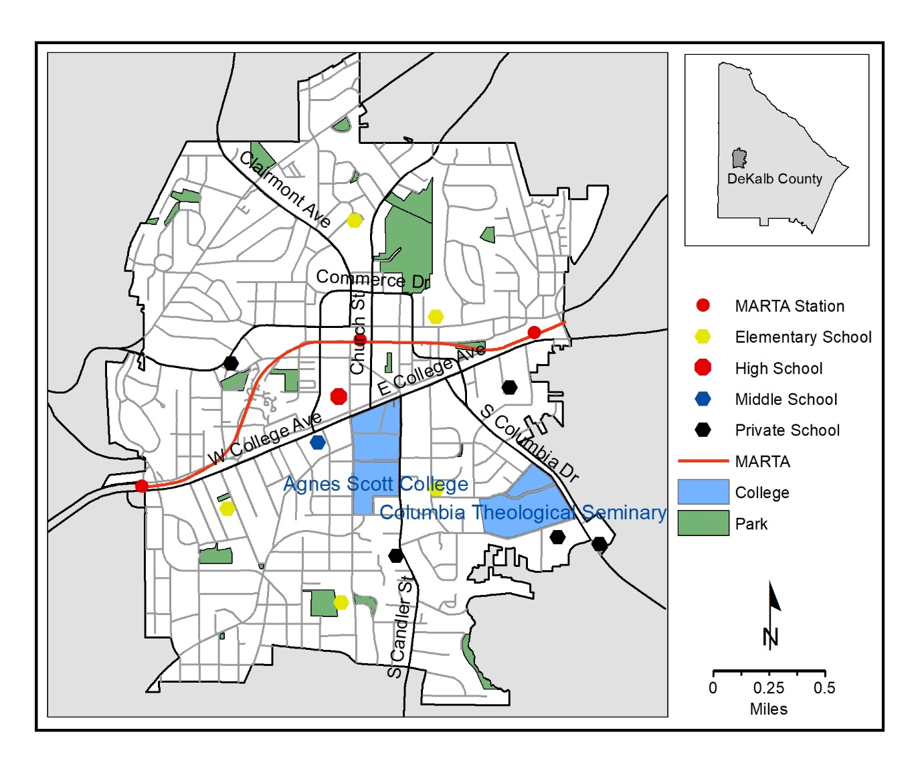
Map 2.3 City of Decatur, Georgia

Slide 17
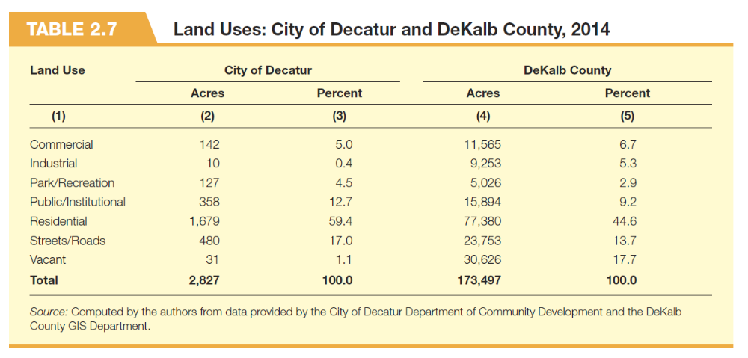

Slide 18
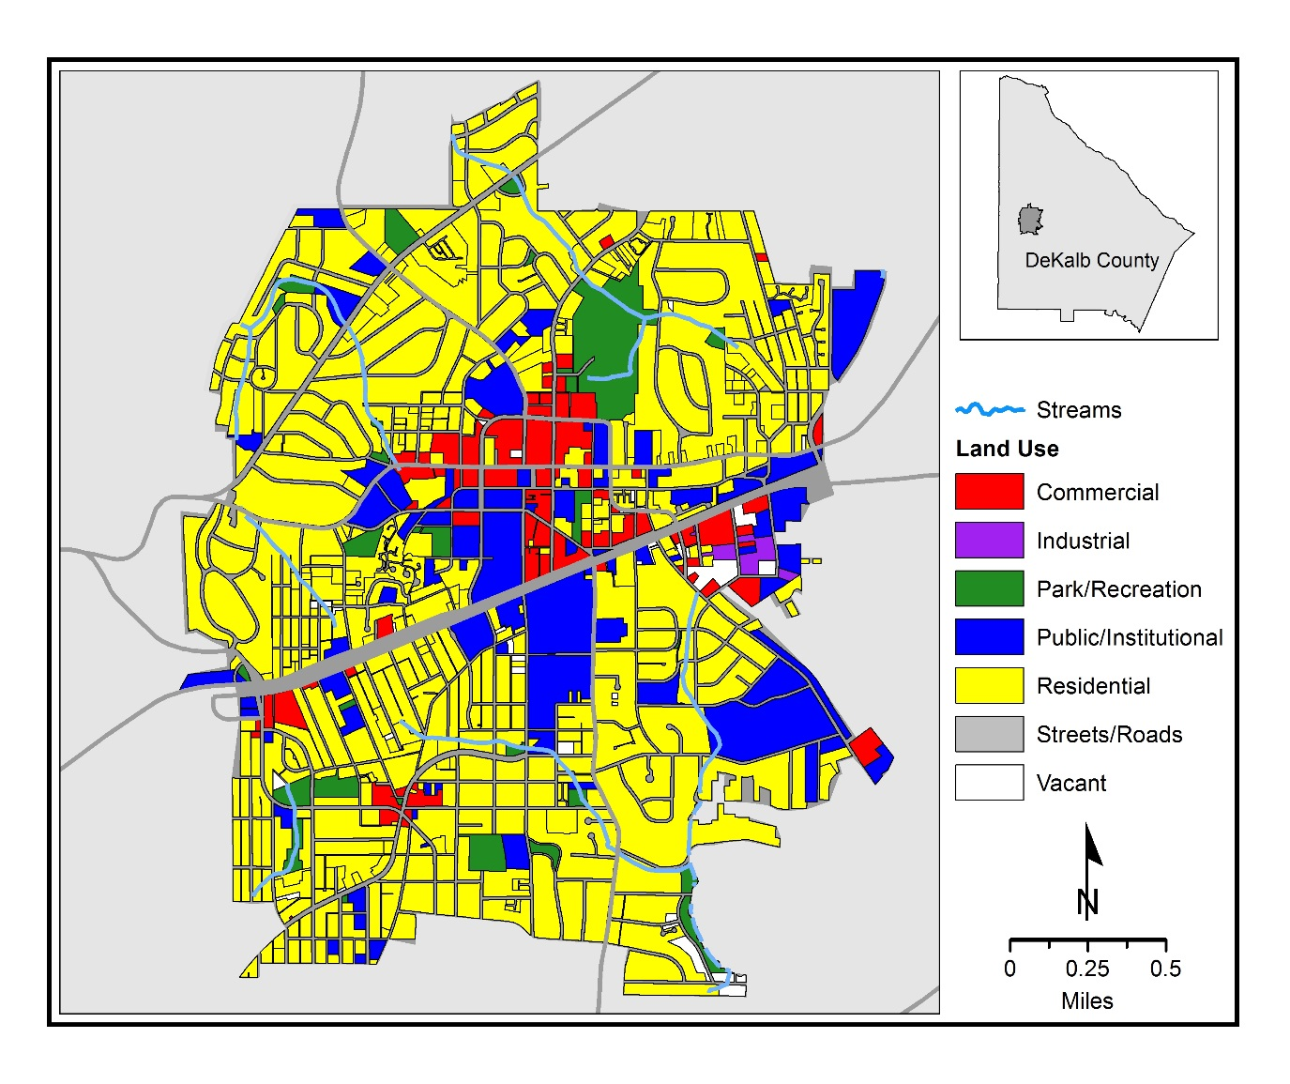
Map 2.4 Existing Land Uses, City of Decatur

Slide 19


Slide 20
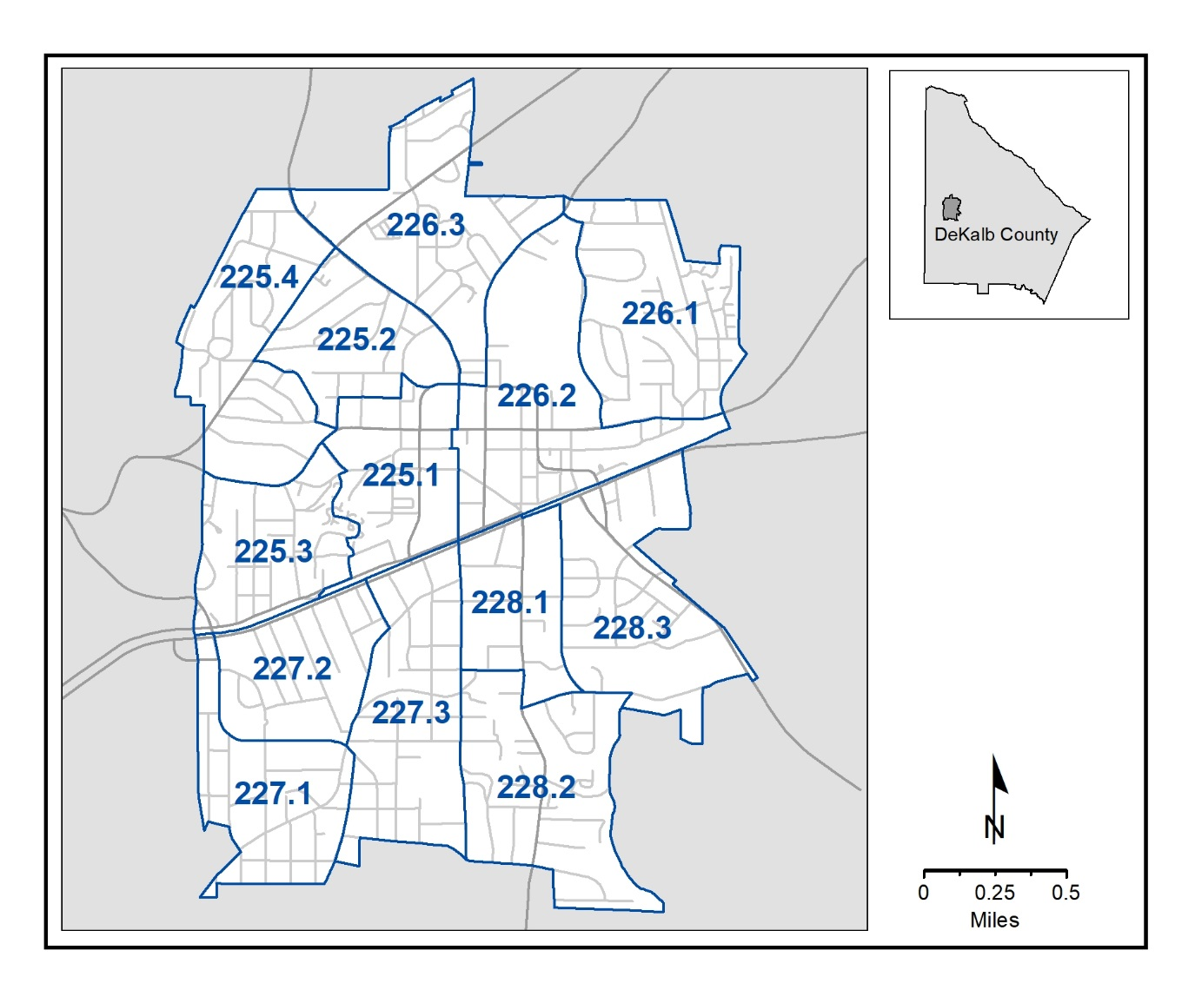
Map 2.5 Decatur Block Groups, 2010

Slide 21


Slide 22
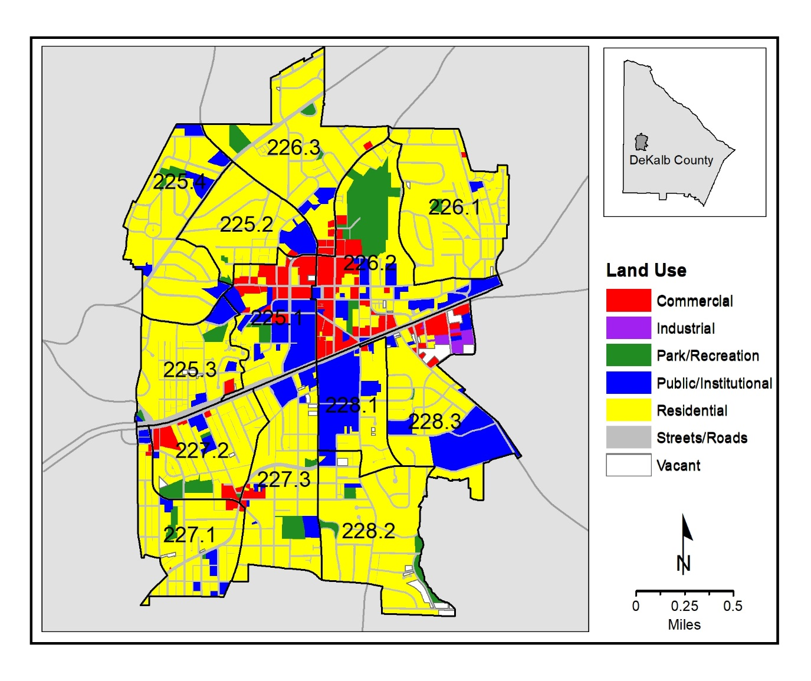
Map 2.6 Existing Land Uses: Decatur Block Groups

Slide 23
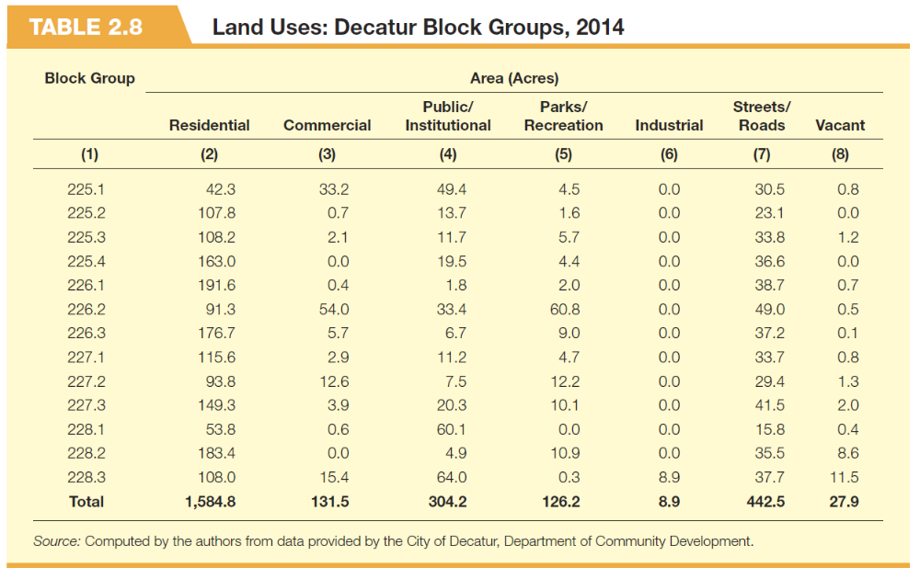

Slide 24


Slide 25
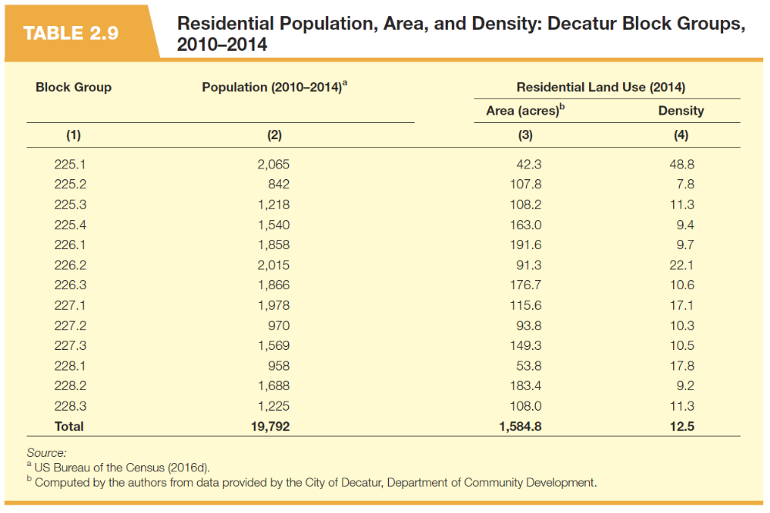

Slide 26
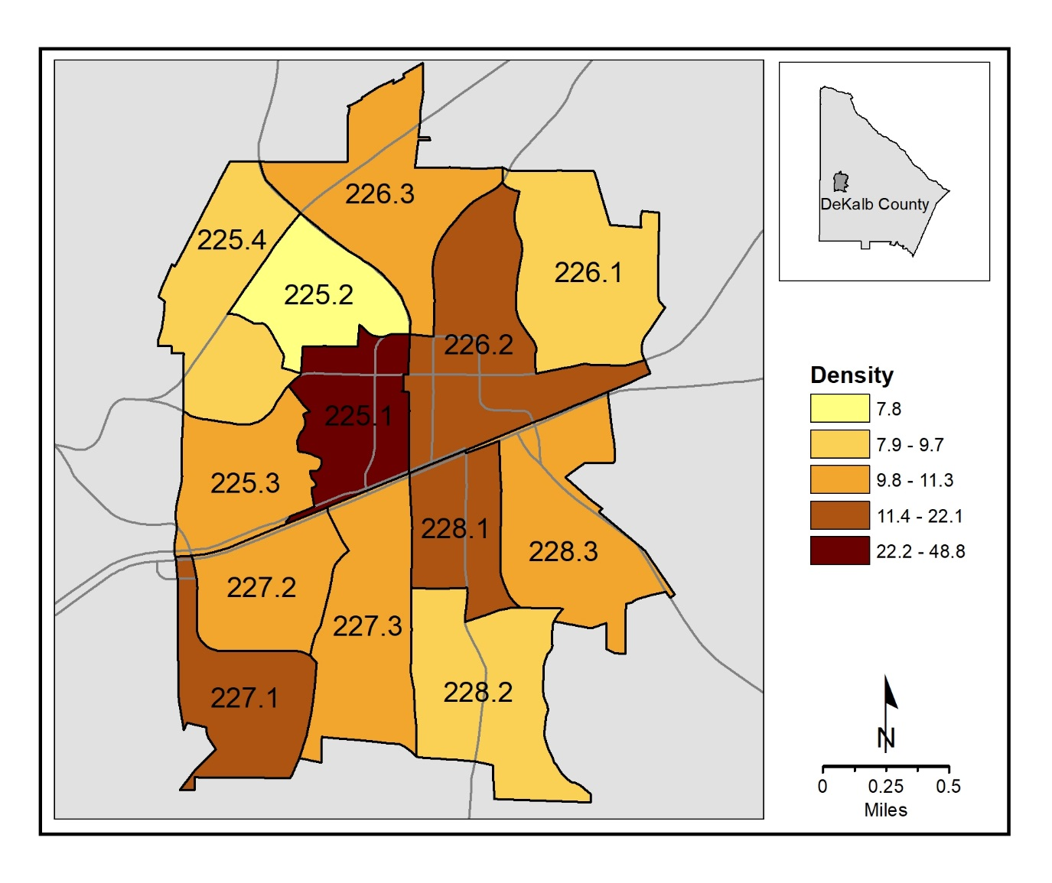
Map 2.7 Residential Density: Decatur Block Groups, 2010–2014

Slide 28
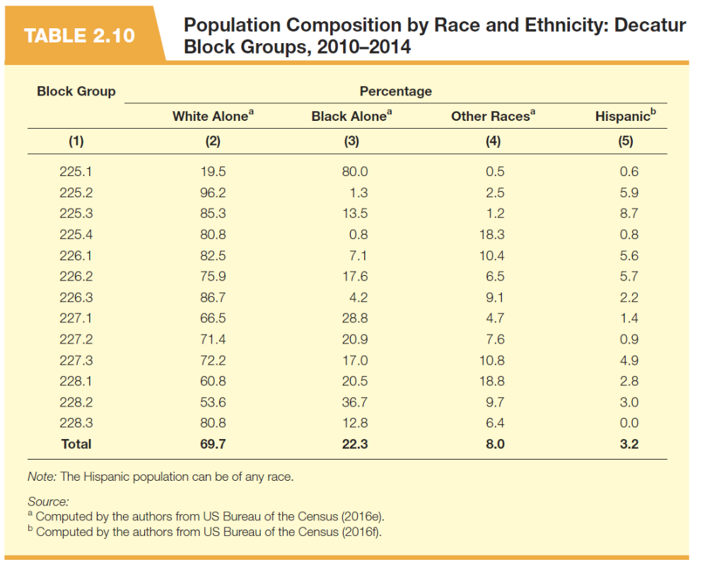

Slide 29
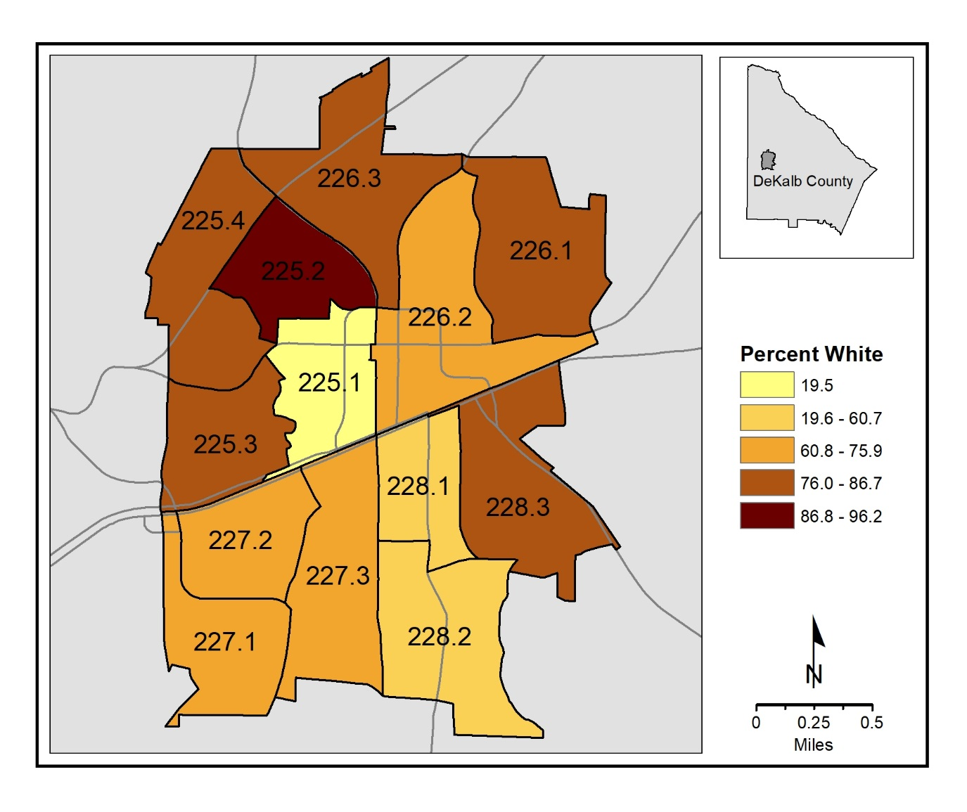
Map 2.8 Percent White-Only Population: Decatur Block Groups, 2010–2014

Slide 30


Slide 31
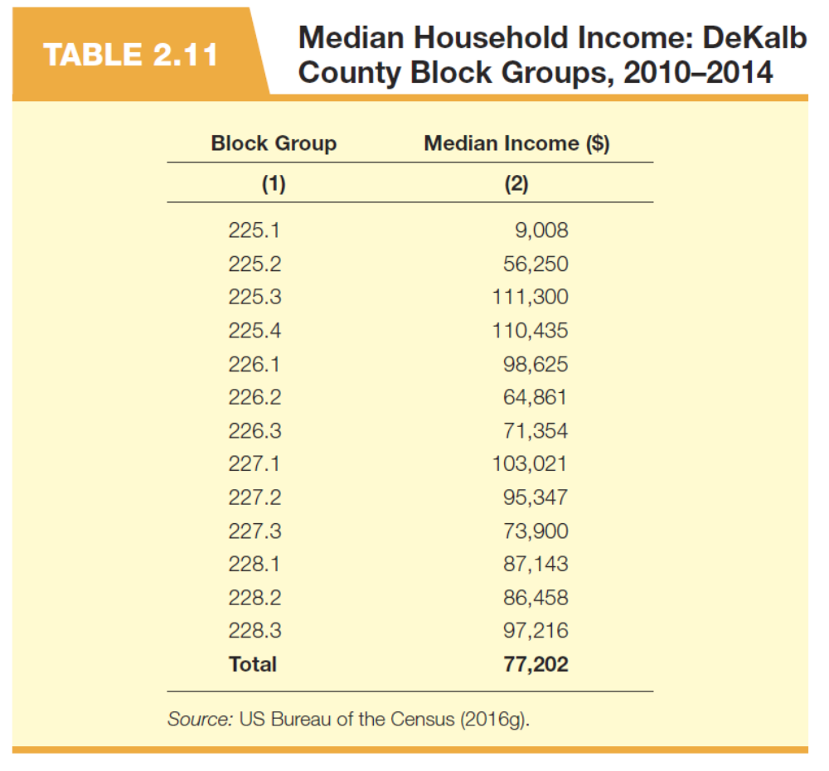

Slide 32
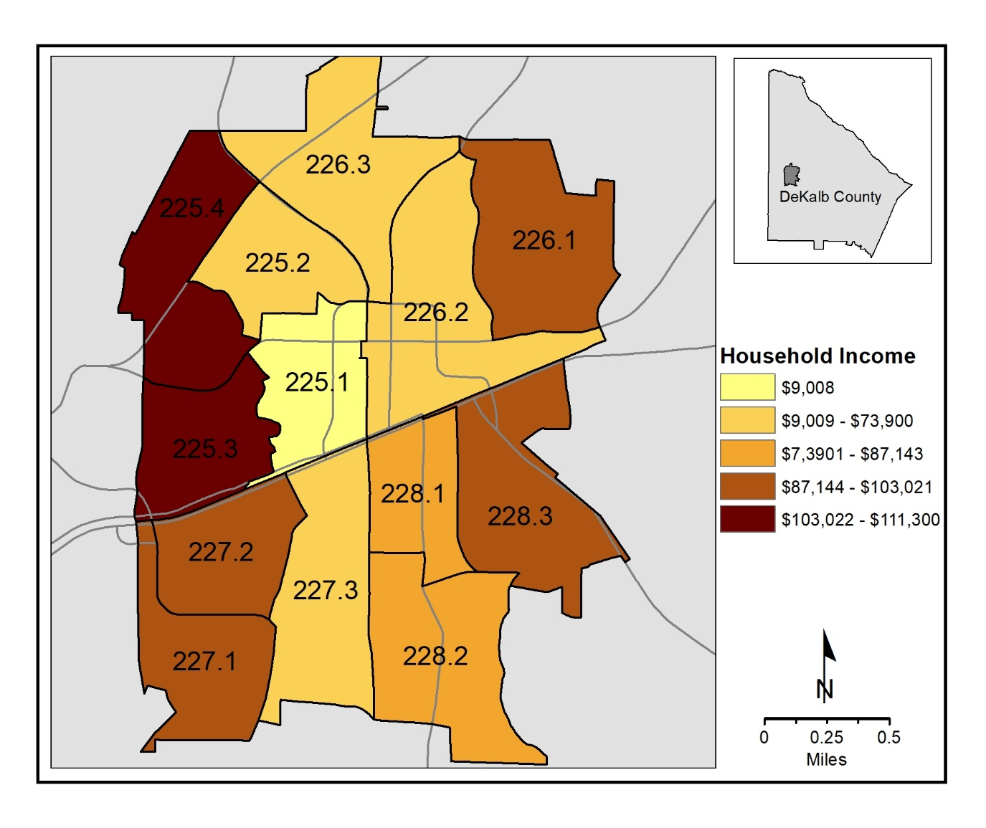
Map 2.9 Median Household Income: Decatur Block Groups, 2010–2014

Slide 33


Slide 34
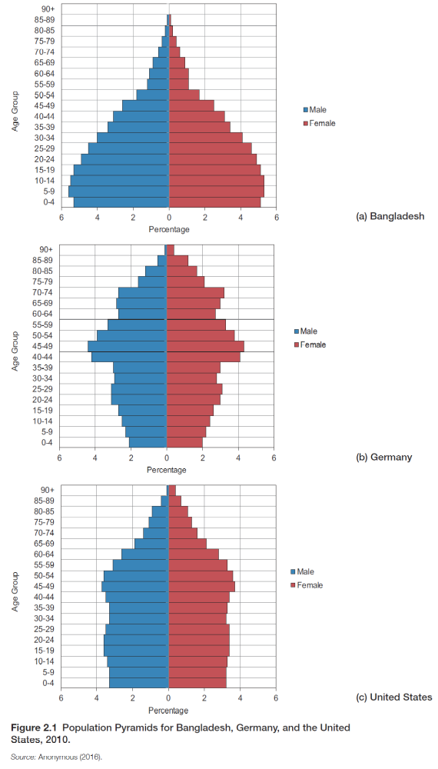

Slide 35
Figure 2.2 Georgia Population Pyramid, 2010

Slide 36
Figure 2.3 DeKalb County Population Pyramid, 2010

Slide 37
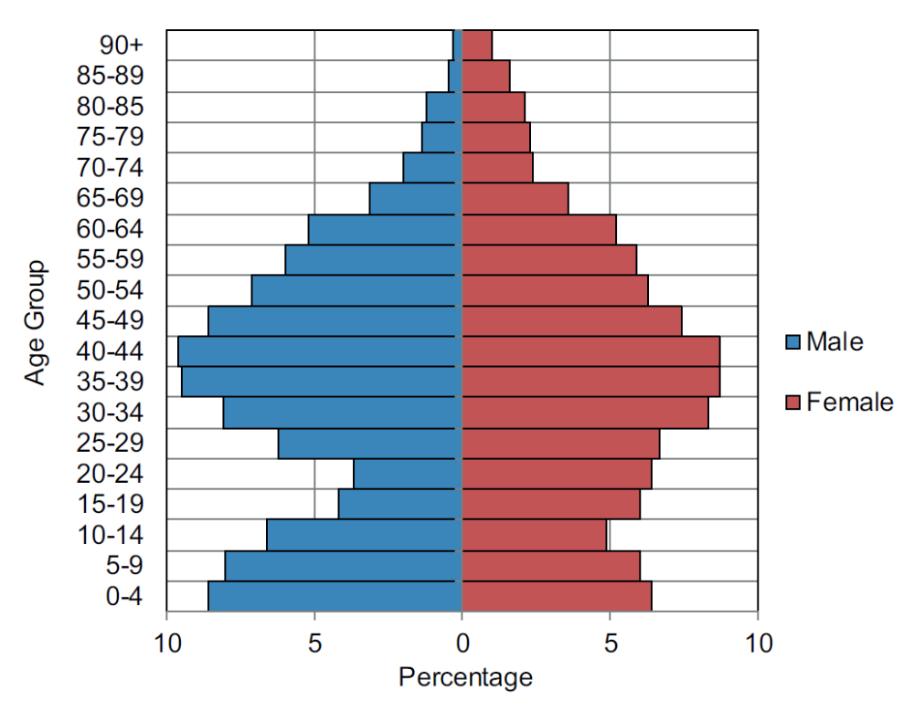
Figure 2.4 Decatur Population Pyramid, 2010

Slide 38


Slide 39
Figure 2.5 Sample Lorenz Curves

Slide 40
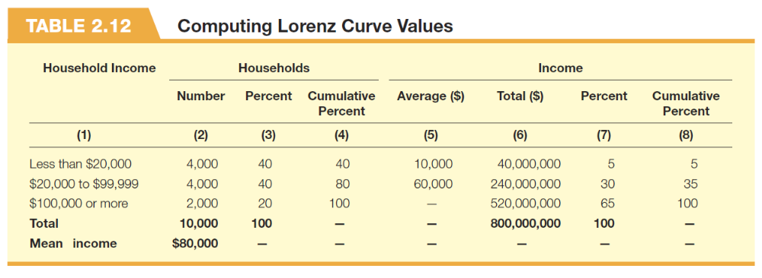

Slide 41
Figure 2.6 Household wealth Lorenz Curves: Decatur and the United States, 2010.

Slide 42


Slide 43
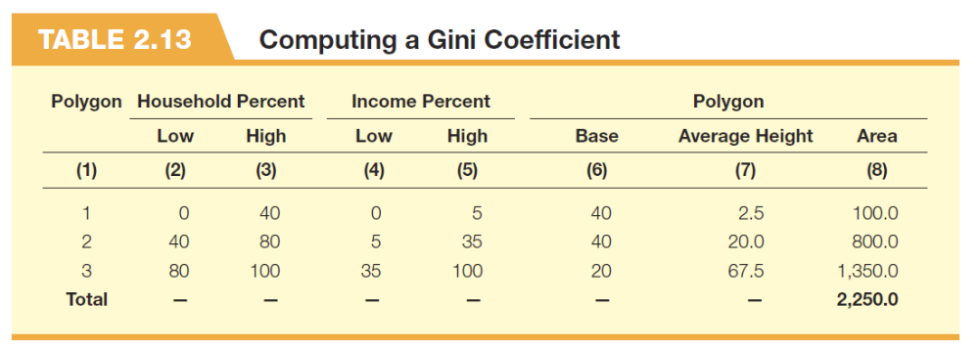

Slide 44
